Slide 1
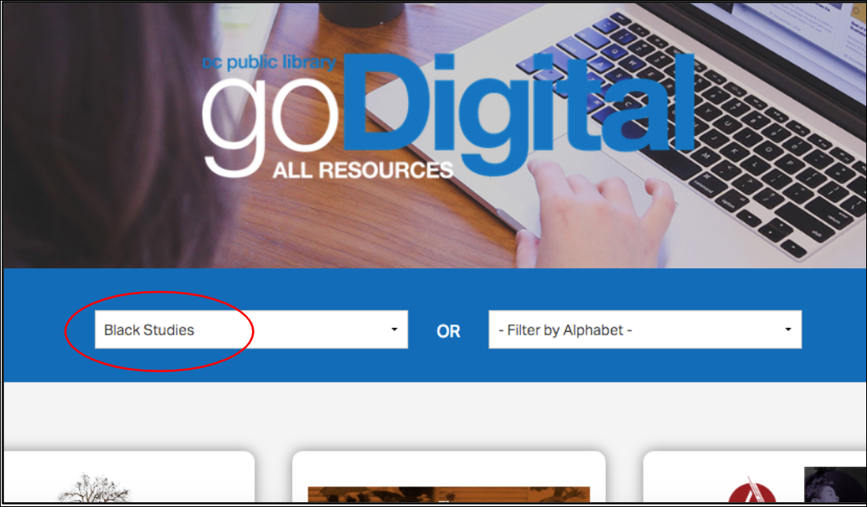
How can I use DC Public Library’s research databases?
How to Use Library: High School, Lesson 8
Notes:
About this lesson
This lesson explains how to navigate the resources in DCPL's research databases. It references items and research topics from the 12-grade cornerstone project, When should people fight for change?
Prepare in Advance:
Ensure that technology is in place for individual research. Each student will also need a pair of headphones. Both the teacher and students will also need a DCPL library card number to login to databases.
If a student does not have a library card, he/she can apply here.
ELA Standards:
RI.11-12.7: Integrate and evaluate multiple sources of information presented in different media or formats (e.g., visually, quantitatively) as well as in words in order to address a question or solve a problem.
W.11-12.8: Gather relevant information from multiple authoritative print and digital sources, using advanced searches effectively; assess the strengths and limitations of each source in terms of the task, purpose, and audience; integrate information into the text selectively to maintain the flow of ideas, avoiding plagiarism and overreliance on any one source and following a standard format for citation.
DC Content Power Standards:
.DC.10.2: Describe disturbances resulting from racial tensions.
12.DC.10.3: Explain how African American leaders resisted discrimination.
C3 Framework Indicators and Common Core Standards for Literacy in History/Social Studies:
D2.His.1.9-12: Evaluate how historical events and developments were shaped by unique circumstances of time and place as well as broader historical contexts.
D2.His.14.9-12: Analyze multiple and complex causes and effects in the past.

Slide 2
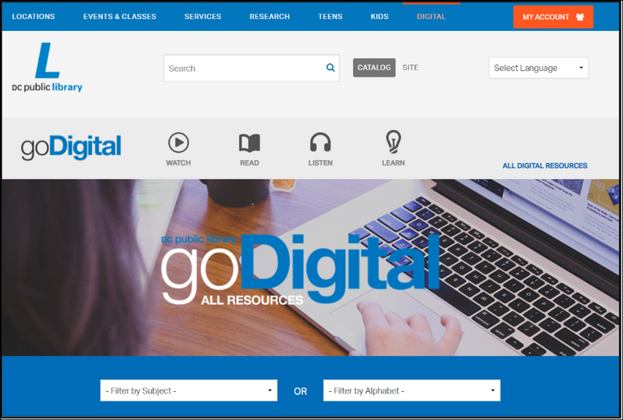
Guiding Questions
How can I use DCPL's research databases?
Notes:
Teaching notes
Suggested Pacing: 1 minutes
Directions:
Say, "The DCPL website offers dozens of databases and tools to support your research. You might be wondering, 'Where do I start?' In this lesson, we will explore the resources offered in the research databases and how to best use these tools."
Attributions:
Previous slide - goDigital Research Databases, courtesy of D.C. Public Library
Current slide - goDigital Research Databases, courtesy of D.C. Public Library

Slide 3
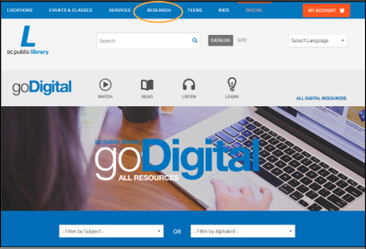
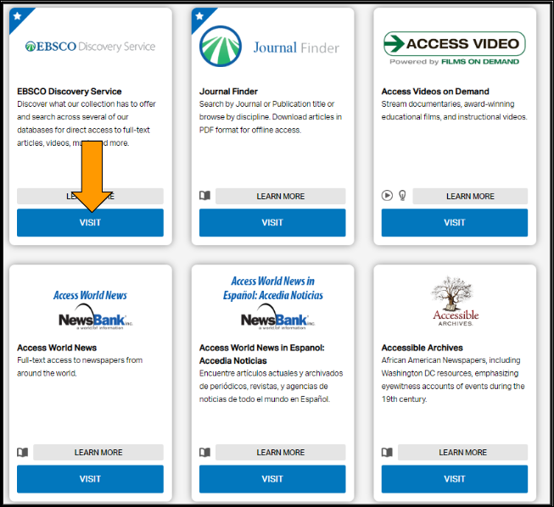
DCPL Research Database
Britannica Academic (reference)
DIGDC (primary sources)
Gale Virtual Reference Library (reference)
Journal Finder (academic journals)
NewsBank (newspapers)
Notes:
Teaching notes
Suggested Pacing: 3 minutes
Directions:
Using an established classroom routine, arrange students in small groups. Each student will need access to devices and headphones.
You and each student will need access to a D.C. One library card number.
Direct students to navigate to the DCPL homescreen: www.dclibrary.org
Say, "In order to access the research databases, go to the top tool bar and hover over "RESEARCH." When the menu drops down, select "DATABASES."
Say, "Once you are there, scroll down, noticing the variety of database options. What kinds of sources can you find here?" Invite 2-3 students to share out loud.
Say, "There are so many databases to choose from. Ultimately, your choice will depend on the type of source you need. Here are some of the most commonly used databases. If you are looking for reference materials, start with Britannica or Gale Virtual Reference Library. If you need academic journals, Journal Finder is a great place to start. if you are researching DC history, DIGDC is helpful for finding primary sources, and NewsBank is your go-to source for newspaper articles."
Student Look Fors:
Students exploring the databases
Source possibilities include reference, articles, newspapers, primary, videos, music, oral histories, etc.
Attribution:
goDigital Research Databases, courtesy of D.C. Public Library

Slide 4
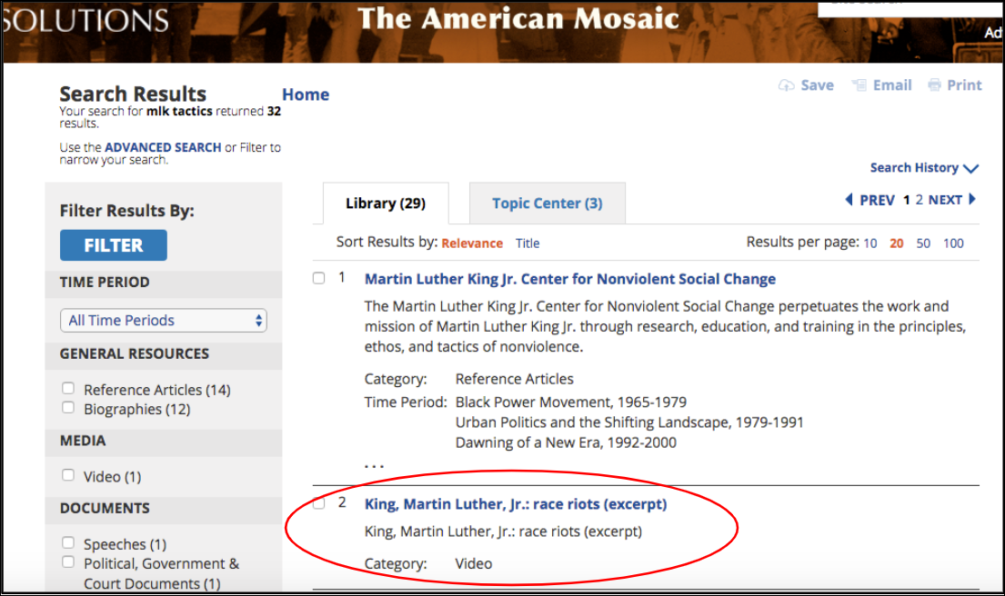
Focusing your Search
How have past African American leaders resisted discrimination?
Notes:
Teaching notes
Suggested Pacing: 5 minutes
Directions:
Say, "With so many databases to choose from, it might be easy to get overwhelmed or feel unsure of where to start. The goDigital research database collection has a great feature that can help you narrow your source. For example, I'd like to explore the question, 'How have past African American leaders resisted discrimination?' Above the list of databases, there is a bar that allows you to filter the databases by subject or alphabet. Let's narrow down our search by focusing on the subject, 'Black Studies.'
Say, "Now I have a list of databases that specifically relate to Black Studies. Let's check out 'The African American Experience.' Knowing that Dr. Martin Luther King, Jr. was renown for his civil rights activism, I'm curious about his tactics. After searching 'Martin Luther King tactics,' this link to an interview with him popped up." Go to the following link: Tactics Video. Display this on a large screen in front of the class.
Ask, "How did MLK encourage people to resist discrimination? What tactics did he rely on? Which tactics did he discourage people from using? Discuss these questions in your group." Invite each group to share an idea from their discussion.
Student Look Fors:
MLK did not think riots pay off. He felt that the violence becomes a distraction from the movement.
He encouraged people to march and gather, without inciting violence.
Attributions:
The African American Experience: The American Mosaic, courtesy of D.C. Public Library
"King, Martin Luther, Jr.: Race Riots (Excerpt)." The American Mosaic: The African American Experience, ABC-CLIO,2018, africanamerican.abc-clio.com/Search/Display/1501468. Accessed 26 Sept. 2018.

Slide 5
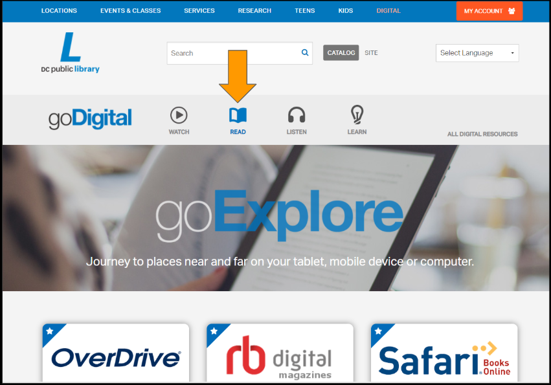
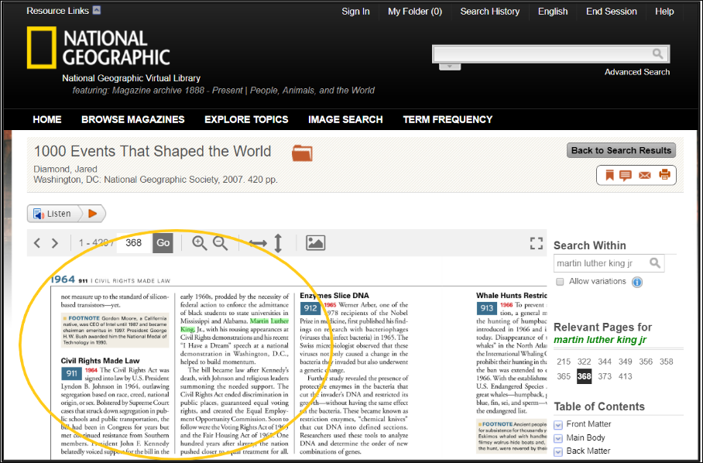
Research Database: Read
How did Martin Luther King Jr. fight for change and "build momentum" towards new laws?
MLK organized and spoke at Civil Rights demonstrations.
King spoke powerfully and inspired people to stand for justice.
King's efforts led to the Civil rights Act being passed.
Notes:
Teaching notes
Suggested Pacing: 3 minutes
Directions:
Say, "On the DCPL research database homepage, you can also narrow down your databases by the type of resource you are looking for. For example, if you would like to access digital versions of books, magazines, or newspapers, you can click on 'Read.' I'd like to learn more about MLK's tactics, so I am going to check out National Geographic's digital collection, knowing that the magazine focuses on world history, sociology, and geography. Check out this excerpt from the book, '1000 Events That Shaped the World.' Listen as I read aloud: (1964) 'The Civil Rights Act was signed into law by US President Lyndon B. Johnson in 1964, outlawing segregation, based on race, creed, national origin, or sex. Bolstered by Supreme Court cases that struck down segregation in public schools and public transportation, the bill had been in Congress for years but met continued resistance from Southern members. President John F. Kennedy belatedly voiced support for the bill in the early 1960's, prodded by the necessity of federal action to enforce the admittance of black students to state universities in Mississippi and Alabama. Martin Luther King, Jr., with his rousing appearances at Civil Rights demonstrations, and his recent 'I Have a Dream' speech at a national demonstration in Washington, D.C., helped to build momentum.'"
Say, "I am curious to know more about how MLK's tactics built momentum towards getting laws passed. I want to continue exploring this through other sources."
Attribution:
National Geographic Virtual Library, courtesy of D.C. Public Library

Slide 6
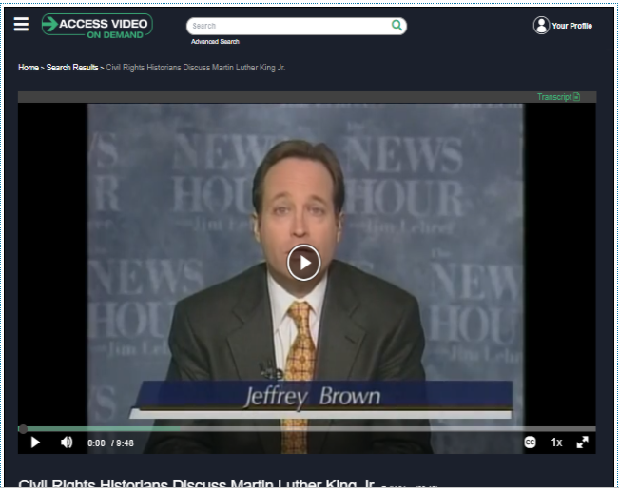
Research Database: Watch
Notes:
Teaching notes
Suggested Pacing: 6 minutes
Directions:
Using an established classroom routine, distribute a note card to each student.
Say, "If you click on the 'Watch' link on the goDigital site, you will be directed to databases that offer video content. I selected 'Access Video on Demand.' After searching this database for more about Dr. Martin Luther King's tactics, I found this video of historians discussing MLK's influence on laws in our country. As we watch, think about our question after reading the last source. 'How did MLK build momentum towards changing laws?' Record your thoughts on your notecard."
Click on the video image. You will be directed to the video. Watch until the 5 minute mark.
Say, "In your groups, share the ideas you recorded on your note cards."
After groups have discussed for a few minutes, invite 2-3 students to share out loud with the class.
Student Look Fors:
MLK organized people in demonstrations. He "put pressure on the government" by gathering people and being a voice for their needs.
MLK worked with President Johnson to advocate for change. He had an ongoing formal relationship, founded on their shared interest in the south and equality.
He helped President Johnson see the power in granting greater voting access to Black Americans, which ultimately increased the black community's power and voice in how the country operates.
Attribution:
"Civil rights Historians Discuss Martin Luther King, Jr.," Access Video On Demand, courtesy of D.C. Public Library

Slide 7
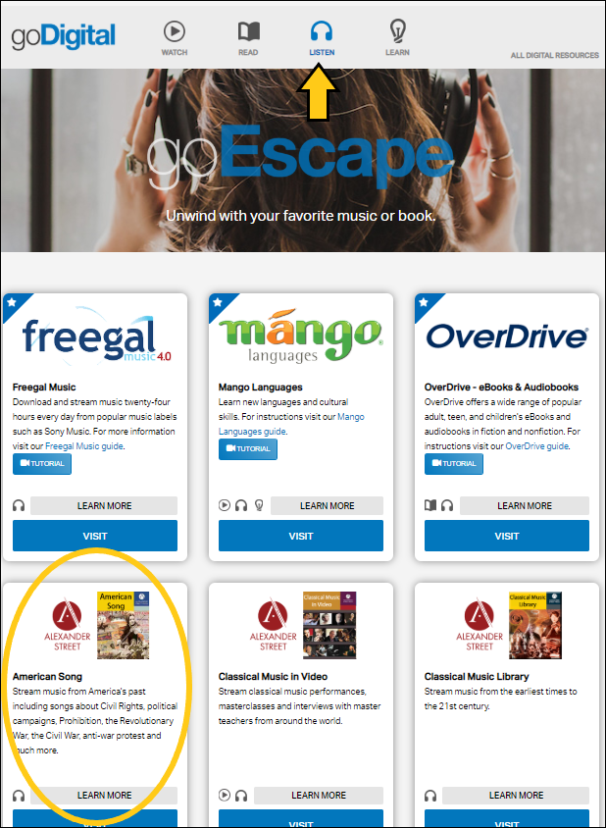
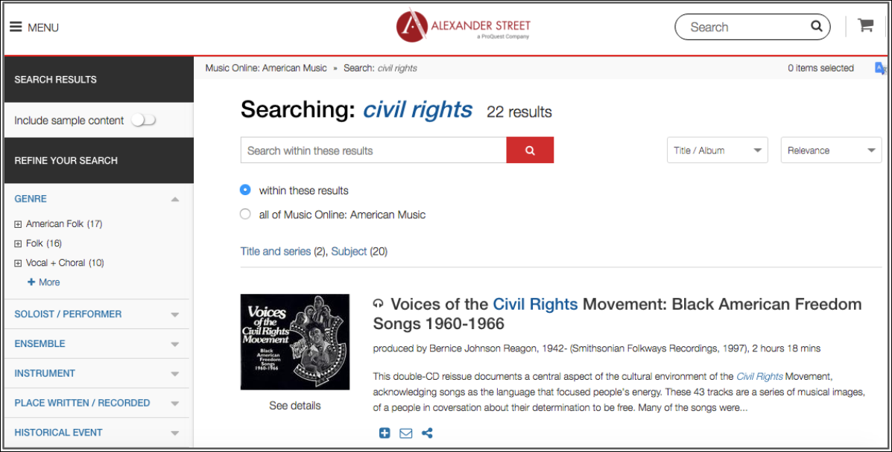
Research Database: Listen
How did African American musicians fight for change through their music?
Notes:
Teaching notes
Suggested Pacing: 6 minutes
Directions:
Say, "In addition to speeches and marches, African American artists have found ways to resist discrimination. In the goDigital research databases, DCPL offers access to free music, audiobooks, language instruction and more. Click on "listen" to access this." Invite students to navigate to the listen page on their devices.
Say, "As the Civil Rights movement gained momentum, musicians channeled their messages and passion for fighting for change into their music. How did their music build momentum and inspire others to fight for change? In your groups, visit the 'American Song' database. Once there, search 'civil rights' to find collections of songs written to support the Civil Rights movement. Spend a few minutes exploring different songs from this era and discuss in your group: How did African American musicians fight for change through their music?"
Student Look Fors:
Music served as a tool for focusing people's energy and frustration over discrimination in a powerful, but peaceful way.
Music was used in demonstrations as a form of communal expression for hope and change.
Musicians advocated for change through their lyrics.
Civil Rights' music moved people spiritually, creating more momentum to fight for change.
Attribution:
Alexander Street: American Song, courtesy of D.C. public library

Slide 8
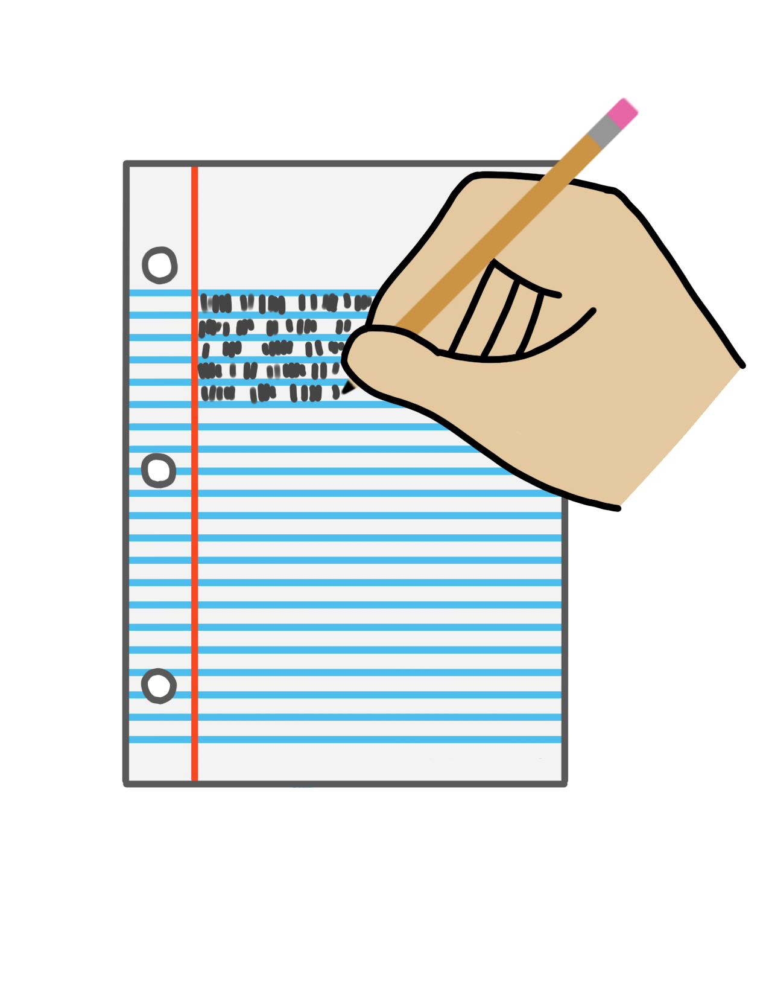
Express Your Understanding
Which tactics do you think are most effective for fighting for change?
Write a paragraph describing at least two effective tactics.
Give examples from history to support your answer.
Use the DCPL research database to find examples.
Notes:
Teaching notes
Suggested Pacing: 10 minutes
Directions:
Direct students to take out a blank lined piece of paper or distribute paper using an established classroom routine.
Say, "In this lesson, we have explored tactics used by Dr. Martin Luther King Jr. and African American musicians to fight against discrimination. Which tactics are most effective? Write a paragraph describing at least two effective tactics. Using the DCPL research databases, find examples from history of these effective tactics to support your answer."
Collect student writing as a formative assessment.
Student Look Fors:
Students using DCPL research databases to find other examples of leaders fighting discrimination effectively.
Effective tactics might include:
marches
speeches
art
music
poetry
running for office/working with government officials

