Slide 1
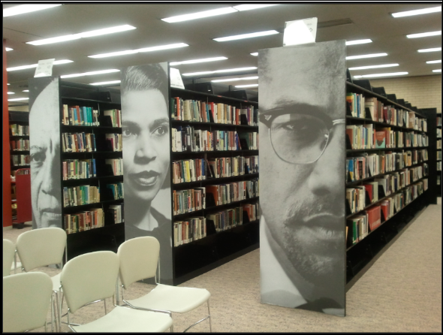
How can I use DC Public Library resources?
How to Use Library: High School, Lesson 7
Notes:
About this lesson
This lesson explains how to navigate the resources offered by DCPL at its variety of locations. It references items and research topics from the 12-grade cornerstone project, When should people fight for change?
ELA Standards:
RI.11-12.7: Integrate and evaluate multiple sources of information presented in different media or formats (e.g., visually, quantitatively) as well as in words in order to address a question or solve a problem.
W.11-12.8: Gather relevant information from multiple authoritative print and digital sources, using advanced searches effectively; assess the strengths and limitations of each source in terms of the task, purpose, and audience; integrate information into the text selectively to maintain the flow of ideas, avoiding plagiarism and overreliance on any one source and following a standard format for citation.
Prepare in Advance:
Ensure that technology is in place for individual research. Each student will also need a research topic and keywords. Both the teacher and students will also need a DCPL library card number to login to databases.
If a student does not have a library card, he/she can apply here.
DC Content Power Standards:
12.DC.10.2: Describe disturbances resulting from racial tensions.
12.DC.10.3: Explain how African American leaders resisted discrimination.
C3 Framework Indicators and Common Core Standards for Literacy in History/Social Studies:
D2.His.14.9-12: Analyze multiple and complex causes and effects in the past.

Slide 2
Guiding Questions
What makes DC Public Library a great place to do research in my city?
How can I use the resources available to me at DC Public Library?
Notes:
Teaching notes
Suggested Pacing: 3 minutes
Directions:
Say, "Washington, DC is a great place to be a student. The D.C. Public Library offers so many resources to support your research. What kind of resources have you experienced at the library?" Invite several students to share out loud with the class.
Say, "With all the resources available through the library, you may not be sure where to start. In this lesson, you will get an overview of the resources offered at the library and how to access them.
Student Look Fors:
Students may share the following resources:
Librarians
Digital tools
Classes on technology, research, etc.
Book collections
Attribution:
Previous slide - Photo of Special Collections at the Martin Luther King Jr. Memorial Library circa 2016, courtesy of D.C. Public Library

Slide 3
Resources at the Library
Thousands of books with an online public access catalog
Variety of sources: reference databases, journals, magazines, etc
Special Collections: primary sources related to D.C. history
Tools: access to a computer, free printing and copying, and more
Librarians ready to help who can answer any questions you might have
What resources can I find at the library?
Notes:
Teaching notes
Suggested Pacing: 2 minutes
Directions:
Say, "The library contains endless resources to help you in your research. You can find thousands of books and a variety of sources, which can be explored and searched through the online catalog. Librarians are one of the greatest resources offered in the library. If you need help finding books about a research topic or are not sure how to cite a source, the librarian can help. If the location you visit does not have what you need, librarians can help you locate what you need elsewhere."
Say, "One of the unique things that D.C. Public Library offers are Special Collections. These collections include primary sources related to D.C. history topics. Additionally, if you need to use a computer, printer, copier, etc, the library provides these services to the community."

Slide 4
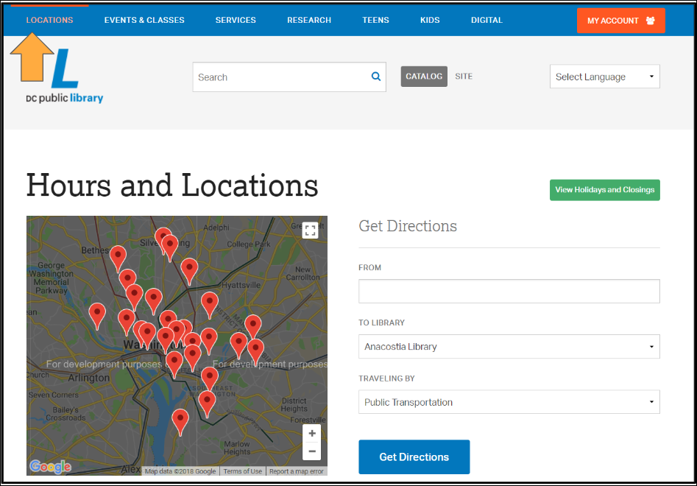
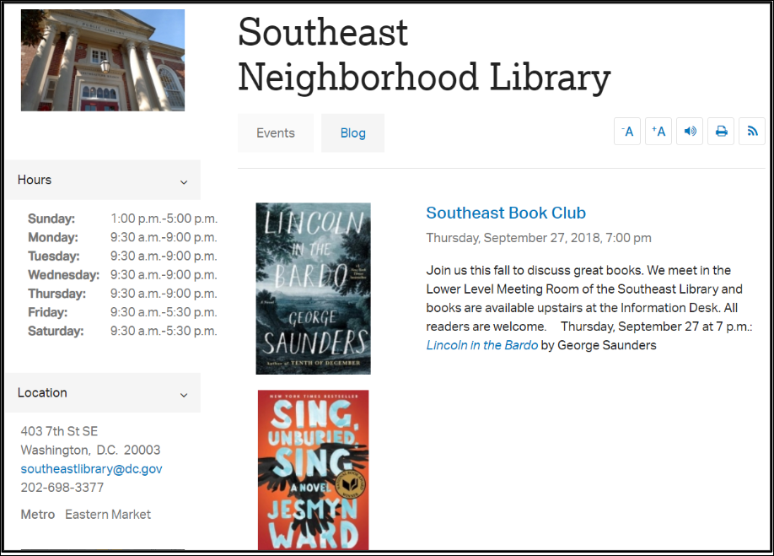
DCPL Locations
Click on Locations to find:
Directions to the location nearest you
Location hours and contact information
Special events at each location
Neighborhood Library blog posts written by librarians at each location
Notes:
Teaching notes
Suggested Pacing: 5 minutes
Directions:
Each student will need access to an electronic device. Invite students to take out electronic devices and follow along as you navigate the site.
Say, "With libraries all across the city, you are sure to find a location near you. From the DCPL home page, click on 'Locations' at the top of the page. Use the map to find the location nearest to your home or school. You can get directions and recommendations on the closest metro stop."
Say, "Once you find the most convenient location, click on the link to its site. There you will find special events and blog posts written by local librarians. Notice the location's hours, so you will be prepared for your next trip." Invite students to navigate to their local library site and spend a few minutes exploring events and the blog at their location.
Student Look Fors:
Students exploring their local library site.
Attribution:
Locations, courtesy of D.C. Library

Slide 5
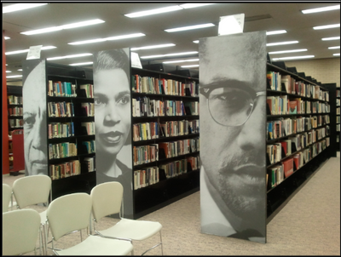
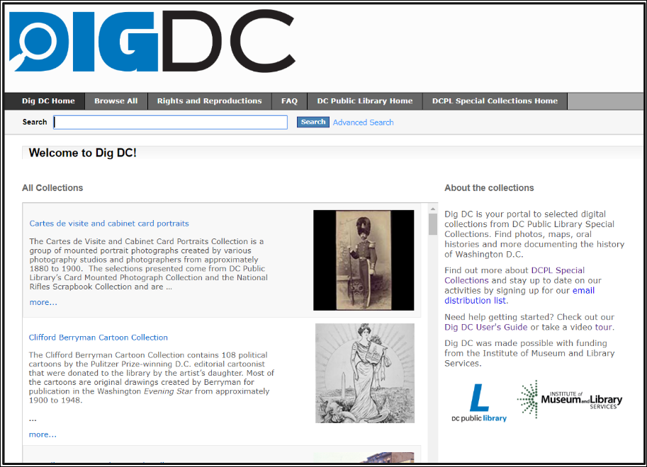
DCPL Special Collections
Check out DCPL's Special Collections!
Notes:
Teaching notes
Suggested Pacing: 5 minutes
Directions:
Say, "One of the unique features of the DCPL system is its Special Collections where you can find primary sources on D.C.'s history. On your electronic device, follow along with me as I navigate to the main site. Go to the DCPL homepage and click on 'Research.' On the drop down menu, select 'Special Collections.' Take a few minutes to scroll down on this page and explore the different collections offered. Notice the type of information you find."
Walk around as students explore the site.
Ask, "What information did you find in the collections?" Invite students to share aloud with the class.
DCPL has digitized some of the content in its Special Collections. You can access this through the DIGDC site. You can navigate to DIGDC by selecting 'Research' on the top tool bar and choosing 'DIGDC' on the drop down menu. There, you can enter your research keywords to find primary sources related to your research topic.
Student Look Fors:
Special Collections contents include:
maps, photographs, documents, and artifacts relevant to D.C. history
Archives including: Black Studies, Punk, D.C. neighborhoods, and more.
Attribution:
Special Collections, DIGDC, courtesy of D.C. Public Library.

Slide 6
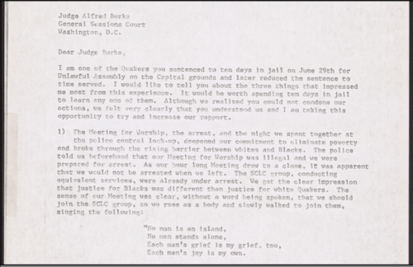
Special Collections: Poor People's Campaign
How can historical documents from the Special Collections help me understand today's social justice issues?
Notes:
Teaching notes
Suggested Pacing: 5 minutes
Directions:
Say, "The Special Collections can be helpful as you are conducting research on topics related to D.C., even social justice issues we are facing today. For example, in understanding the historical context of the Black Lives Matter movement, we can learn a lot about the history of police/judicial reform in our nation's capital. One of the Special Collections, the Poor People's Campaign, DIGDC describes as follows: "The Poor People's Campaign was a civil rights movement initiated by Martin Luther King, Jr. and the Southern Christian Leadership Conference in spring 1968 to support the efforts of American poor people. The campaign lobbied for economic justice and vital social programs via an Economic Bill of Rights and organized a protest encampment of thousands of poor people on the National Mall, known as Resurrection City, beginning May 21, 1968. Resurrection City had its own university, 'soul tent', city hall, and newspaper, two issues of which are included in the collection. The campaign effectively ended on June 24th when the camp was cleared by police following the expiration of SNCC's National Park Service permit. This was King's last major campaign as he was assassinated in Memphis, Tennessee on April 4, 1968."
Help students navigate to the DIGDC database. Once there, scroll down the Special Collections list until you see "Poor People's Campaign." Invite students to scroll through the sources in the collection and to stop on "Letter to Judge Alfred Burke of the D.C. General Sessions Court."
Say, "This letter was written by a Quaker man who was arrested during a prayer session and demonstration as part of the Poor People's Campaign."
Say, "Read the first page of this letter independently. What efforts were made by the Poor People's Campaign to reform the police/judicial system? What problems were they advocating to change? How does this relate to issues we are facing in our country today?" Invite students to share in a whole class discussion.
Student Look Fors:
People were upset that the poor and minority groups were not being given equal voice and opportunities.
People were arrested despite protesting/demonstrating in peaceful methods.
People from minority race and religious groups were arrested unfairly.
The Poor People's Campaign wrote letters, demonstrated peacefully, lobbied for social programs to share their concerns with government leaders.
Attribution:
Poor People's Campaign, Special Collections (DIGDC), courtesy of D.C. Public Library

Slide 7
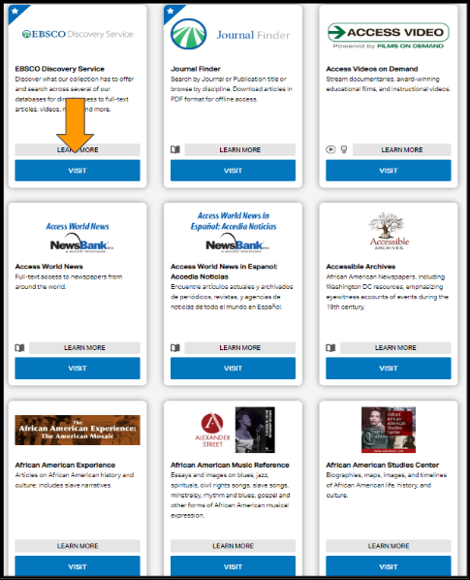
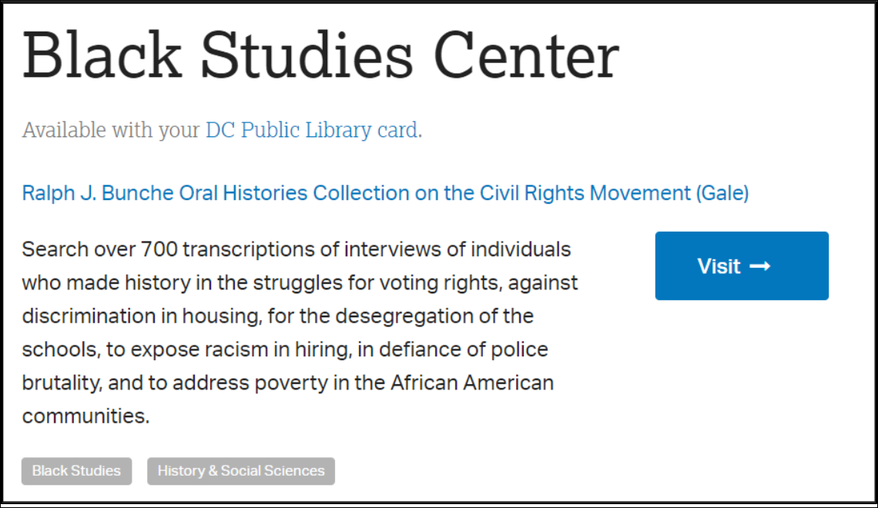
Online Resources
Notes:
Teaching notes
Suggested Pacing: 2 minutes
Directions:
Say, "In addition to offering research materials at physical locations, DCPL provides access to great research materials online. All you will need is you D.C. Public Library Card or D.C. One Card! By clicking on 'Research' on the top toolbar on the DCPL home page and then selecting 'Databases' on the drop down menu, you will have access to dozens of source databases for your research. Here, you can filter by subject, such as 'Black Studies,' or the type of materials you are looking for, such as articles, newspapers, music, videos, and much more."
Attributions:
Black Studies Center, courtesy of D.C. Public Library
Research databases, courtesy of D.C. Public Library

Slide 8
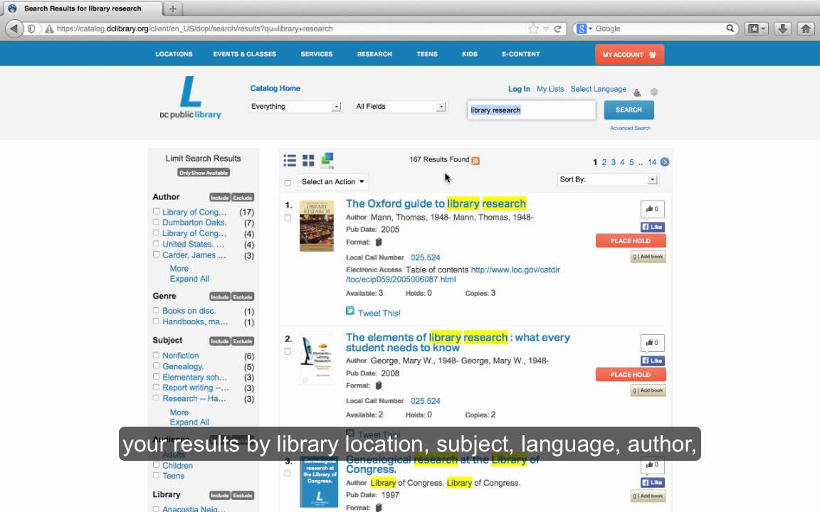
Using the Online Catalog
Notes:
Teaching notes
Suggested Pacing: 2 minutes
Directions:
Say, "In order to find the most relevant sources at the library, you will need to use the catalog to locate books and other materials for your research. Let's watch to see how it works!"
Play the video.
Click "View the original page" at the bottom of the slide to view the video in full screen.
Attribution:
"How to Search the Online Catalog," courtesy of D.C. Public Library

Slide 9
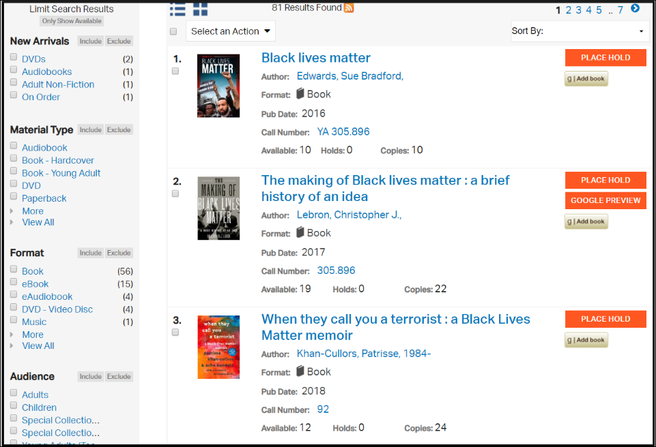
Express Your Understanding
Use the online catalog for your own research!
Use your research keywords to locate and record the call information for three sources.
Record this information on your sticky note.
Now you're ready to visit the library!
Notes:
Teaching notes
Suggested Pacing: 5 minutes
Directions:
Using an established classroom routine, distribute an index card to each student.
Say, "Now that we have learned how to use the online catalog, use your research keywords to search for three relevant sources. Record the call number and title on your index card so you will know where to look! Check the availability of your sources and be sure to place a hold at your local library if it is not already available at the location nearest you."
Say, "Take a look at my example. I am conducting research on social justice, specifically the Black Lives Matter movement. Using 'Black Lives Matter' as my keywords, I found several great sources through the catalog. Now, it's your turn!"
Walk around and check to make sure students are finding sources and recording the information on the index card, as a formative assessment.
Student Look Fors:
Students using keywords to find and record three sources.
Attribution:
Online Catalog, courtesy of D.C. Public Library

