Slide 1
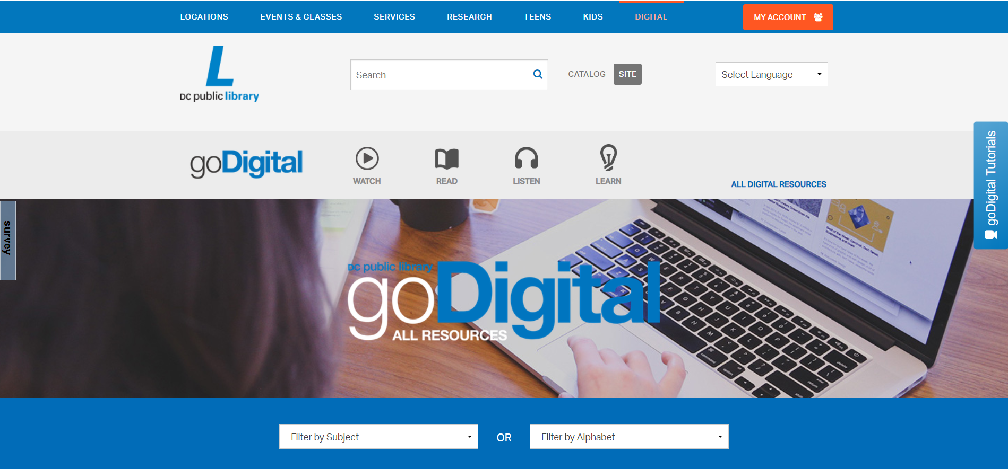
How do I summarize research and avoid plagiarism?
How to Use Library: High School, Lesson 4
Notes:
About this lesson
This lesson explains how to take notes and avoid plagiarism in the research process. It describes how to evaluate sources for bias. It references items and research topics from the 12-grade cornerstone project, When should people fight for change? This lesson also assumes students are practiced in reading informational text and writing a concise summary.
Materials:
Summarizing Information
Starting Research
ELA Standards:
W.11-12.9: Draw evidence from literary or informational texts to support analysis, reflection, and research.
W.11-12.8: Gather relevant information from multiple authoritative print and digital sources, using advanced searches effectively; assess the strengths and limitations of each source in terms of the task, purpose, and audience; integrate information into the text selectively to maintain the flow of ideas, avoiding plagiarism and overreliance on any one source and following a standard format for citation.
Prepare in Advance:
Ensure that technology is in place for individual research. Students should have access to their research sources (books, articles, websites, etc.). Both the teacher and students will also need a DCPL library card number to login to databases.
If a student does not have a library card, he/she can apply here.
DC Content Power Standards:
12.DC.10.2: Describe disturbances resulting from racial tensions.
12.DC.10.3: Explain how African American leaders resisted discrimination.
C3 Framework Indicators and Common Core Standards for Literacy in History/Social Studies:
D2.His.1.9-12: Evaluate how historical events and developments were shaped by unique circumstances of time and place as well as broader historical contexts.
D2.His.14.9-12: Analyze multiple and complex causes and effects in the past.
Attribution:
D.C. Public Library Online Research Database, courtesy of the D.C. Public Library

Slide 2
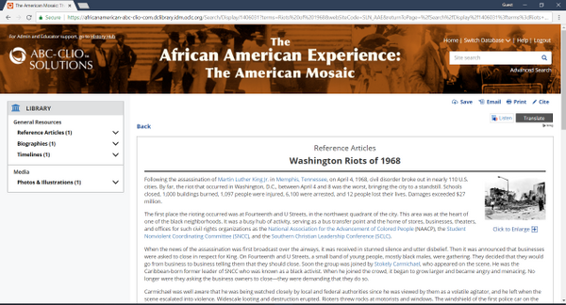
Guiding Questions
How do I summarize research and avoid plagiarism?
How do I select the most relevant and supportive information?
Notes:
Teaching notes
Suggested Pacing: 2 minutes
Directions:
Ask, "How do you take notes about a topic, such as the Washington, D.C. Riots of 1968 by summarizing information from a source?"
Ask, "How do you make sure you are selecting the best information for your notes? Which information will be the most relevant and supportive?"
Students will share out a few brief responses.
Teacher will read aloud the first paragraph to give students an overview of the topic:
"Following the assassination of Martin Luther King Jr. in Memphis, Tennessee, on April 4, 1968, civil disorder broke out in nearly 110 U.S. cities. By far, the riot that occurred in Washington, D.C., between April 4 and 8 was the worst, bringing the city to a standstill. Schools closed, 1,000 buildings burned, 1,097 people were injured, 6,100 were arrested, and 12 people lost their lives. Damages exceeded $27 million."
Student Look-Fors:
Students will already be familiar with the definition of a summary. Students may state that a summary is a short description of the main ideas of a source or segment of a source.
Students may identify that a summary is given in their own words.
Students may acknowledge that not all information in a source will be relevant or supportive of their research questions, so they must choose carefully.
Students may not be familiar with the Washington Riots of 1968.
Students might look up more information about this topic in a reference text.
Attribution:
The African American Experience, courtesy of the D.C. Public Library

Slide 3
Research Vocabulary
What types of research notes can I take?
Quotations | Paraphrase | Summary
Writing the author or speaker's words word for word. | Putting a section from a source into your own words. | Stating the main ideas of a source in your own words.
Notes:
Teaching notes
Suggested Pacing: 3 minutes
Directions:
Use an established classroom routine to arrange students in their research groups. Each student will need access to devices and research materials.
Explain to students that there are several different methods for recording information from a source.
Say, "Depending on the information you are recording and your writing goals, writers may choose to record quotations, paraphrasing, or summaries from the source. A quotation is information from a source, written using the exact words. Paraphrasing is restating a segment of information from a source into your own words. A summary is usually much shorter, and restates just the main ideas of the text.
Ask, "When does it make sense to use each type of note?"
Instruct students to discuss within their groups.
Call on groups to share out answers.
Student Look-Fors:
Quotations are useful when an author states an idea in a particularly powerful way.
Paraphrasing is helpful when you need to provide details about a topic, without needing an author's specific language.
Summaries are helpful when giving an overview of an idea or topic.

Slide 4
Research Vocabulary
How do I avoid plagiarism?
Plagiarism is using an author or speaker's words or ideas without giving credit to the source.
Notes:
Teaching notes
Suggested Pacing: 2 minutes
Directions:
Say, "Plagiarism is using an author or speaker's words or ideas without giving credit to the source."
Ask, "How can you avoid this?" Invite students to share out answers.
Explain that in the D.C. Public Library's online databases, it is very easy to find the citation information you need. Many of these databases will actually generate the citation information for you!
Student Look-Fors:
Students may share the following tips:
Giving credit to the author, whether you quote, paraphrase, or summarize from a source.
Keep track of your sources and page numbers as you research.
Know and use APA guidelines as you write.
Ask a librarian for help if you aren't sure how to cite your source!

Slide 5
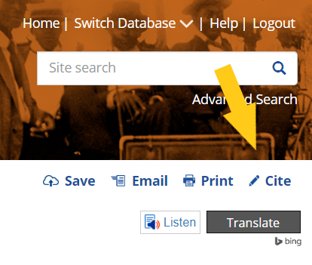
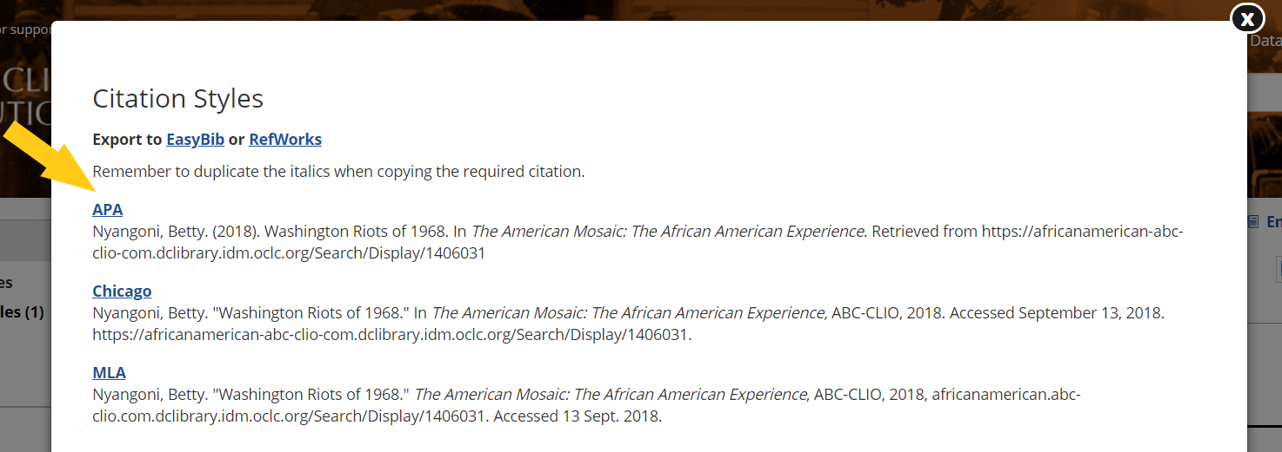
Getting Organized for Research
To generate citation information:
On the page of the article, click Cite.
Use the APA style of formatting, unless directed otherwise by a teacher.
Record the citation information at the top of your note-catcher.
Notes:
Teaching notes
Suggested Pacing: 1 minute
Directions:
Distribute the Starting Research handout and Summarizing Information note-catcher. Use established classroom routine to provide students with devices.
As you distribute the materials, make sure all students have a few focus questions selected from their Starting Research handout.
Say, "Gathering your research materials before you start reading will help you keep your notes organized, and makes it easier to keep track of sources. You will need the focus questions from your Starting Research handout, the Summarizing Information handout, and your research sources.
Say, "Keeping track of your sources as you work will help you stay organized and prepared for writing your final paper. Generally, in academic writing, you will be required to use APA style formatting. Many data bases have "cite" tools that make it very easy to gather the citation information you need. Look on the tool bar just above the article you are reading for the word 'cite.' Click on this, and then jot down the APA style citation."
Student Look-Fors:
Handouts and research sources are out on desks.
Several research focus questions on Starting Research handout.
Attribution:
African American Experience, courtesy of D.C. Public Library

Slide 6
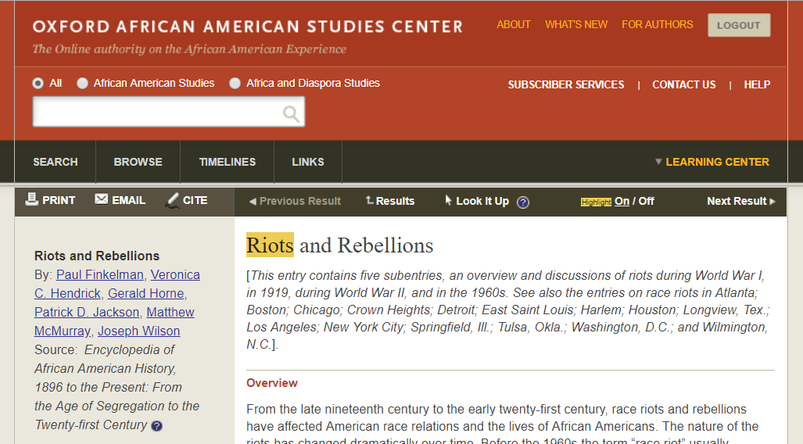
Selecting Information for Notes
What was the result of the riots?
What caused the Washington Riots of 1968?
Notes:
Teaching notes
Suggested Pacing: 1 minute
Directions:
Say, "There is often much more information in a source about a given topic than you could possibly read or use in your writing. For example, this article from the Oxford African American Studies Center has extensive information about race riots throughout American history. Not all of this information is relevant to my topic. To find the most relevant and supportive information about my topic, I need to go back to my focus questions."
Ask a student to read aloud the focus questions from the slide.
Attribution:
Oxford African American Studies Center, courtesy of the D.C. Public Library

Slide 7
Selecting Information for Notes
Which notes are most relevant to the focus questions?
The assassination of Dr. Martin Luther King, Jr in April 1968 led to a new wave of riots as African Americans poured into the streets of their own communities, attacking property, especially that owned by whites, in anger and frustration. Since then other riots have been situational, caused by certain events. A good example of this is the riots in Los Angeles in 1992 following the acquittal of police who had seemed to use excessive force against the motorist Rodney King.
Notes:
Teaching notes
Suggested Pacing: 1 minute
Directions:
Say, "After skimming this article, this paragraph stood out, as it specifically mentions the 1968 riots. Follow along as I read the text out loud."
Remind students of the following focus questions:
What caused the Washington Riots of 1968?
What was the result of the riots?
Ask, "With these questions in mind, which notes from this source will be most relevant? Does it make more sense to quote directly, paraphrase, or summarize the information?"
Invite students to discuss in their research groups.
Student Look-Fors:
This information contains important details that are relevant to the focus questions. A summary may be too brief. Paraphrasing will capture the major points. There isn't any language that is particularly powerful or written by a primary source, so quoting is not necessary.
Students might paraphrase the following ideas:
The riots started in reaction to the assassination of MLK. People were angry and frustrated by racism toward African Americans.
The Washington riots inspired future riots in America. People started to riot as a reaction to specific upsetting events.
Attribution:
Oxford African American Studies Center, courtesy of the D.C. Public Library

Slide 8
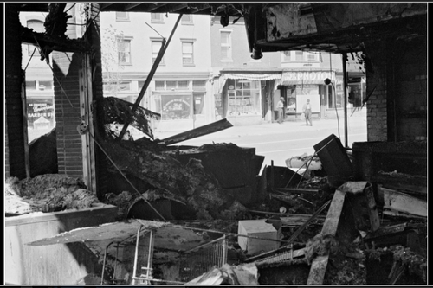
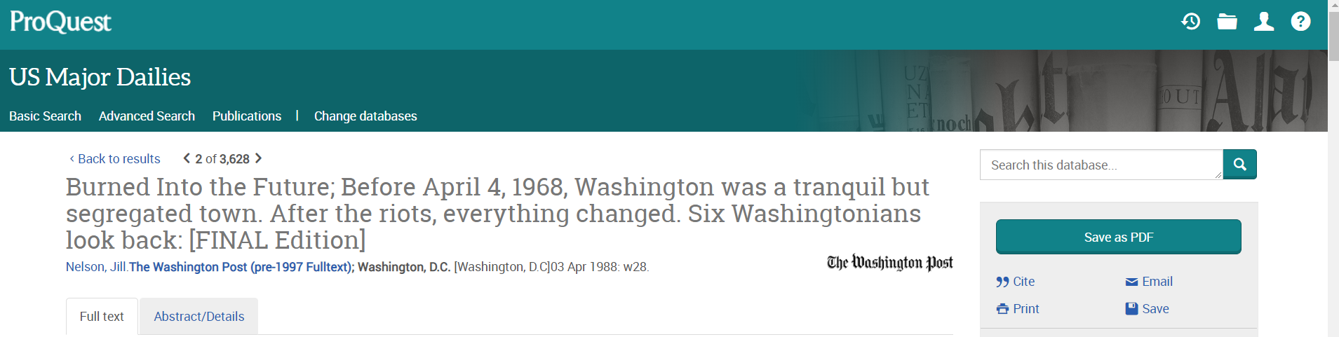
Selecting Information for Notes
Take notes from a variety of sources, for stronger analysis.
Use D.C. Public Libraries' online database to check out:
videos
photos
newspaper articles
Notes:
Teaching notes
Suggested Pacing: 3 minutes
Directions:
Explain that gathering notes from multiple sources allows writers to create a stronger analysis and present more thorough research on a topic.
Say, "In addition to providing access to online article databases, the D.C. Public Library online research tools give access to historical newspaper articles, photos, images, and much more."
Say, "Take a look at this photograph from the Library of Congress, accessed through Britannica's High School database. What additional information does this image give me about the results of the Washington Riots of 1968?"
Explain that the bottom source was pulled from the ProQuest database on the DCPL website. This database includes over a century of newspaper articles from the major daily newspapers in the US. This article, written in 1988, offers eye-witness reflections on the effects of the Washington Riots of 1968.
Ask, "How might this article support the analysis of my focus questions?"
Student Look-Fors:
Student responses will vary:
The photograph reveals the extensive damage caused by the Washington Riots of 1968. The rioters definitely made their message heard, but at a great cost. The city likely had to spend a lot of money and time repairing the damage.
Having first hand accounts of the riots will provide a clearer, more accurate picture of the event.
The article is written in 1988, which allows for the writer to explore the results over twenty years. This will allow a greater analysis of the short term and long term effects of the riots.
Attributions:
Britannica School, "Building in Washington, D.C., destroyed during the riots that followed the assassination of Martin Luther King, Jr., April 1968," courtesy of D.C. Public Library
ProQuest, "Burned into the Future; Before April 4, 1968, Washington was a tranquil but segregated town. After the riots, everything changed. Six Washingtonians look back," courtesy of D.C. Public Library

Slide 9

Evaluating Information from Sources
Read each source, ask:
Is the author/speaker biased?
Does the author cite sources properly?
Notes:
Teaching notes
Suggested Pacing: 5 minutes
Directions:
Say, "Not all sources are credible or may offer a biased point of view. What are some indicators that an author may be biased?"
Invite students to share answers aloud with the class.
Explain that being able to identify biased information is important when you are analyzing a topic for research, to ensure you are presenting a balanced, objective presentation of a topic.
Pull up the "Burned into the Future," newspaper article (accessed through the ProQuest database) to show students or provide a printed copy for each student. Scroll or skip down to the first story told, by Colonel Warren L. Freeman.
Say, "In your research groups, read Colonel Freeman's story. Discuss his point of view, including any evidence of bias in his story. Decide as a group whether/not information could be summarized or quoted from Colonel Freeman's story for research. If you decide to use his account, what other perspectives may need to be included to support an objective analysis?"
Invite groups to explore the website to make sure the author's sources are cited.
Student Look-Fors:
Some indicators of bias include extreme positions, or focusing on the emotional side of a topic.
After analyzing Colonel Warren's story, students might share:
Colonel Freeman has clearly experienced prejudice from the white community in DC, as he describes his background working for a telephone company. This may have influenced his perspective of the riots. However, he was also a member of the National Guard, so he was a part of the law enforcement that intervened in the Washington Riots of 1968. While he was a member of the law enforcement team, he is also a part of the black community and had many friends that took part in the rioting. Colonel Freeman describes his dilemma in navigating these two perspectives. Due to his unique perspective, it is worth using his account in our research, but we may want to balance his perspective, by also sharing the perspectives of rioters and white community members.
Attributions:
ProQuest, "Burned into the Future; Before April 4, 1968, Washington was a tranquil but segregated town. After the riots, everything changed. Six Washingtonians look back," courtesy of D.C. Public Library

Slide 10
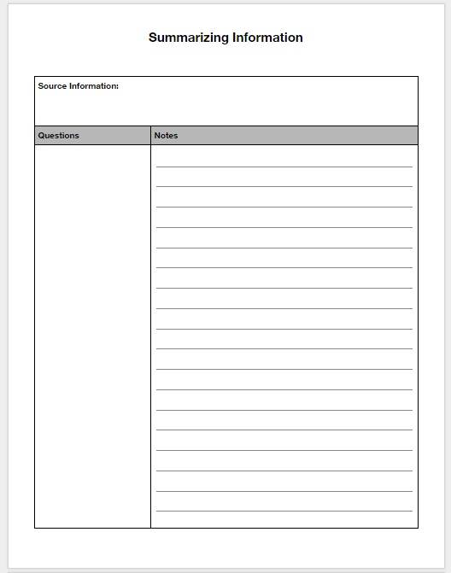
Express your Understanding
Choose another story from the "Burned into the Future" article. After reading . . .
Identify the author's bias. Acknowledge this in your notes.
Summarize ideas or paraphrase important details in your notes.
Record any powerful quotes that may be useful in your writing.
Notes:
Teaching notes
Suggested Pacing: 8 minutes
Directions:
Invite students to skim through the "Burned into the Future" newspaper article and choose another perspective to read, from the remaining five individuals interviewed in the article.
Say, "As you read, take note of an indication of bias. Read the individual's story completely, then identify any relevant ideas/details to add to notes. Jot these down, as well as any powerful quotes."
Say, "Be sure to add this source information at the top of your Summarizing Information handout."
Walk around the room and make sure students are reading another story from the article, adding notes to their handout.
Collect Summarizing Information handouts as formative assessment.
Student Look-Fors:
Students will select one of the following stories and add notes to their handout, accordingly.
Larry Rosen, a store owner
Ramsey Clark, a US attorney reporting to the President
Virginia Ali, owner of Ben's Chili Bowl
Oliver T. Carr, DC native and owner of development company
Attribution:
ProQuest, "Burned into the Future; Before April 4, 1968, Washington was a tranquil but segregated town. After the riots, everything changed. Six Washingtonians look back," courtesy of D.C. Public Library

