Slide 1
Where do I start?
How to Use Library: High School, Lesson 3
Notes:
About this lesson
This lesson guides students in how to begin with their research by thinking about what they already know, brainstorming research questions, and identifying keywords. The lesson references items and research topics from the 12th-grade cornerstone project, When should people fight for change?
Materials:
Starting Research
Freedmen’s Bureau_Introduction
ELA Standards:
W.11-12.8: Gather relevant information from multiple authoritative print and digital sources, using advanced searches effectively; assess the strengths and limitations of each source in terms of the task, purpose, and audience; integrate information into the text selectively to maintain the flow of ideas, avoiding plagiarism and overreliance on any one source and following a standard format for citation.
DC Content Power Standards:
12.DC.10.3: Explain how African American leaders resisted discrimination.
C3 Framework Indicators and Common Core Standards for Literacy in History/Social Studies:
D2.His.12.9-12. Use questions generated about multiple historical sources to pursue further inquiry and investigate additional sources.

Slide 2
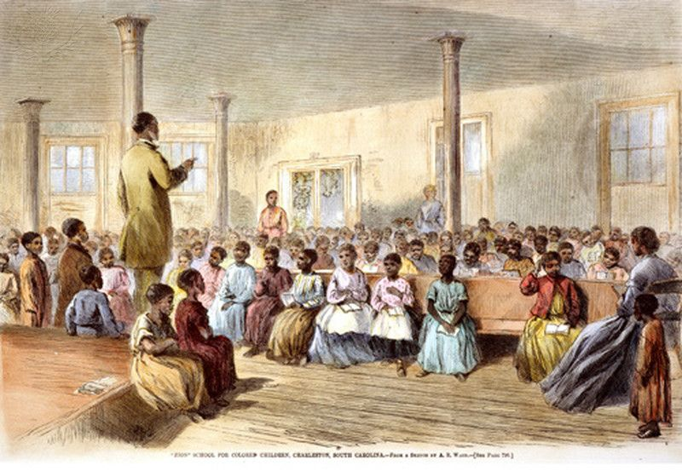
Guiding Question
What do I do first to get started on my research?
Notes:
Teaching notes
Suggested Pacing: 2 minutes
Directions:
Ask, "How do you get started on researching a topic such as how the Freedmen's Bureau fought discrimination and segregation?"
Ask, "What do you do first?"
Student Look-Fors:
Many students may not know anything about the Freedmen's Bureau, and be unsure about where to start.
Students might look up what the Freedmen's Bureau was in a reference text.
Attributions:
Freedmen's School, Britannica, courtesy of the D.C. Public Library

Slide 3
Review
Gather information from multiple sources.
Explore different points of view and bias.
Analyze evidence and evaluate arguments.
Develop an understanding of a topic.
Record what is learned.
Show the sources of information in a bibliography with correct notation.
Notes:
Teaching notes
Suggested Pacing: 1 minute
Directions:
Review the process of research.
Explain that research is a process, it is more than just doing a quick search or reading the encyclopedia.
To research we need to:
Gather information from multiple sources.
Explore different points of view and bias.
Analyze evidence and evaluate arguments.
Develop an understanding of a topic.
Record what is learned.
Show the sources of information in a bibliography with correct notation.

Slide 4
Introduction
How can I get ready to research my topic? What do I need to do first?
Step 1: Think about what you already know
Step 2: Brainstorm questions
Step 3: Identify keywords
Notes:
Teaching notes
Suggested Pacing: 2 minutes
Directions:
Explain that expert researchers need to organize their thinking and make a plan before researching a topic.
Say, "The first step in this process is to think about what you already know about a topic. If you don't know anything at all, you can use a reference like a dictionary or an encyclopedia to obtain a general overview. The next step would be to brainstorm important questions about your topic that you need to answer in your research. Finally, identify keywords from these questions to search for information."
Divide the class into small groups or pairs depending upon your class needs and explain that students will be practicing this process with their groups.
Pass out Starting Research handout.
Create a teacher-made "Starting Research" anchor chart that mirrors the handout. This anchor chart will be created during the lesson and be displayed as a reference in the room after its completion. Throughout the lesson you will use this to chart to model to research process, adding information as students add to their handouts.

Slide 5
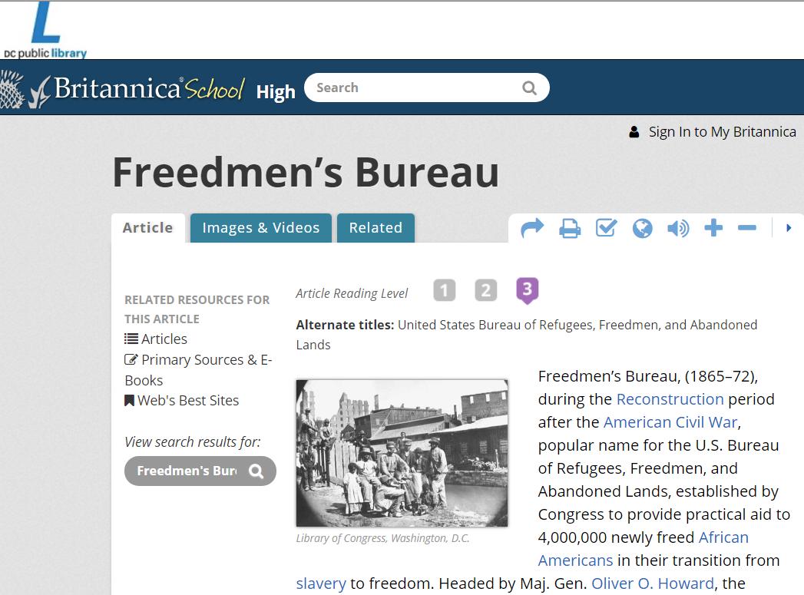
Think About What You Already Know
Notes:
Teaching notes
Suggested Pacing: 5 minutes
Directions:
Say, "For example, if you were researching the Freedmen's Bureau, you might not know anything at all about this topic."
Draw student attention to the slide. Say, "In that case, look at a general source like a dictionary or an encyclopedia to get a basic understanding of what the Freedmen's Bureau was. For example, if you looked up the Freedmen's Bureau in the Encyclopedia Britannica, this is the result."
Instruct groups to read this text from the screen and use the "Think about what you already know. . ." column of their Starting Research handouts to record general information they can learn about the Freedmen's Bureau.
After several minutes, call on groups to share out information.
Model adding information to "Starting Research" chart as students share out.
Student Look-Fors:
The Freedmen's Bureau was an organization set up by the government after the Civil War.
It was created to help African Americans who had been slaves transition to freedom.
Congress provided aid to 4 million African Americans.
It was another name for the U.S. Bureau of Refugees, Freedmen, and Abandoned Lands
Attributions:
Freedmen's Bureau, Britannica, courtesy of the D.C. Public Library

Slide 6
Brainstorm Questions
What am I trying to find out or understand about the Freedmen's Bureau?
Step 1: Think about what you already know
Step 2: Brainstorm questions
Step 3: Identify keywords
Notes:
Teaching notes
Suggested Pacing: 5 minutes
Directions:
Explain that the next step is to brainstorm questions to guide your research.
Say, "You need to think deeply about exactly what it is you want to understand about your topic. Think about why you are doing this research. What is your goal? What do you want to be able to explain to others about this topic?"
Instruct students to discuss within their groups and generate some questions to ask to better understand the Freedmen's Bureau.
Students record their questions in the "Brainstorm questions. . ." column of the Starting Research handout.
Call on groups to share out answers and model adding questions to class "Starting Research" anchor chart.
Student Look-Fors:
What were the goals of the Freedmen's Bureau?
Was it successful?
What happened to the Freedmen's Bureau?
What are some of the things that the Freedmen's Bureau did?
Were people opposed to the Freedmen's Bureau?

Slide 7
Identify Keywords
What are the most important words and ideas I need to know about the Freedmen's Bureau?
Step 1: Think about what you already know
Step 2: Brainstorm questions
Step 3: Identify keywords
Notes:
Teaching notes
Suggested Pacing: 5 minutes
Directions:
Explain that the last step is to identify the most important words and ideas from these questions and our thinking about the topic.
Say, "Looking at our research questions, what are some keywords you notice?"
Students work in groups to identify keywords and add them to the "Identify keywords. . ." column of their Starting Research handouts.
Call on students to share out keywords and ask why they chose those words or ideas as important.
Model adding key words to class anchor chart.
Student Look-Fors:
Freedman's Bureau
slave
goal
effect
legacy
opponents
enemy

Slide 8
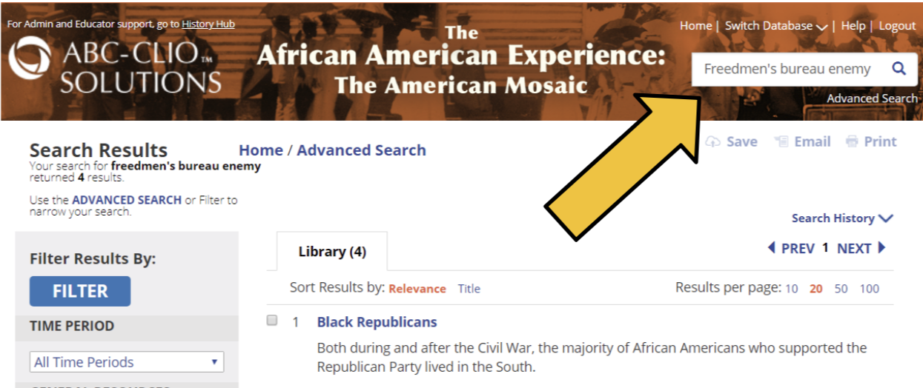
Identify Keywords
Notes:
Teaching notes
Suggested Pacing: 2 minutes
Directions:
Explain that when starting research, these keywords can be used in many different ways.
Draw student attention to two examples on the screen of searches using keywords.
Say, "You can look for these terms in text features of books and magazines.
Say, "You can also enter keywords in online search engines, databases, and dictionaries. Instead of typing in your whole research question, simply use keywords in different combinations within the search box of a search engine."
Say, "Notice the search box in each of these examples. The keywords are slightly different to yield different information."
Ask, "What are the search engines? What are the keywords used in each?"
Student Look-Fors:
DCPL (Gale database): Freedmen's Bureau goal
ABC-CLIO database: Freedmen's Bureau enemy
Attributions:
Gale, courtesy of the D.C. Public Library
The African American Experience, courtesy of the D.C. Public Library

Slide 9
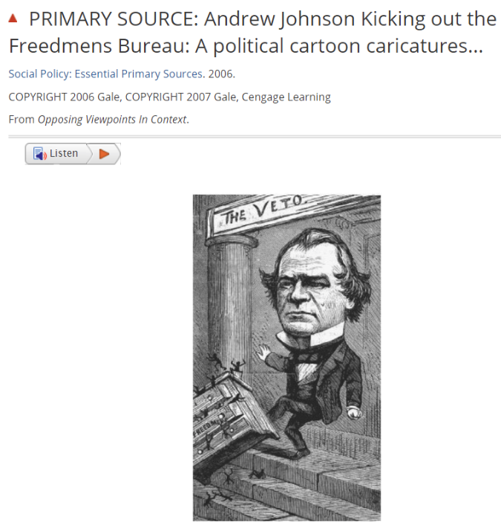
I thought. . .then I learned. . .now I'll look for. . .
I thought. . .then I learned. . .now I'll look for. . .
Notes:
Teaching notes
Suggested Pacing: 2 minutes
Directions:
Say, "As you research and learn more, your thinking about a topic may change. For example, you may learn that President Andrew Johnson opposed the Freedmen's Bureau. In that case, you could add a question to your research questions asking, 'Why did President Johnson oppose the Freedmen's Bureau?' You could also add a keyword, "Andrew Johnson" to your keywords. That way, as you continue your research, you have different and more specific topics/subjects to search."
Model adding information to class anchor chart. Instruct students to add to their Starting Research handouts.
Attributions:
Andrew Johnson Kicking out the Freedmens Bureau, Gale, courtesy of the D.C. Public Library

Slide 10
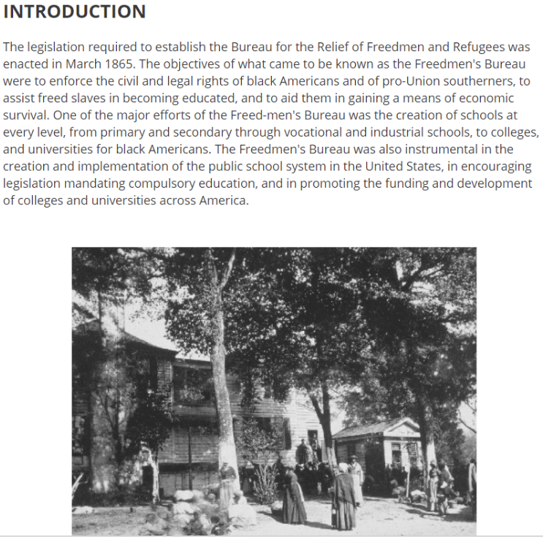
I thought. . .then I learned. . .now I'll look for. . .
Notes:
Teaching notes
Suggested Pacing: 5 minutes
Directions:
Depending on class resources and needs, either have students read this text from the screen or distribute Freedmen's Bureau: Introduction handouts for students to read.
Say, "Let's try this with another source about the Freedmen's Bureau! Work with your group to read this text. What can you learn from this source about the Freedmen's Bureau? What important ideas does this source raise that you want to learn more about?"
Instruct students to add research questions and keywords to the "Keywords. . ." column of the Starting Research handouts.
Call on groups to share out and model adding information to class anchor chart.
Student-Look Fors:
Students will work to find out more about how the Freedmen's Bureau helped freed slaves become educated.
Students may decide to look for modern day schools or universities that were founded by the Freedmen's Bureau.
Students may ask how the Freedmen's Bureau affected the implementation of the U.S. public school system.
Attributions:
An Act to Establish a Bureau for the Relief of Freedmen and Refugees, Gale, courtesy of the D.C. Public Library

Slide 11
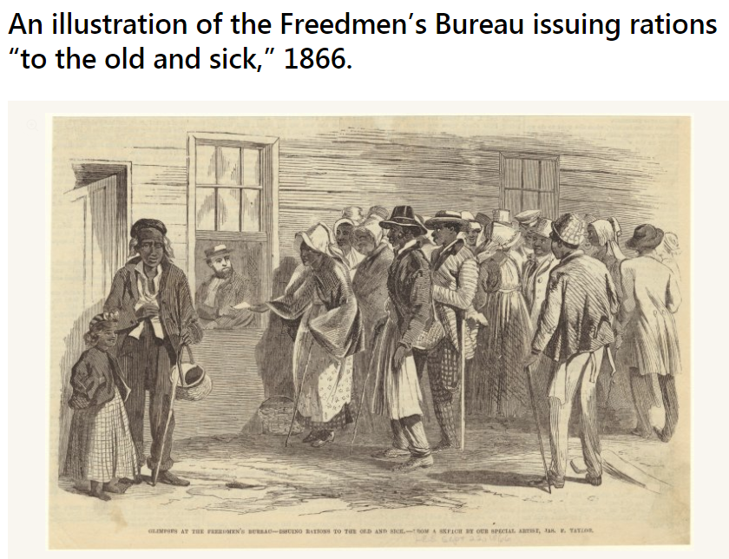
Express Your Understanding
What research question(s) or keyword(s) does this image generate for you about the Freedmen's Bureau?
Notes:
Teaching notes
Suggested Pacing: 3 minutes
Directions:
Direct students to work independently on this task using their handouts.
Say, "Draw a line across the bottom of your Starting Research handout below where you stopped working. If you filled up the whole page, flip your paper over and use the back."
Instruct students to read this text from the screen silently.
Say, "This is an image of the Freedmen's Bureau issuing rations "to the old and sick" in 1866."
Say, "Add at least one research question and one keyword generated by this source to your handout."
Collect the handouts and use as formative assessment.
Student Look-Fors:
Think about what you already know:
The Freedmen's Bureau was established to help former slaves
Brainstorm questions:
What rations did the bureau hand out to people?
Why were there so many sick or old slaves who needed the bureau's help?
What did the bureau give out to people?
Identify keywords:
rations
Freedmen's Bureau
Attribution:
An illustration of the Freedmen's Bureau issuing rations "to the old and sick," courtesy of the Digital Public Library of America

