Slide 1
What are authoritative sources?
How to Use Library: High School, Lesson 2
Notes:
About this lesson
This lesson explains how to use different resources to do research, including how libraries curate authoritative sources of information that include primary and secondary resources. It references items and research topics from the 12th-grade cornerstone project, When should people fight for change?
Materials:
Where Should I research?
ELA Standards:
W.11-12.8: Gather relevant information from multiple authoritative print and digital sources, using advanced searches effectively; assess the strengths and limitations of each source in terms of the task, purpose, and audience; integrate information into the text selectively to maintain the flow of ideas, avoiding plagiarism and overreliance on any one source and following a standard format for citation.
DC Content Power Standards:
12.DC.10.3: Explain how African American leaders resisted discrimination.

Slide 2
Guiding Questions
What makes a source authoritative?
Where can I find authoritative sources of information?
Notes:
Teaching notes
Suggested Pacing: 2 minutes
Directions:
Ask, "What does it mean for a source to be 'authoritative'?"
Ask, "Where are some places to find reliable sources of information? What are the first things you would do or the first place you would look if you were starting a research project?"
Student Look-Fors:
The word "authoritative" sounds and looks like the word "authority", which means to have some kind of power, or that it can be trusted.
A phone or a computer to get online and use a search engine like Google.
Reading Wikipedia articles online.

Slide 3
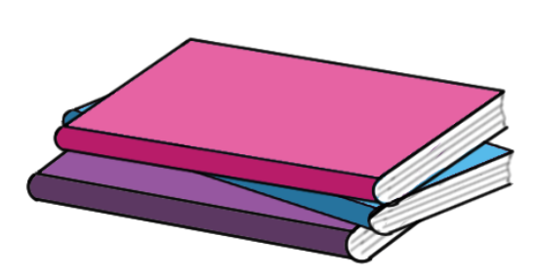
Research Vocabulary
A source that is authoritative can be trusted to be accurate and true.
Notes:
Teaching notes
Suggested Pacing: 2 minutes
Directions:
Say, "A source of information that is authoritative can be trusted to be accurate and true."
Ask, "Why is it important to always use authoritative sources when we research?"
Student Look-Fors:
It is important to use authoritative sources to make sure the information we get is reliable.
Some sources might contain some things that are true and some things that are not.

Slide 4
Research Vocabulary
Primary source - a picture, text, or any other source that was created at the time being researched
Are all sources the same?
Secondary source - something that was created or written about a person or an event by someone who was not there at the time
Notes:
Teaching notes
Suggested Pacing: 3 minutes
Directions:
Say, "There are two main types of sources, primary sources, and secondary sources."
Explain that primary sources are pictures, texts, or any other source that was created at the time being researched.
Explain that a secondary source is something that was created or written about people or events by someone who was not there at the time.
Ask, "Which type of source do you think is more authoritative? Why?"
Ask, "What are some things that might make a secondary source inaccurate?"
Ask, "What are some things that might make a primary source inaccurate?"
Student Look-Fors:
Primary sources are more authoritative because they were written by people who lived at the time and experienced events first hand.
Primary sources are more reliable because they were made by eyewitnesses.
Students may think that secondary sources are more reliable because they were written or created after people could gather and analyze all the facts.
Secondary source might be inaccurate because it doesn't include all the information, or represents what happened in the wrong way.
A primary source might be inaccurate because of the author's bias - maybe they disagreed with something that happened and wanted to show that it was bad.

Slide 5
Introduction
I do a Google search!
I use the library!
I look on Wikipedia!
Notes:
Teaching notes
Suggested Pacing: 4 minutes
Directions:
Note that there are many tools available online for students to look up information. These include a search engine such as Google, online encyclopedias such as Wikipedia, and library websites such as the D.C. Public Library's goDigital resources.
Have a class discussion about where students would look for information:
Optional: Designate three parts of the room for students to move to, indicating which resource they would use.
Ask, "Why would you choose to use this resource to start your research?"
Ask, "Are all of these resources the same?"
Ask, "Are all of these resources authoritative?"
Student Look-Fors:
It is easy to use Google to find a lot of different sources of information.
There are articles about every subject on Wikipedia.
The library has many different databases that can be used to find information. The library also has librarians that you can ask for help.

Slide 6
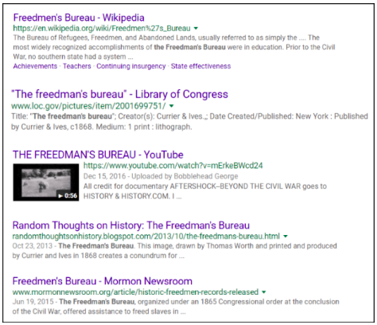
Researching using Google
I do a Google search!
Notes:
Teaching notes
Suggested Pacing: 6 minutes
Directions:
Depending on student needs, divide students into groups of 2-3.
Pass out Where should I research? handout.
Explain that if Google were used to do research on the history of discrimination and Washington D.C., specifically the Freedman's Bureau, it would give results like this.
Ask, "What information can I find on this page?"
Point students towards the titles of each website. If needed, explain that this tells us the name of the article and often the name of the website.
Point students towards the green url, or web address, beneath each title. If needed, explain that this is the web address for that website.
Point students towards the short descriptions below each source. If needed, explain how we can skim these to get a better sense of what this source is about.
Ask, "Why do you think these links are in this order? Why is that one first and this other one third or fourth?"
Explain that while Google is a powerful tool, it does not sort information by how true it is - it sorts information by how many keywords it has, how popular it is, and how long a website has existed.
Instruct students to jot notes about Google on their handouts. If needed, model for students (link to model handout).
Student Look-Fors:
Students note that Google results are sorted by how many keywords it has, how popular it is, and how long it has existed on Google column of handout.

Slide 7
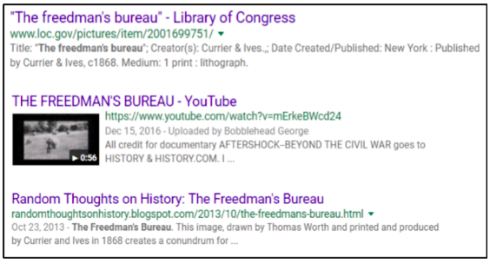
Researching using Google
Notes:
Teaching notes
Suggested Pacing: 5 minutes
Directions:
Explain that one way to make sure you find reliable information when using Google, is to always look at the url of a source. If you can see it is a reputable, or well-known, website then it is more trustworthy than information from a website you have never heard of.
Ask, "Which of these search results is the most authoritative?"
Push students to explain why they believe a source is more authoritative than others on the page.
Explain that, in general, websites that end in ".org" or ".net" belong to organizations or companies that might not be trustworthy. Also, websites with hosting names like "Blogspot" or "WordPress" in the url belong to individuals who may not be experts. On the other hand, websites that end in ".edu" or ".gov" belong to established schools or the government and are more trustworthy.
Model analyzing search results:
Explain that the top search item is from a ".gov" url, meaning it is from a government archive. The title of the source also shows that it is from the Library of Congress, which is a reliable source.
The second result is a youtube video, but since anyone can upload videos to youtube, we do not know if it is authoritative or not.
The "Random Thoughts on History" source has "blogspot" in the title, which means it was made by an individual who may or may not be an expert.
Student Look-Fors:
Students add note that urls of ".edu" or ".gov" are more reliable than urls of ".net" or ".org" on Google column of handout.

Slide 8
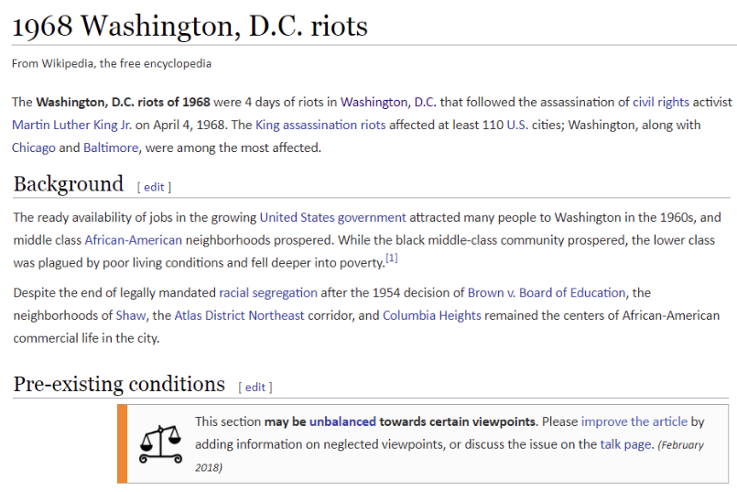
Researching using Wikipedia
Notes:
Teaching notes
Suggested Pacing: 5 minutes
Directions:
Explain that to research using Wikipedia, someone would go to their website and type in what they were searching for into the search bar. For example, this is the article for the 1968 Washington, D.C. riots.
Ask, "What do you notice on this article?"
If needed, point out the message below "Pre-existing conditions"
Ask, "What do you think it means that this section may be unbalanced towards certain viewpoints?"
Ask, "What does it mean that anyone can click on the link to add information?"
Students add notes about Wikipedia to handout.
Student Look-Fors:
The title at the top shows that this is from Wikipedia, a free encyclopedia.
Information is broken down into sections.
There is a short summary at the top.
There is a note at the bottom that a section may be unbalanced and links to where people can add information.
"Unbalanced" means that it might be written from a strong point of view - someone may have written this who has one perspective on the topic, but there may be other perspectives that are important to consider.
If anyone can edit this article or add information, how do we know if it's true?
Students add notes about how anyone can edit Wikipedia articles, which can lead to them being unbalanced or inaccurate to handout.
Attributions:
Wikipedia, "1968 Washington, D.C. riots", courtesy of Wikipedia

Slide 9
Researching using Wikipedia
What does this mean?
Notes:
Teaching notes
Suggested Pacing: 4 minutes
Directions:
Explain that this is another message from a different article on Wikipedia.
Ask, "What is a citation?"
Ask, "What does verification mean?"
Ask, "What does it mean that 'Unsourced material may be challenged and removed'?"
Ask, "What does this show about Wikipedia as a source?"
Explain that because anyone can add to or edit a Wikipedia article, we cannot know if the information in it is accurate. Because of this, it is not an authoritative source.
Students add to notes in Wikipedia column of handout.
Student Look-Fors:
A citation tells where information comes from.
Verification is the process of making sure that something is true.
This means that some of the information is not verified, so you do not know if it is actually true because the source of this information is unknown.
Students add to Wikipedia column of handout.
Student Look-Fors:
Wikipedia, "Jim Crow Laws", courtesy of Wikipedia

Slide 10
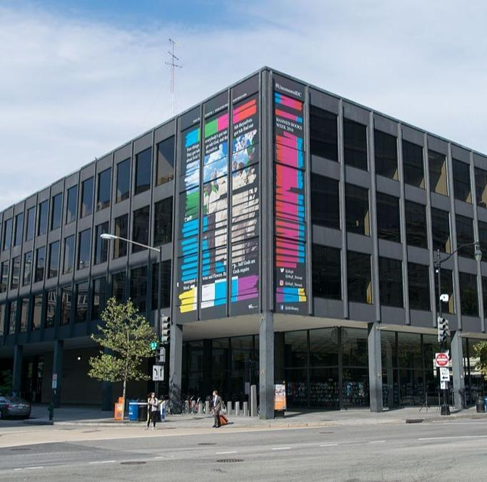
Researching using the library
I use the library!
Notes:
Teaching notes
Suggested Pacing: 4 minutes
Directions:
Ask, "How would researching at the library in my city be different than using Google or Wikipedia?"
Discuss student's preconceptions of what research at a library in their city looks like, noting some of the different resources libraries now offer such as websites, computers, magazines, journals, and people you can ask for help (librarians)!
Explain that, unlike a search engine or an online encyclopedia, the goal of a library in their city is to collect relevant and true information from authoritative sources. This information can be in an actual library building that we can access by visiting and reading books, newspapers, and magazines, or it can be online through the library website.
Explain that whether it is in books or websites, all of the information in a library is curated, or specifically chosen to be there, because it is important and relevant. That makes the city library a much smarter place to research than other places on the wild web.
Tell students to add what they have learned about the city library being a source of authoritative sources that are relevant to the "library" column of the handout.
Student Look-Fors:
Not just anyone can get their work into a library, that means that the sources would be more authoritative.
Libraries do not just have books, but actually, they have all kinds of resources like books, magazines, videos, articles, and more.

Slide 11
Researching using the library
Notes:
Teaching notes
Suggested Pacing: 1 minute
Directions:
Watch video to close lesson
Attributions:
Use of Library

