Slide 1
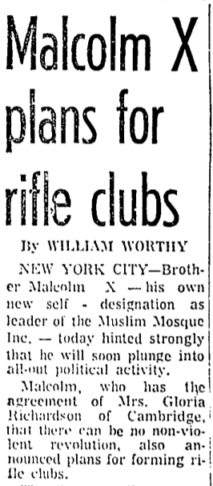
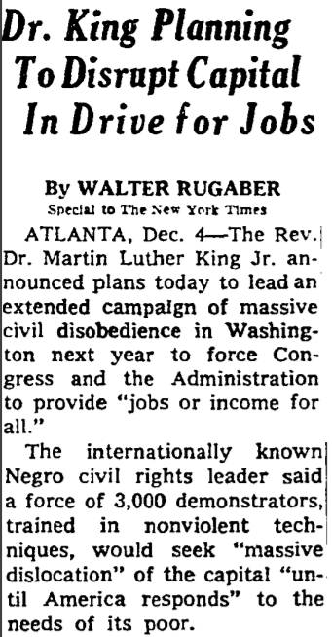
What is Research?
How to Use Library: High School, Lesson 1
Notes:
About this lesson
This lesson explains what it means to research. It references items and research topics from the 12-grade cornerstone project, When should people fight for change?
Materials:
Loving Your Enemies
Ballot or the Bullet
MLK vs. Malcolm X
Cornerstone 3
ELA Standards:
W.11-12.7: Conduct short as well as more sustained research projects to answer a question (including a self-generated question) or solve a problem; narrow or broaden the inquiry when appropriate; synthesize multiple sources on the subject, demonstrating understanding of the subject under investigation.
W.11-12.9: Draw evidence from literary or informational texts to support analysis, reflection, and research.
W.11-12.6: Use technology, including the Internet, to produce, publish, and update individual or shared writing products in response to ongoing feedback, including new arguments or information.
W.11-12.8: Gather relevant information from multiple authoritative print and digital sources, using advanced searches effectively; assess the strengths and limitations of each source in terms of the task, purpose, and audience; integrate information into the text selectively to maintain the flow of ideas, avoiding plagiarism and overreliance on any one source and following a standard format for citation.
DC Content Power Standards:
12.DC.10.3: Explain how African American leaders resisted discrimination
C3 Framework Indicators and Common Core Standards for Literacy in History/Social Studies:
D2.His.4.9-12. Analyze complex and interacting factors that influenced the perspectives of people during different historical eras.

Slide 2
Guiding Questions
What is research?
How can you do research in your city?
Notes:
Teaching notes
Suggested Pacing: 2 minutes
Directions:
Ask the first guiding question, "What is research?"
Ask students what they think of when they hear the word research. What images, memories, or ideas come to mind?
Ask the second guiding question, "How can you do research in your city?"
Ask students where they research in their city. What tools would they need?

Slide 3
What is research?
When you research, you study something in detail to discover facts and reach new conclusions about a topic.
Notes:
Teaching notes
Suggested Pacing: 1 minute
Directions:
Explain that when you research, you study something in detail to discover facts and reach new conclusions about a topic.

Slide 4
Why do we do research?
Why do we do research?
Notes:
Teaching notes
Suggested Pacing: 1 minute
Directions:
Say, "People do research to become experts about something. An expert is someone who has a special skill or knowledge about a topic. An expert does not just accept what other people say is true."
Say, "An expert does not just read about what other people think, they examine the evidence and come to their own conclusion."

Slide 5
The Process of Research
Gather information from multiple sources.
Explore different points of view and bias.
Analyze evidence and evaluate arguments.
Develop an understanding of a topic.
Record what is learned.
Show the sources for information in a bibliography with correct notation.
Notes:
Teaching notes
Suggested Pacing: 2 minutes
Directions:
Explain that research is a process, it is more than just doing a quick search or reading the encyclopedia.
To research we need to:
Gather information from multiple sources.
Explore different points of view and bias.
Analyze evidence and evaluate arguments.
Develop an understanding of a topic.
Record what is learned.
Show the sources for information in a bibliography with correct notation.

Slide 6
Gather information from multiple sources
Why do you need more than one source?
Notes:
Teaching notes
Suggested Pacing: 3 minutes
Directions:
Explain that a source is any place or reference you obtain information from. A source could be a book, magazine, article, website, video, or even an audio clip.
Ask, "When you gather information, why would it be important to use more than one source?"
Student Look-Fors:
Students understand that if you use one source and it turns out to be wrong you will have an erroneous understanding of something. By using many sources, you can gather more information.
Learning from several different sources helps you find out new information about a topic.
Using many sources gives you different perspectives - not all people may agree about the same topic.
By using multiple sources, you are better able to determine how trustworthy one source is compared to another.

Slide 7
Gather information from multiple sources
Notes:
Teaching notes
Suggested Pacing: 5 minutes
Directions:
Pass out MLK vs. Malcom X handout.
Depending on classroom resources, students can read text from screen or from Loving Your Enemies handout.
Say, "For example, imagine that you are doing research to understand the different tactics used by African American leaders to resist discrimination. As part of your research, you find this resource about Martin Luther King Jr."
Ask, "What can we learn about Martin Luther King Jr.'s tactics for resisting discrimination from this source? Read this text and jot your thinking in the first column of your handout."
Lead a short class discussion to share out answers.
Student Look-Fors:
Martin Luther King Jr. believed in nonviolent methods to confront discrimination.
He based this on his beliefs as a Christian minister.
As a leader, he brought hundreds of thousands of people together from many racial groups.
Attributions:
Gale, "Loving Your Enemies" courtesy of the D.C. Public Libraries

Slide 8
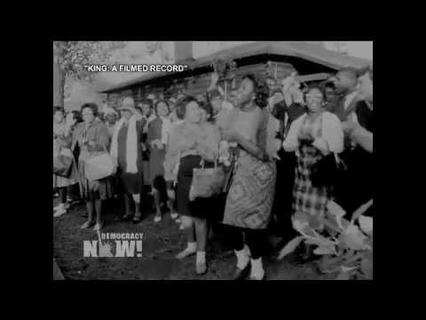
Gather information from multiple sources
Notes:
Teaching notes
Suggested Pacing: 6 minutes
Directions:
Ask, "Does this mean you are done researching the tactics of African American leaders? Of course not! There may be more to learn about MLK's tactics. You are just getting started! For example, you could keep researching and find this video. What else can you learn about MLK's tactics from this source?"
Have students jot new information they learn about MLK's tactics in the first column of their handout.
Play video and hold a brief discussion to share out answers.
Student Look-Fors:
Martin Luther King Jr.'s goal was to have so many people be arrested that they would fill the jails. He believed that this would show how determined people were to be free and to show people everywhere how African Americans were being discriminated against.
Protesters are singing, smiling, and clapping as they are arrested.
MLK wanted to use nonviolence to appeal to the public's conscience.
Attributions:
Access Video On Demand, "Fill the Jails" courtesy of D.C. Public Library

Slide 9
The Process of Research
Gather information from multiple sources.
Explore different points of view and bias.
Analyze evidence and evaluate arguments.
Develop an understanding of a topic.
Record what is learned.
Show the sources for information in a bibliography with correct notation.
Notes:
Teaching notes
Suggested Pacing: 1 minute
Directions:
Next, you need to explore different points of view and bias.
Explain that a "point of view" is a way of thinking about, or an opinion about, a topic. Different people can have different points of view on the same topic.
Remind students that an expert does not just accept what someone says is true. To become experts you have to look at all the evidence, all the different points of view and analyze it all for yourself.

Slide 10
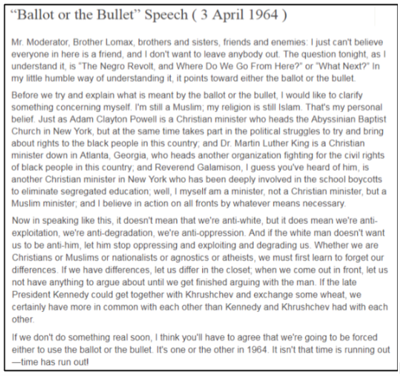
Explore different points of view and bias
Notes:
Teaching notes
Suggested Pacing: 6 minutes
Directions:
Depending on classroom resources, students can read text from screen or from Ballot or the Bullet Speech handout.
Say, "This is a speech by another African American leader, Malcolm X. As you read this text, jot down the tactics that Malcolm X used to protest discrimination on your handout."
Students will record their thinking in the second column of the MLK vs. Malcolm X handout.
Discuss what Malcolm X's tactics were and how they differed from MLK's.
Student Look-Fors:
Malcolm X also wanted to protest discrimination and thought that people should come together to stop it.
Malcolm X believed that discrimination should be protested by "whatever means necessary", not just by using non-violence.
Attributions:
Oxford African American Studies Center, "'Ballet or the Bullet' Speech (3 April 1964)" courtesy of D.C. Public Library

Slide 11
The Process of Research
Gather information from multiple sources.
Explore different points of view and bias.
Analyze evidence and evaluate arguments.
Develop an understanding of a topic.
Record what is learned.
Show the sources for information in a bibliography with correct notation.
Notes:
Teaching notes
Suggested Pacing: 1 minute
Directions:
Explain that doing research is not just collecting information. The point of research is to become an expert - to analyze the evidence in order to understand a topic.

Slide 12
Analyze evidence and develop your own understanding
Why do we do research?
Notes:
Teaching notes
Suggested Pacing: 6 minutes
Directions:
Draw student attention to the slide. Explain that these article titles and excerpts are to illustrate differences in tactics of Malcolm X and MLK; students do not need to read the texts or analyze them.
Say, "These are just two examples of the many differences between Malcolm X and MLK."
Say, "Now that you have researched the different points of view of two African American leaders on how to protest discrimination, you can analyze the evidence and draw your own conclusion about which tactic was more effective."
Engage class in a discussion about which tactic they believe was more effective and why.
Student Look-Fors:
Responses will vary, but must be based on evidence from previous slides.
Attributions:
Proquest, "Malcolm X to Organize Gun Clubs", courtesy of D.C. Public Library
Proquest, "Dr. King Planning To Disrupt Capital In Drive for Jobs", courtesy of D.C. Public Library

Slide 13
The Process of Research
Gather information from multiple sources.
Explore different points of view and bias.
Analyze evidence and evaluate arguments.
Develop an understanding of a topic.
Record what is learned.
Show the sources for information in a bibliography with correct notation.
Notes:
Teaching notes
Suggested Pacing: 1 minute
Directions:
Explain that the final part of the process of research is to record what we learn. Experts take notes to record what is learned and also to show where information came from.

Slide 14
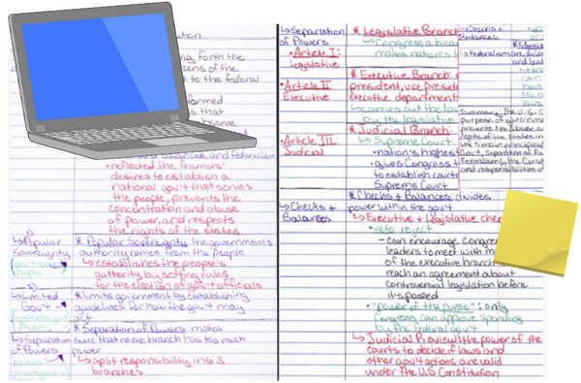
Recording what you learn
How can I organize what I've learned so that I can remember it?
Notes:
Teaching notes
Suggested Pacing: 2 minutes
Directions:
Say, "Imagine that all the facts we gather as we research are like blocks. If we just throw them all together without organizing them, we will not be able to find the information we need later."
Explain that to help you organize your thinking, you need to take notes and organize them into groups that make sense.
For example, you could organize all your information about MLK's tactics into one group, and all of Malcolm X's tactics into another group like we did in the handout during the lesson. Then, as you continue researching you would add information to each group.

Slide 15
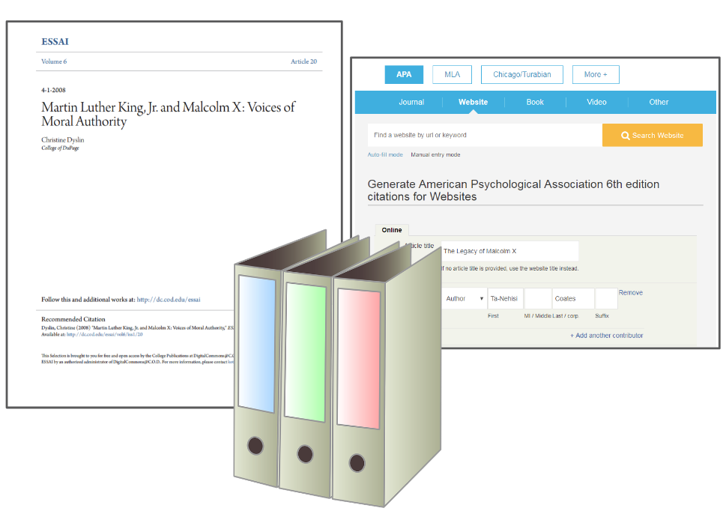
Recording what you learn
Notes:
Teaching notes
Suggested Pacing: 3 minutes
Directions:
Note that as we research, we will likely discover new groups of information to add to our notes - such as another tactic that a different African American leader used to protest discrimination.
Remind students that they will also want to keep track of where they obtain information, so they can go back later to find more information and/or cite their sources in their bibliography.
Explain that this is just the start of the process of research. Real research would require students to spend more time looking at more sources, recording more information, and doing a more in-depth analysis of what they learn.

