Slide 1
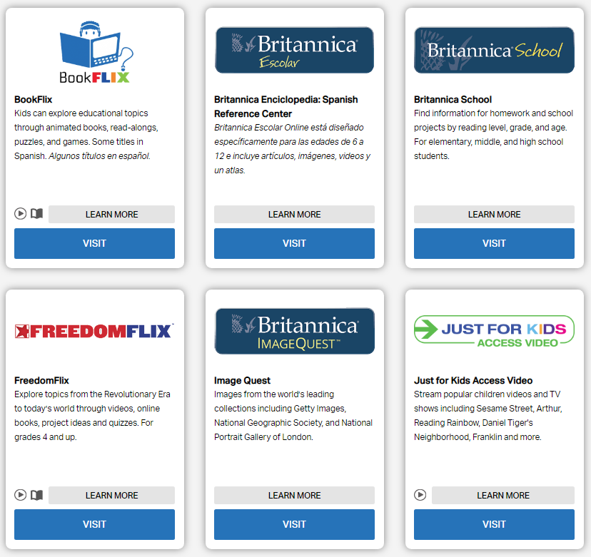
Choosing the Right Resources
How to Use Library: Elementary, Lesson 8
Notes:
About this lesson
In this lesson, students will learn how to use three of the student-friendly resources on the DCPL website. It references items and research topics from the 3rd-grade inquiry arc, Who Changes D.C.?
Materials:
Summarizing Information (handout)
Summarizing Information (model)
What Information to List
Suggested Topics List
ELA Standards:
W.5.8: Recall relevant information from experiences or gather relevant information from print and digital sources; summarize or paraphrase information in notes and finished work, and provide a list of sources.
W.5.9: Draw evidence from literary or informational texts to support analysis, reflection, and research.
W.5.7: Conduct short research projects that use several sources to build knowledge through investigation of different aspects of a topic.
W.4.8: Recall relevant information from experiences or gather relevant information from print and digital sources; take notes and categorize information, and provide a list of sources.
W.4.9: Draw evidence from literary or informational texts to support analysis, reflection, and research.
W.4.7: Conduct short research projects that build knowledge through investigation of different aspects of a topic.
W.3.8: Recall information from experiences or gather information from print and digital sources; take brief notes on sources and sort evidence into provided categories.
W.3.7: Conduct short research projects that build knowledge about a topic.
Prepare in Advance:
Have your DC Public Library card number ready to access lesson materials throughout the lesson.
DC Content Power Standards:
3.4.5: Identify and research outstanding statements of moral and civic principles made in Washington, D.C., as well as the leaders who delivered them, that contributed to the struggle to extend equal rights to all Americans (e.g., Lincoln and his second inaugural address, Frederick Douglass and his speech against lynching at the Metropolitan AME Church, Martin Luther King Jr. and his speeches at the Lincoln Memorial in 1957 and 1963, and Rodolfo “Corky” Gonzales at the Poor People’s March).
4.7.7: Explain various reasons why people came to the colonies, including how both whites from Europe and blacks from Africa came to America as indentured servants who were released at the end of their indenture.
5.4.7: Students identify prominent people and movements for social justice in the United Stated including: Frederick Douglass, the Grimke sisters, and William Lloyd Garrison and the abolishment of slavery.
5.14.3: Identify key leaders in the struggle to extend equal rights to all Americans through the decades (e.g., Mary McLeod Bethune, Ella Jo Baker, César Chávez, Frederick Douglass, Rodolfo “Corky” Gonzales, Charles Houston, Martin Luther King Jr., Thurgood Marshall, Carlos Montes, Baker Motley, Rosa Parks, Malcolm X, Eleanor Roosevelt, and Reies López Tijerina).

Slide 2
Guiding Question
Which resource should I choose?
Notes:
Teaching notes
Suggested Pacing: 1 minute
Directions:
Explain that in this lesson students will learn how to decide which online resource to use depending upon their needs.

Slide 3
Introduction
Research Question: How did Frederick Douglass help to extend equal rights to all Americans?
Which resource should I use?
Notes:
Teaching notes
Suggested Pacing: 2 minutes
Directions:
Distribute devices for each student to have access to the DC Public Library research database. If there are not enough devices for each student, then students may work in small groups, but each student will be working to take their own notes.
Make sure students have access to a DC Public Library card in order to log in to DCPL.
Pass out a Summarizing Information handout to each student.
Tell students that today they will be working to use all of their research skills to become an expert on a topic: How did Frederick Douglass help extend equal rights to all Americans?.
Remind students that they already have learned the DCPL has many databases, but not all of them will have relevant information to a specific topic. Many of these databases are made for adults or high school students. Others contain information that is not about the topics students may be researching.
Today, they will learn to use three student-friendly resources to conduct research:
Britannica School
Just for Kids: Access Video
elibrary
Student Look-Fors:
Students understand that the DCPL website hosts many databases, not all of which are relevant to students' needs.
Attribution:
"goDigital" DC Public Library. Sept. 23, 2018.

Slide 4
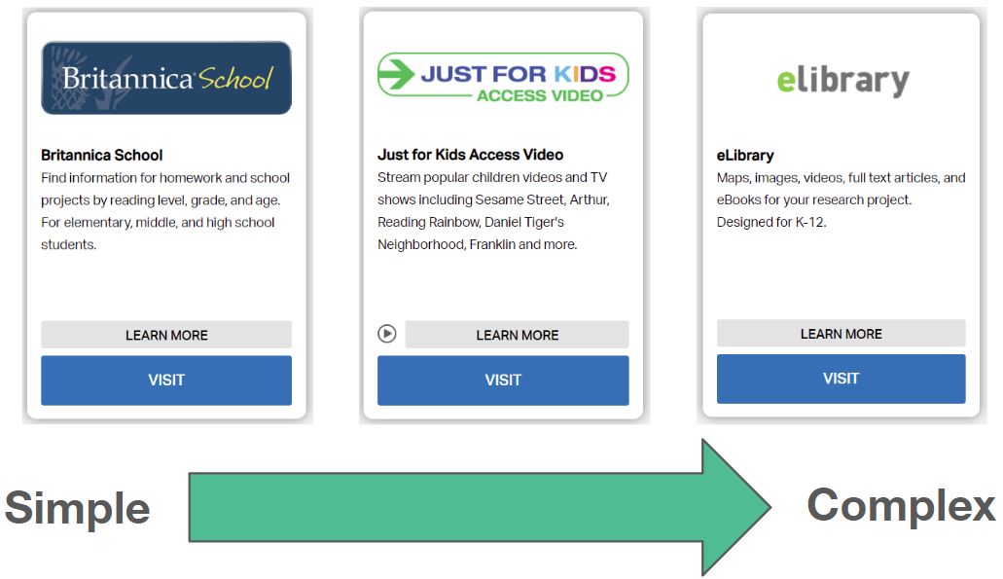
Simple to Complex
Notes:
Teaching notes
Suggested Pacing: 1 minute
Directions:
Explain that when researching a topic, students should look at multiple sources. To do this, it is a good idea to start with something simple and then move to a source that is more complex.
Britannica School will provide a general overview of most topics.
Just for Kids: Access Video provides video clips and documentaries on most topics that will provide more information.
Elibrary will give students more detailed information about a topic with maps, images, videos, articles, and even ebooks.
Student Look-Fors:
Students know that they can use Britannica School, Just for Kids, and elibrary to research most topics.
Students understand what type of information each database will provide.
Attribution:
"goDigital" DC Public Library. Sept. 23, 2018.

Slide 5
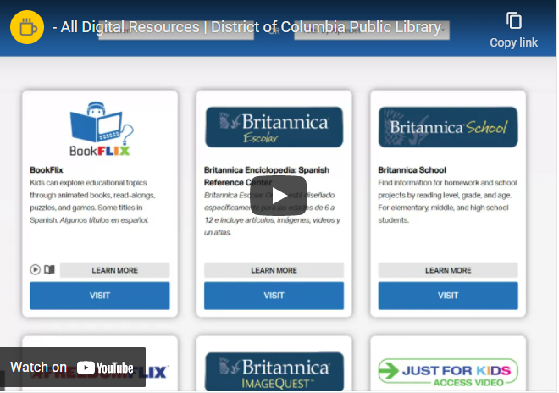
Filter by Subject
Notes:
Teaching notes
Suggested Pacing: 1 minute
Directions:
Instruct students to visit the DCPL website: www.dclibrary.org, and navigate to the research database page (as in Lesson 7).
Once there, watch the video and have students navigate to the research databases by hovering over the "Research" tab at the top of the page and selecting "Databases."
Play video and monitor students as they navigate to the correct page. Click on "View the original page" to view the video in full screen.
Student Look-Fors:
Students use the "Filter by Subject" drop-down menu to navigate to the "Children" page.

Slide 6
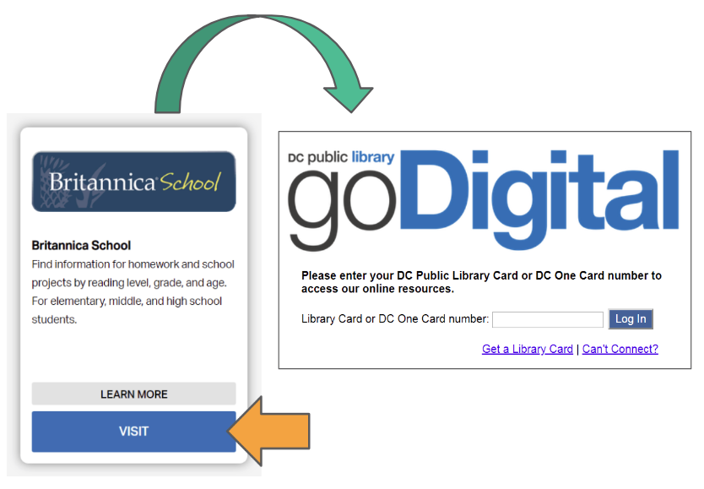
Britannica School
Notes:
Teaching notes
Suggested Pacing: 2 minutes
Directions:
Instruct students to find the Britannica School database and select it by clicking on the blue "VISIT" button.
If needed, help students scroll down the page to find the Britannica School database or model how to navigate to this database for students.
Remind students that they will need to have to enter their DC Public Library card number to access the database.
Student Look-Fors:
Students find the Britannica School database, and successfully log in using their DC Public Library cards.
Attribution:
"goDigital" DC Public Library. Sept. 23, 2018.

Slide 7
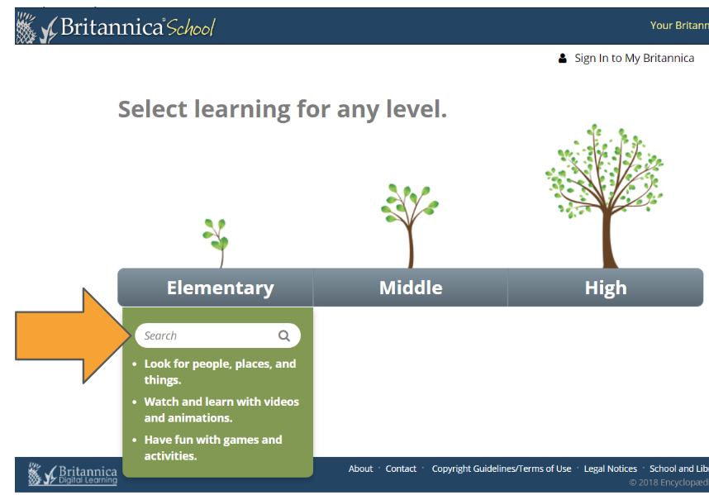
Britannica School
Notes:
Teaching notes
Suggested Pacing: 5 minutes
Directions:
Inform students that to use this resource, students can click on the white "Search" bar under "Elementary". Then, they can use keywords to search for more information about a topic.
Note that in Britannica, when searching for people, they should start with the last name, then a comma, then the first name. For example, to search for Frederick Douglass students would type: Douglass, Frederick.
Allow students five minutes to research and take notes using Britannica School on a person, place or topic related to the research question, "How did Frederick Douglass help extend equal rights to all Americans?".
Remind students to be sure to record the source of any information used in the "Source Information" box, and take notes in the "Notes" section of their Summarizing Information handouts.
Allow students to work, circulating throughout the class and assisting as needed.
Student Look-Fors:
Students successfully use Britannica School to search for relevant information.
Students record source information on Summarizing Information handout.
Students jot notes related to the research question on Summarizing Information handout.
Attribution:
"Britannica School." Britannica. Accessed on Sept. 25, 2018.

Slide 8
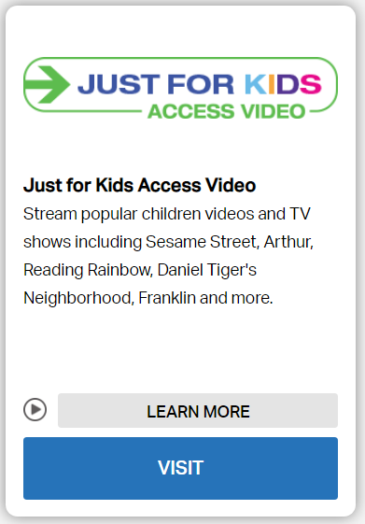
Just for Kids: Access Video
Notes:
Teaching notes
Suggested Pacing: 1 minute
Directions:
Instruct students to close the "Britannica School" tab and return to the DC Public Library research page.
Explain that the next database source they will use is Just for Kids: Access Video.
Instruct students to scroll down the page to find the Just for Kids: Access Video; select it by clicking on the blue "VISIT" button.
If needed, help students scroll down the page and click on the blue "VISIT" button. Note that students may not be prompted to enter their DC Public Library number again, since they already entered in with Britannica School.
Student Look-Fors:
Students successfully navigate to Just for Kids: Access Video.
Attribution:
"goDigital" DC Public Library. Sept. 23, 2018.

Slide 9
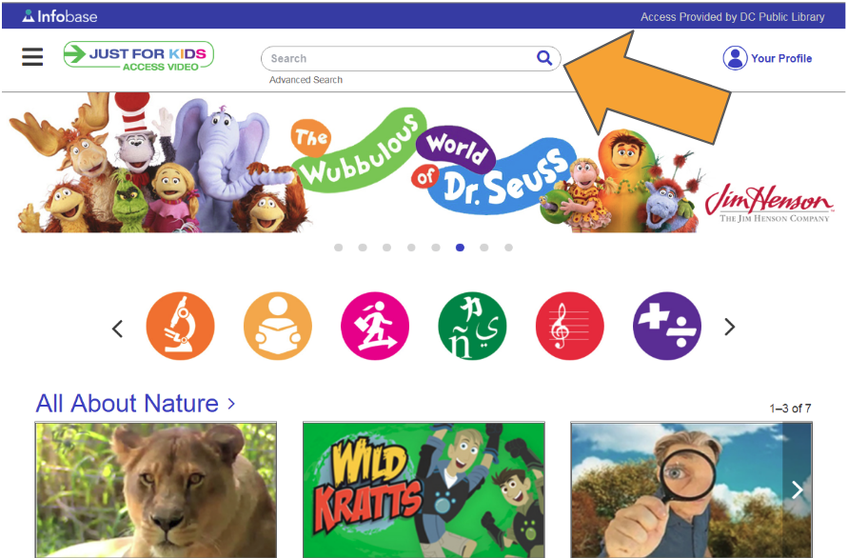
Just for Kids: Access Video
Notes:
Teaching notes
Suggested Pacing: 5 minutes
Directions:
Demonstrate to students that in this resource, the search box is located at the top of the page.
To search, simply type in the name or keywords that relate to your research topic.
Allow students five minutes to research and take notes related to the research question, "How did Frederick Douglass help extend equal rights to all Americans?" on Just for Kids: Access Video.
Remind students to be sure to record the source of any information used in the "Source Information" box, and take notes in the "Notes" section of their Summarizing Information handouts.
Allow students to work, circulating throughout the class and assisting as needed.
Student Look-Fors:
Students successfully use Just for Kids: Access Video to search for relevant information.
Students record source information on Summarizing Information handout.
Students jot notes related to the research question on Summarizing Information handout.
Attribution:
"Just for Kids: Access Video." Infobase. Accessed Sept. 25, 2018.

Slide 10
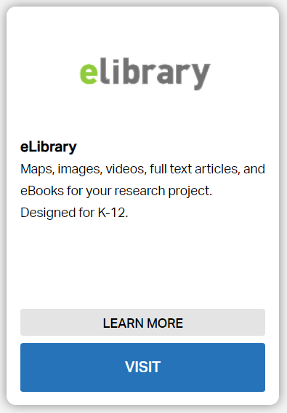
Elibrary
Notes:
Teaching notes
Suggested Pacing: 1 minute
Directions:
Instruct students to close the "Just for Kids: Access Video" tab and return to the DC Public Library research page.
Explain that the next database source they will use is elibrary.
Once on the DC Public Library research page, inform students that they will next use the "Filter by Alphabet" search box, rather than the "Children" filter box. This search box is to the right of the "Children" search box.
Attribution:
"goDigital" DC Public Library. Sept. 23, 2018.

Slide 11
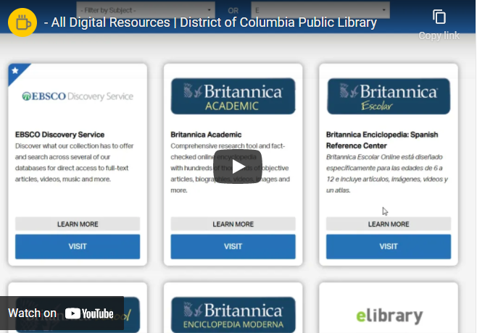
Elibrary
Notes:
Teaching notes
Suggested Pacing: 1 minute
Directions:
Inform students to watch the video demonstrating how to use the "Filter by Alphabet" drop-down menu to select "E" to filter for elibrary. Click on "View the original page" to view the video in full screen.
Direct students to use this method to find and access elibrary. Circulate through the class as needed to assist students.
Student Look-Fors:
Students to select the letter "E" from the "Filter by Alphabet" drop-down menu.
Students scroll down the page, find the elibrary database and select it by clicking on the blue "VISIT" button.
Attribution:
- All Digital Resources l District of Columbia Public Library

Slide 12
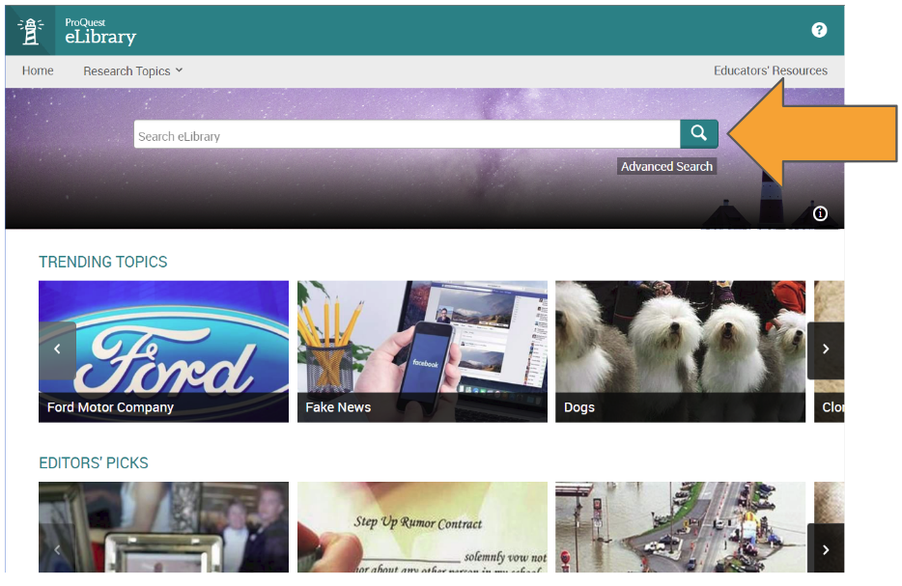
Elibrary
Notes:
Teaching notes
Suggested Pacing: 5 minutes
Directions:
Inform students that once in the database elibrary, to note that the search box in this resource is also located at the top of the page.
Allow students five minutes to research and take notes using elibrary on the research question, "How did Frederick Douglass help extend equal rights to all Americans?"
Remind them to make sure to record the source of information used in the "Source Information" box, and take notes in the "Notes" section of their Summarizing Information handouts.
Allow students to work, circulating throughout the class and assisting as needed.
Student Look-Fors:
Students successfully use elibrary to search for relevant information.
Students record source information on Summarizing Information handout.
Students jot notes related to the research question on Summarizing Information handout.
Attribution:
"Elibrary." ProQuest. Accessed Sept. 25, 2018.

Slide 13
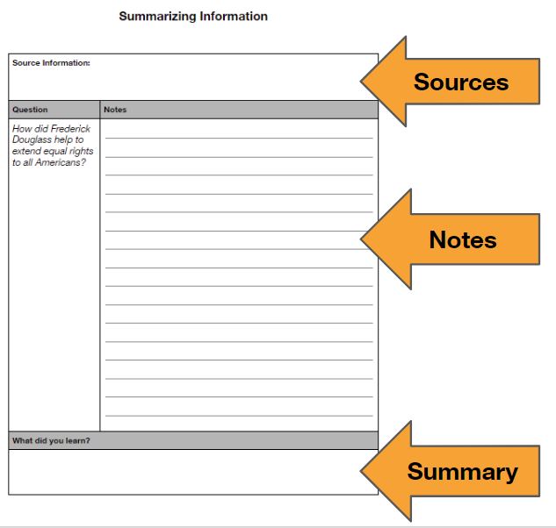
Express Your Understanding
Notes:
Teaching notes
Suggested Pacing: 2 minutes
Directions:
Inform students they now should have recorded information from three different databases on the research question, "How did Frederick Douglass help extend equal rights to all Americans?".
Allow students to finish up completing Summarizing Information handouts.
Collect Summarizing Information handouts to use as a formative assessment of research skills.
Student Look-Fors:
Students use Britannica School, Just for Kids: Access Video, and elibrary to take notes and summarize what they learned about the research question, "How did Frederick Douglass help extend equal rights to all Americans?".
Summarizing Information handouts will have recorded three different database sources, notes and summary statement from each database visited.

