Slide 1
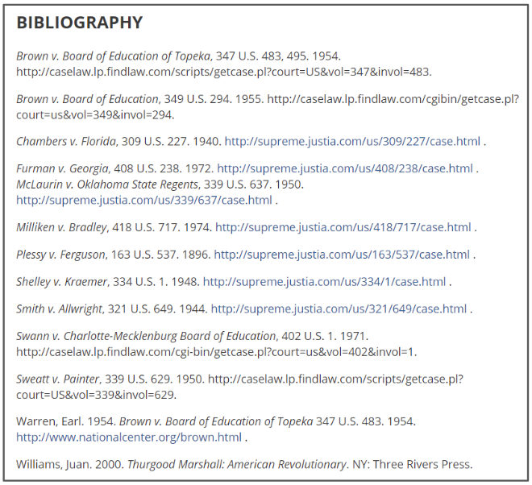
Listing sources of information
How to Use the Library: Elementary, Lesson 6
Notes:
About this lesson
In this lesson, students will learn why it is important to record sources in research. Next, they will learn how to list their sources using the Summarizing Information handout.
Materials:
Summarizing Information (model)
Summarizing Information (handout)
What information to list (anchor chart)
Suggested Topics List
ELA Standards:
W.3.8: Recall information from experiences or gather information from print and digital sources; take brief notes on sources and sort evidence into provided categories.
W.5.8: Recall relevant information from experiences or gather relevant information from print and digital sources; summarize or paraphrase information in notes and finished work, and provide a list of sources.
W.4.8: Recall relevant information from experiences or gather relevant information from print and digital sources; take notes and categorize information, and provide a list of sources.
Prepare in Advance:
Have your DC Public Library card number ready to access lesson materials throughout the lesson.
List of grade-appropriate research questions that align with what you are currently studying in class or the Suggested Research Topics list.
The larger version of the Summarizing Information handout used to model in Lesson 5.
DC Content Power Standards (3):
3.DC.4.4 - Explain how Washington, D.C., was selected and named as our capital city.
3.DC.4.5 - Identify and research outstanding statements of moral and civic principles made in Washington, DC, as well as the leaders who delivered them, that contributed to the struggle to extend equal rights to all Americans (e.g., Lincoln and his second inaugural address, Frederick Douglass and his speech against lynching at the Metropolitan AME Church, Martin Luther King Jr. and his speeches at the Lincoln Memorial in 1957 and 1963, and Rodolfo “Corky” Gonzales at the Poor People’s March).
DC Content Power Standards (4):
4.DC.6.6 - Identify the influence and achievements of significant leaders of the time (e.g., John Marshall, Andrew Jackson, Chief Tecumseh, Chief Logan, Chief John Ross, and Sequoyah).
4.DC.8.2 - Explain how political, religious, and economic ideas and interests brought about the Revolution (e.g., resistance to imperial policy, the Stamp Act, the Townshend Acts, taxes on tea, and Coercive Acts).
DC Content Power Standards (5):
5.DC.5.1 - Describe the extension of and controversy about slavery into the territories, including popular sovereignty, the Dred Scott decision, and the Kansas-Nebraska Act.
C3 Framework Indicators and Common Core Standards for Literacy in History/Social Studies:
D2.His.9.3-5. Summarize how different kinds of historical sources are used to explain events in the past.

Slide 2
Guiding Question
Why do I need to record sources of information?
Notes:
Teaching notes
Suggested Pacing: 1 minute
Directions:
Explain that in this lesson students will learn how to record the sources of information they use in their research and why this is important.

Slide 3
Introduction
Why is it important to list my sources?
Find true and relevant information.
Use information from different sources to build understanding.
Take notes to remember what is being learned.
Notes:
Teaching notes
Suggested Pacing: 2 minutes
Directions:
Explain that a source is any place or resource from which students obtain information.
Reference the To Research. . . anchor chart from Lesson 1 to review what research looks like.
Remind students that one question they should ask about the credibility of a source is, "Where did this source come from?"
Explain that students are doing research for a purpose or goal - whether that is to write a paper, plan an activity, or to create some other type of project to present to others. Students need to show their audience that they obtained this information from reliable sources.
Student Look-fors:
Students understand that citing sources informs the audience where information comes from.

Slide 4
Introduction
This list names the sources where I obtained my information.
Notes:
Teaching notes
Suggested Pacing: 2 minutes
Directions:
Explain that when professional researchers such as scientists, historians, or authors publish their research, they include a detailed list of sources sometimes called a bibliography. This list shows the audience that true and relevant information was used. It also lets the audience check the research by going to the listed sources to fact check.
Note that sometimes this list is also called a "works cited" or even "attributions".
To illustrate, click on "Exit full screen" at the top of the page and show students these teaching notes by scrolling down to the "Attributions" section.
Attribution:
"Marshall, Thurgood." Global Issues in Context. Gale. Sept. 16, 2018.

Slide 5


What Information to List
Notes:
Teaching notes
Suggested Pacing: 3 minutes
Directions:
If needed, create a What Information to List anchor chart to reference throughout the lesson.
Explain that to list sources, students need to look for the title name and, depending on the source, the source name.
Explain that the "title" is the name of the specific video, article, web page, or book.
Explain that the "source" is the name of website, magazine, or text that is being used.
For example, to cite a book you can simply use the title. In this case, "All About Inventions and Discoveries". This is both the title and the source.
To cite an article from a magazine, you would first cite the title, "Lincoln" and then the source that the article came from, "National Geographic".
Explain that when citing a website, students will use the same method used for citing a magazine. First cite the article or web page name, then cite what website it came from.
Student Look-Fors:
Students understand that listing a source means writing down the title of the specific source being used as well as the name of where that source came from.
Attributions:
Wireless telegraphy at sea: Wireless officer sending a message by Morse Code. Britannica ImageQuest, Encyclopædia Britannica. Accessed 22 Sep 2018.
"National Geographic." National Geographic Magazine. Accessed Sept. 22, 2018.

Slide 6
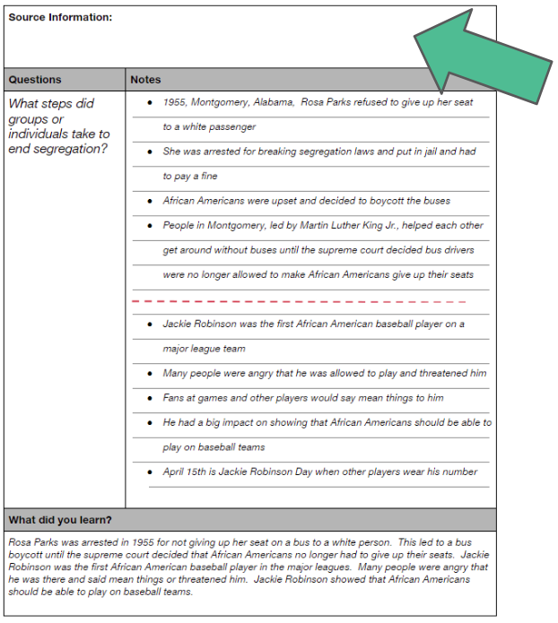
How to list sources
How can I list my sources?
Notes:
Teaching notes
Suggested Pacing: 1 minutes
Directions:
Point out that this is a copy of the notes sheet that students worked on in Lesson 5. One section is still not complete, the "Source Information" box at the top of the page.
Explain that in Lesson 5, students took notes from two different sources to answer a research question, and then summarized what they had learned. The last step is to list where that information was obtained.

Slide 7
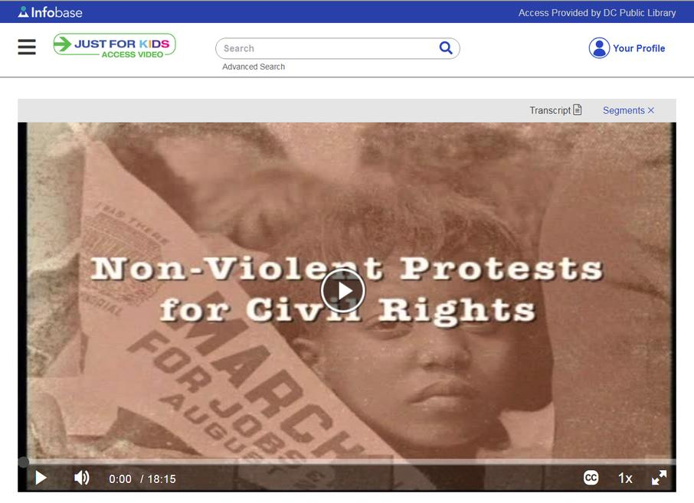
Finding the right information
Notes:
Teaching notes
Suggested Pacing: 2 minutes
Directions:
Explain that this is the first source that was used in the previous lesson (Lesson 5). Point out the source is a video.
Inform students that the title and source for each resource needs to be added to the "Source Information" list in the Summarizing Information handout.
Explain that the "title" is the name of the specific video, article, web page, or book.
Draw student attention to the title in the center of the image. Model locating the source title, "Non-Violent Protests for Civil Rights," and record it at the top of the handout (see example)
Explain that the "source" is the name of the website, magazine, or text that is being used.
Draw student attention to the source name, "Just for Kids: Access Video" located in the upper left-hand corner of the image. Model locating the source and record it in the "Source Information" box at the top of the Summarizing Information handout (see example), after the title.
Refer to What Information to List anchor chart as needed.
Student Look-Fors:
Students understand that listing a source means writing down the title of the specific source being used as well as the name of where that source came from.
Attribution:
"Civil Rights Movements and Protests." Just for Kids: Access Video, Access Video. Sept. 14, 2018.

Slide 8
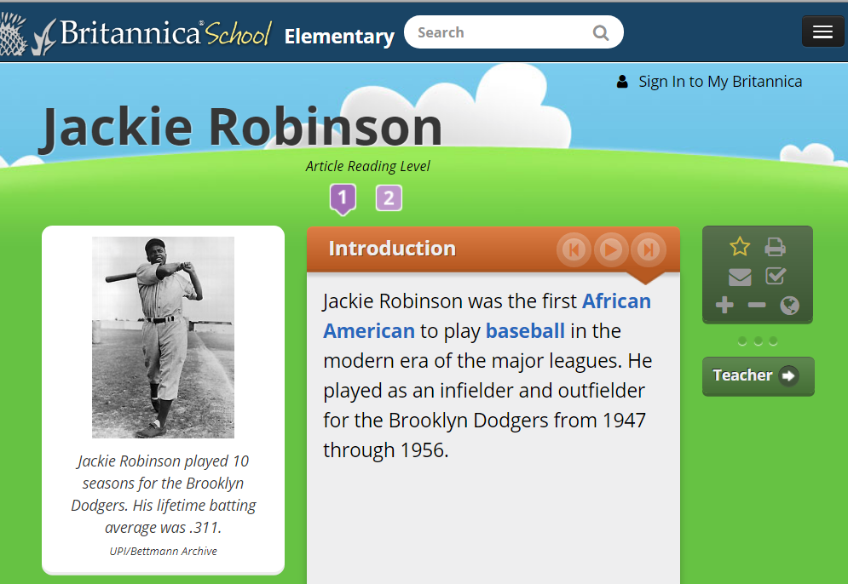
Finding the right information
Notes:
Teaching notes
Suggested Pacing: 3 minutes
Directions:
Use established classroom routine to divide class into small groups of 2-3.
Explain that this is another source used in Lesson 5.
Ask, "What is the title we should list for this source?
Allow students to turn and talk about the title.
Model locating the title, "Jackie Robinson" and writing it in the "Source Information" box of the Summarizing Information handout.
Ask, "What is the name of this source?
Allow students to turn and talk about the name of the source.
Model adding this information to the "Source Information" box at the top of the Summarizing Information handout by first writing the title, followed by the source name (see example).
Refer to What Information to List anchor chart as needed.
Student Look-Fors:
Students understand that listing a source means writing down the title of the specific source being used as well as the name of where that source came from.
Attribution:
"Robinson, Jackie" Britannica School, Encyclopædia Britannica, 14 Sep. 2018.

Slide 9
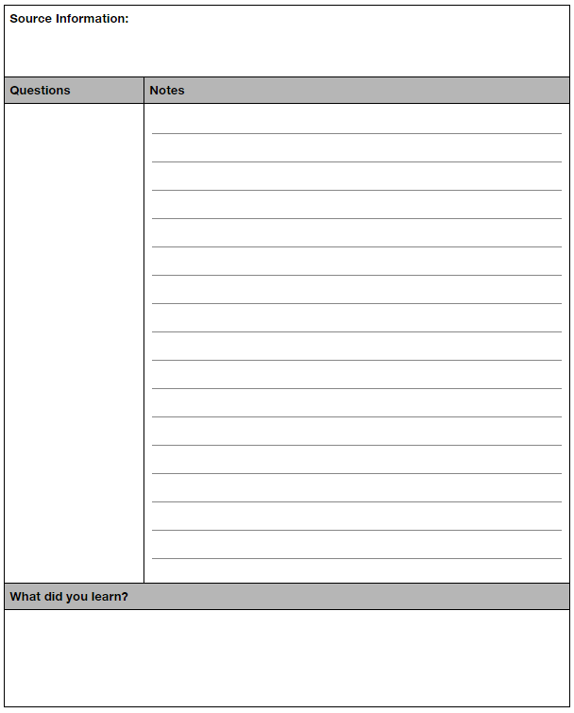
Express Your Understanding
Write research question
Jot notes
Summarize what was learned
List source
Notes:
Teaching notes
Suggested Pacing: 10 minutes
Directions:
Students will work independently to complete the steps and research a topic using at least one source. Sources can be print or, if devices are available, online.
Display the What Information to List anchor chart for students to use as a reference.
Display a list of grade-appropriate research questions that align with current class study. Refer to a Suggested Research Questions list in the Additional Materials, if needed.
Explain to students that they will be working on a research question of their own or from a provided class list.
Distribute Summarizing Information handout to each student. Students will write research questions, jot notes, summarize what was learned, and list sources on the handout.
Refer back to What Information to List anchor chart to remind students about what information to look for when listing sources.
Collect Summarizing Information handouts for a formative assessment.
Student Look-Fors:
Students write a research question in "Questions" section.
Students jot notes in "Notes" section.
Students summarize what they learn in their own words in the "What did you learn?" section.
Students list a source they used in the "Source Information" section.

