Slide 1
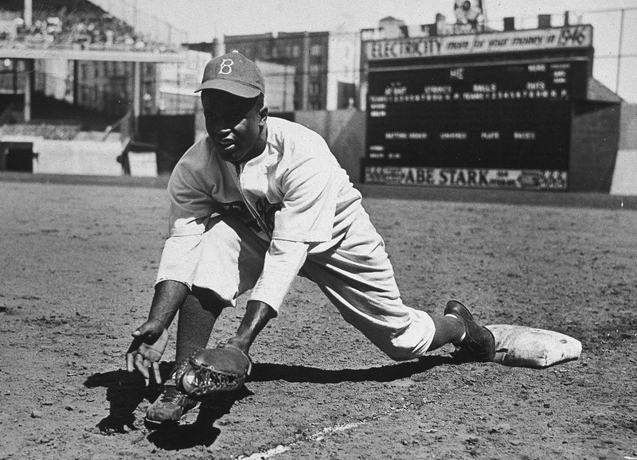
Organizing information from different sources
How to Use the Library: Elementary, Lesson 5
Notes:
About this lesson
In this lesson, students will learn how to take notes from multiple sources in order to answer a research question, then summarize those notes in their own words. It references items and research topics from the 5th-grade inquiry arc, What is the best way to promote change? Students will just be gathering material from multiple sources in this lesson, not citing sources. Citing sources is the focus of the next lesson.
Materials:
Summarizing Information (model)
Summarizing Information (handout)
NAACP (handout)
ELA Standards:
W.5.8: Recall relevant information from experiences or gather relevant information from print and digital sources; summarize or paraphrase information in notes and finished work, and provide a list of sources.
W.5.9: Draw evidence from literary or informational texts to support analysis, reflection, and research.
W.5.7: Conduct short research projects that use several sources to build knowledge through investigation of different aspects of a topic.
W.4.8: Recall relevant information from experiences or gather relevant information from print and digital sources; take notes and categorize information, and provide a list of sources.
W.3.10: Write routinely over extended time frames (time for research, reflection, and revision) and shorter time frames (a single sitting or a day or two) for a range of discipline-specific tasks, purposes, and audiences.
W.4.9: Draw evidence from literary or informational texts to support analysis, reflection, and research.
W.4.7: Conduct short research projects that build knowledge through investigation of different aspects of a topic.
W.3.8: Recall information from experiences or gather information from print and digital sources; take brief notes on sources and sort evidence into provided categories.
W.3.7: Conduct short research projects that build knowledge about a topic.
W.5.10: Write routinely over extended time frames (time for research, reflection, and revision) and shorter time frames (a single sitting or a day or two) for a range of discipline-specific tasks, purposes, and audiences.
W.4.10: Write routinely over extended time frames (time for research, reflection, and revision) and shorter time frames (a single sitting or a day or two) for a range of discipline-specific tasks, purposes, and audiences.
Prepare in Advance:
Have your DC Public Library card number ready to access lesson materials throughout the lesson.
DC Content Power Standards:
5.14.3 - Identify key leaders in the struggle to extend equal rights to all Americans through the decades (e.g., Mary McLeod Bethune, Ella Jo Baker, César Chávez, Frederick Douglass, Rodolfo “Corky” Gonzales, Charles Houston, Martin Luther King Jr., Thurgood Marshall, Carlos Montes, Baker Motley, Rosa Parks, Malcolm X, Eleanor Roosevelt, and Reies López Tijerina).
5.14.4 - List and describe the steps toward desegregation (e.g., A. Philip Randolph’s proposed 1941 March on Washington, Jackie Robinson and baseball, Truman and the Armed Forces, Adam Clayton Powell and Congress, and the integration of public schools
C3 Framework Indicators and Common Core Standards for Literacy in History/Social Studies:
D2.His.9.3-5. Summarize how different kinds of historical sources are used to explain events in the past.

Slide 2
Guiding Question
How can I organize information from different sources?
Notes:
Teaching notes
Suggested Pacing: 1 minute
Directions:
Explain that in this lesson, students will learn to organize information from different sources.
Attribution:
Previous slide - Image: "Jackie Robinson" Britannica ImageQuest. Britannica. Sept. 16, 2018.

Slide 3
Let's Review
Writing down the main ideas and details in your own words.
Using short phrases and keywords.
Breaking down big ideas into the most important parts.
Notes:
Teaching notes
Suggested Pacing: 1 minute
Directions:
Remind students that when to take notes they need to summarize information which means:
Writing down the main ideas and details in your own words.
Using short phrases and keywords.
Breaking down big ideas into the most important parts.

Slide 4
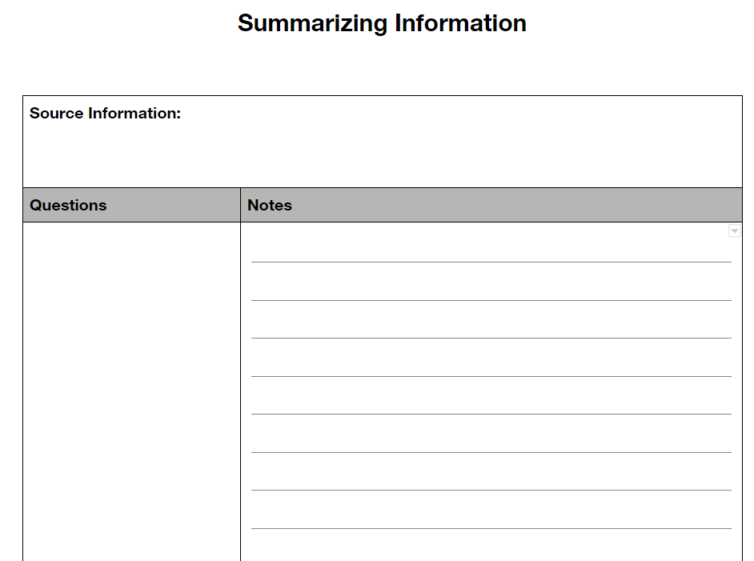
Introduction
How do I organize my notes?
Notes:
Teaching notes
Suggested Pacing: 1 minute
Directions:
Explain that researching means taking a lot of notes. These notes need to be organized in order to help remember what is being learned.
Say, "In previous lessons, you have prepared to begin research by generating research questions and keywords about the topic of desegregation. Today we will practice answering a research question in our notes by looking at different sources."
Use established classroom routine to divide class into small groups of 2-3 and distribute Summarizing Information Notes Sheet.
Create a larger version of the handout on the board or create a teacher-made anchor chart. You will use this to model summarizing throughout the lesson.
Additional Note:
The focus of this lesson is to gather material from multiple sources. Citing sources will not be taught in this lesson, but in the next lesson.

Slide 5
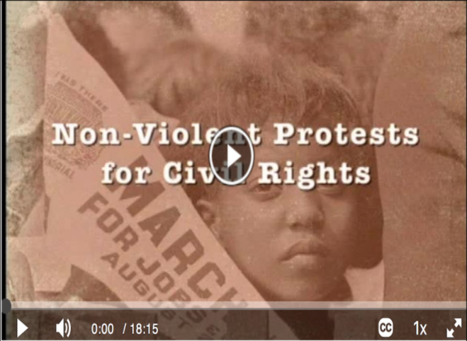
Civil Rights Movements and Protests
Notes:
Teaching notes
Suggested Pacing: 6 minutes
Directions:
Explain that the research question has already been written on student's notes sheets: "What steps did groups or individuals take to end segregation?"
Video link "Civil Rights Movements and Protests." Just for Kids: Access Video, Access Video. Sept. 14, 2018..
Tell students that they will be working with their groups to summarize information from the video to answer the research question.
If needed, refer back to the What is a Summary? anchor chart from Lesson 4 to review.
Watch the video and give groups time to talk and write in the "Notes" sections of their handouts.
Call on groups to share out summaries and model adding these to the class chart (see example).
Student Look-Fors:
In 1955, Montgomery, Alabama, Rosa Parks refused to give up her seat to a white passenger.
Parks was arrested for breaking segregation laws and put in jail and had to pay a fine.
African Americans were upset and decided to boycott the buses.
People in Montgomery, led by Martin Luther King Jr., helped each other get around without buses until the Supreme Court decided bus drivers were no longer allowed to make African Americans give up their seats.
Attribution:
Linked video: "Civil Rights Movements and Protests." Just for Kids: Access Video, Access Video. Sept. 14, 2018.

Slide 6
Jackie Robinson
Notes:
Teaching notes
Suggested Pacing: 4 minutes
Directions:
Explain that, while the information gathered so far is valuable, there is more work to be done to answer the research question, "What steps did groups or individuals take to end segregation?"
Video link: "Robinson, Jackie" Britannica School, Encyclopædia Britannica, 14 Sep. 2018.
If prompted, enter your DC Public Library card number to view the video.
Click on the "View the original page" link at the bottom of the page to see a full-screen version of the video.
Model drawing a line across the bottom of the notes for the Montgomery Bus Boycott (see example).
Explain that each group will work to jot notes form this video about what steps groups or individuals took to end segregation.
Watch the video and give students time to discuss with their groups and work on taking notes.
Model adding notes to Summarizing Information handout (see example).
Student Look-Fors:
Jackie Robinson was the first African American baseball player on a major league team.
Many people were angry that he was allowed to play and threatened him.
Fans at games and other players would say mean things to him.
He had a big impact on showing that African Americans should be able to play on baseball teams.
April 15th is Jackie Robinson Day when other players wear his number.
Attribution:
"Robinson, Jackie" Britannica School, Encyclopædia Britannica, 14 Sep. 2018.

Slide 7
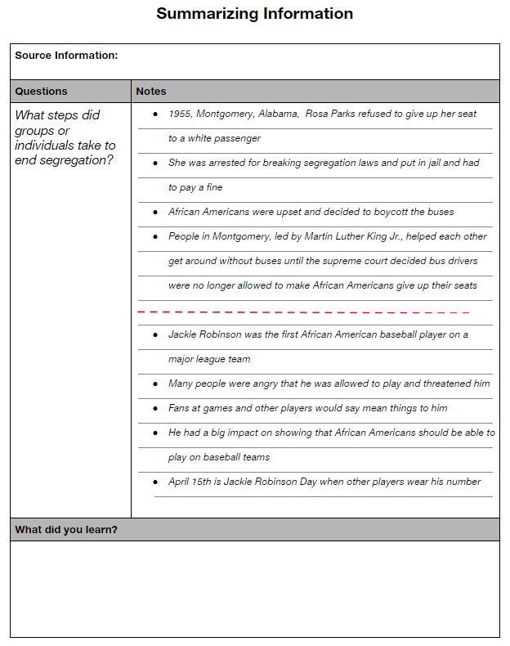
What did you learn?
How can I summarize what I've learned?
Notes:
Teaching notes
Suggested Pacing: 3 minutes
Directions:
Explain that once information is gathered from multiple sources, students should stop and think about what they have learned.
Point out the "What did you learn?" section at the bottom of the handout.
Explain that this is where students should write a short summary of their notes.
If needed, use the What is a Summary? chart from Lesson 4 to review.
Model writing a short summary with class (see example).
Point out that this does not mean copying notes into sentences. Instead, it means picking out the big ideas that are most important and writing them in your own words.
Students are not expected to list sources, that will be addressed in the following lesson.
Student Look-Fors:
Students understand how to summarize notes in their own words.
Additional Note:
The focus of this lesson is to gather material from multiple sources. Citing sources will not be taught in this lesson, but in the next lesson.

Slide 8
Express Your Understanding (Part 1)
Notes:
Teaching notes
Suggested Pacing: 3 minutes
Directions:
Distribute another blank copy of the Summarizing Information handout.
Explain that students will work independently to summarize information in order to further answer the research question: "What steps did groups or individuals take to end segregation?"
Video link: "CIVIL RIGHTS: President Truman Addresses NAACP." Elibrary. Accessed Sept. 27, 2018.
If prompted, enter your DC public library card number.
Scroll down the page to view the video or click on the "View the original page" link to see a full-screen version.
Repeat as needed and give students time to read the caption, watch the video several times and jot their notes on their handouts.
Students are not expected to list sources, that will be addressed in the following lesson.
Click to the next slide once students are finished.
Student Look-Fors:
President Truman stated all Americans should enjoy equal rights.
Truman promised to remove any remaining barriers preventing equal rights to citizens.
Truman declared there should be no discrimination based on ancestry, religion, race or color.
Attribution:
"CIVIL RIGHTS: President Truman Addresses NAACP." Elibrary. Accessed Sept. 27, 2018.

Slide 9
Express Your Understanding (Part 2)
Notes:
Teaching notes
Suggested Pacing: 5 minutes
Directions:
If needed, distribute NAACP handout for students to read.
Depending on student's needs and grade level, either read aloud to students as they follow along or have students read independently.
Tell students to use this article in order to add more information to answer the research question, "What steps did groups or individuals take to end segregation?" When students are done, they will write a few sentences in their own words to summarize what they learned in the "What did you learn?" section of the handout.
Collect handouts as a formative assessment.
Students are not expected to list sources, that will be addressed in the following lesson.
Student Look-Fors:
Martin Luther King Jr. was arrested many times for protesting unfair laws.
He believed that African Americans should be treated equally.
Martin Luther King Jr. gave many speeches about equal rights.
He wanted his followers to be non-violent, even if they were attacked.
The NAACP was made to help African Americans get equal rights.
The NAACP asked congress to pass laws to make sure everyone was treated equally.
In 1954 the NAACP won the case that made it legal for African Americans to go to schools that had been only for white people.
It helped organize demonstrations and asked Congress to pass laws that would help everyone be equal.
Attribution:
Article: "National Association for the Advancement of Colored People (NAACP)" Britannica School. Britannica. Sept. 15, 2018.

