Slide 1
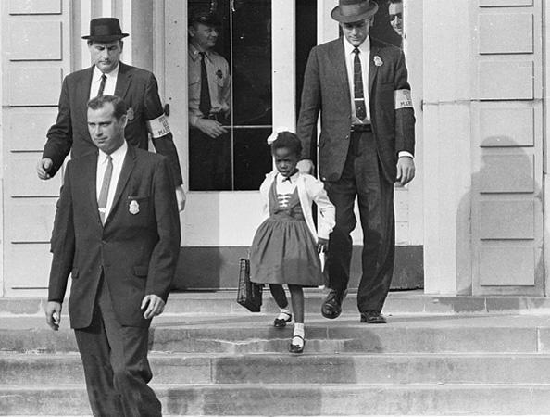
Taking notes to summarize information
How to Use the Library: Elementary, Lesson 4
Notes:
About this lesson
This lessons teaches students to take notes by summarizing information in their own words, explaining what students do first to get ready to research. It references items and research topics from the 5th-grade inquiry arc, What is the best way to promote change?
Materials:
Summarizing Information (handout)
Summarizing Information (model)
What is a Summary (anchor chart)
Ruby Bridges (handout)
ELA Standards:
W.5.8: Recall relevant information from experiences or gather relevant information from print and digital sources; summarize or paraphrase information in notes and finished work, and provide a list of sources.
W.4.8: Recall relevant information from experiences or gather relevant information from print and digital sources; take notes and categorize information, and provide a list of sources.
W.3.10: Write routinely over extended time frames (time for research, reflection, and revision) and shorter time frames (a single sitting or a day or two) for a range of discipline-specific tasks, purposes, and audiences.
W.3.8: Recall information from experiences or gather information from print and digital sources; take brief notes on sources and sort evidence into provided categories.
W.5.10: Write routinely over extended time frames (time for research, reflection, and revision) and shorter time frames (a single sitting or a day or two) for a range of discipline-specific tasks, purposes, and audiences.
W.4.10: Write routinely over extended time frames (time for research, reflection, and revision) and shorter time frames (a single sitting or a day or two) for a range of discipline-specific tasks, purposes, and audiences.
Prepare in Advance:
Have your DC Public Library card number ready to access lesson materials throughout the lesson.
DC Content Power Standards:
5.DC.14.4 - List and describe the steps toward desegregation (e.g., A. Philip Randolph’s proposed 1941 March on Washington, Jackie Robinson and baseball, Truman and the Armed Forces, Adam Clayton Powell and Congress, and the integration of public schools).
C3 Framework Indicators and Common Core Standards for Literacy in History/Social Studies:
D2.His.9.3-5. Summarize how different kinds of historical sources are used to explain events in the past.

Slide 2
Guiding Question
How do you summarize what you read?
Notes:
Teaching notes
Suggested Pacing: 1 minute
Directions:
Explain that in this lesson students will learn how to take notes by summarizing information as they research.
Attribution:
Previous Slide - Courtesy of DC Public Library and Gale Biography in Context.

Slide 3
Let's Review
To research. . .
Find true and relevant information.
Use information from different sources to build understanding.
Take notes to remember what is being learned.
Notes:
Teaching notes
Suggested Pacing: 1 minute
Directions:
Review the process of research.
Explain that part of the process of doing research is summarizing what you learn by taking notes.

Slide 4
Introduction
What is a summary?
Writing down the main ideas and details in your own words.
Using short phrases and keywords.
Breaking down big ideas into the most important parts
Notes:
Teaching notes
Suggested Pacing: 2 minutes
Directions:
If needed, create a What is a Summary? anchor chart to refer back to throughout the lesson.
Explain that when you summarize a piece of text, video, or audio, you write down the main ideas and details in your own words using short, key phrases and words. The point of a summary is to break down the big ideas into just the most important parts.
Use established classroom routine to divide class into small groups of 2-3 and distribute Summarizing Information Notes Sheet.
Create a larger version of the handout on the board or create a teacher-made anchor chart. You will use this to model summarizing throughout the lesson.

Slide 5
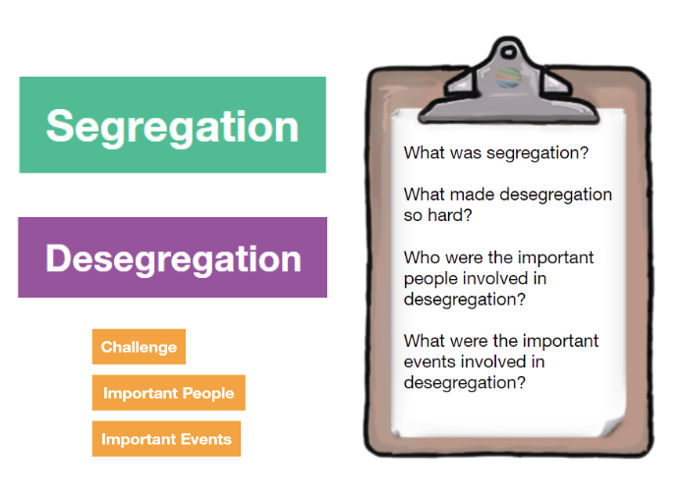
Introduction
Notes:
Teaching notes
Suggested Pacing: 1 minute
Directions:
Say, "In the previous lesson, you prepared to begin research by generating research questions and keywords about the topic of desegregation. Today, we will research to answer some of these questions and summarize the information we find."

Slide 6
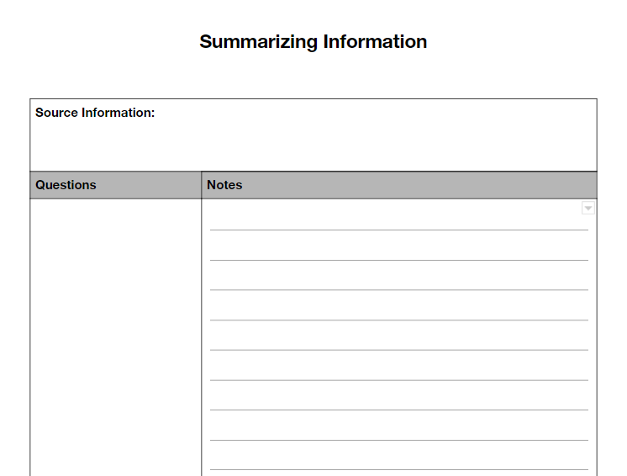
Setting Up
Notes:
Teaching notes
Suggested Pacing: 2 minutes
Directions:
Explain that first, we need to write down a research question from our list. Model jotting the first question, "What was segregation?" in the "Questions" column of the Summarizing Information handout.
Instruct students to copy this into their own handouts
Student Look-Fors:
Students record the question in "Questions" column of their Summarizing Information handouts.

Slide 7

Jim Crow Law
Notes:
Teaching notes
Suggested Pacing: 4 minutes
Directions:
Have your library card ready and enter the number at Login to see the video.
Click "View the original page" link at the bottom of the screen to see a full-screen version.
Explain to students that you are going to answer our research question by taking notes on a video and summarizing.
Watch the video (cited below), then think aloud to break down the key phrases, words, and ideas that help to answer the research question: "What was segregation?"
If needed, refer to the Summarizing Information (Model).
If needed, watch the video again.
Model writing this in your own words while students write a summary in the "Notes" section of their Summarizing Information handouts.
Student Look-Fors:
1896 the supreme court decided segregation was legal, this meant that African Americans could be kept separate from whites.
African Americans and whites had different schools.
1954 Supreme Court changed their minds and decided that schools must let both white and African American students attend
Having separate schools was not equal, or fair
Attribution:
Video embedded: "Jim Crow law." Britannica School, Encyclopædia Britannica, 11 Sep. 2018. Accessed 11 Sep. 2018.

Slide 8
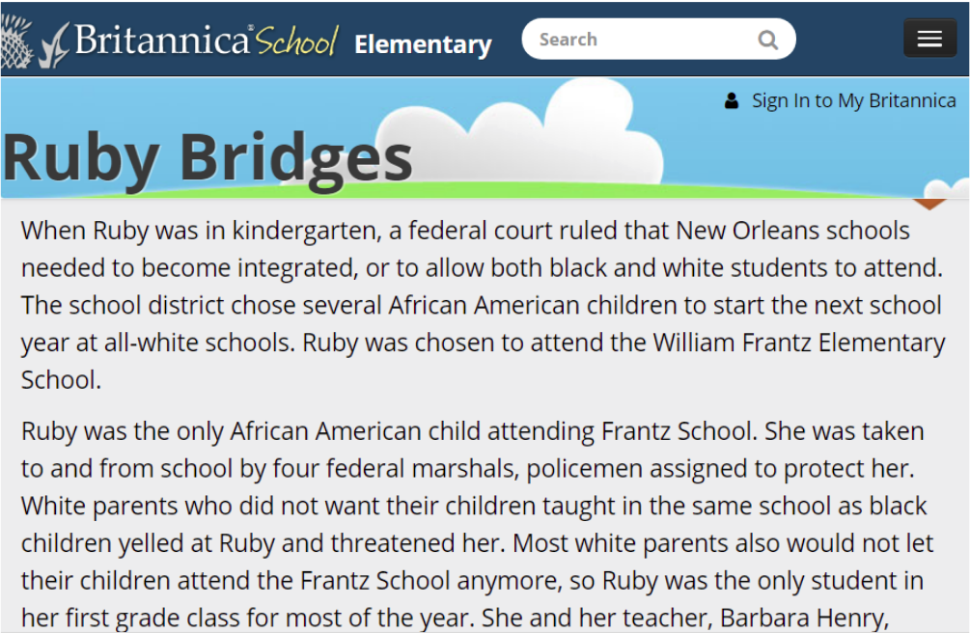
Ruby Bridges
Notes:
Teaching notes
Suggested Pacing: 4 minutes
Directions:
Instruct students to draw a line across their page under their notes or skip a line to show they are moving from one research question to the next.
Model writing the next research question, "What made desegregation so difficult?" below the line in the "Questions" column of the Summarizing Information handout.
If needed, think aloud to infer the meaning of "desegregation" from "segregation."
Explain that students will now practice summarizing together with their group.
Distribute Ruby Bridges text to students.
Direct students to read along as you read the text aloud. Then, students are to work with their groups to jot the key phrases, words, and ideas that help to answer their research question in the "Notes" section of the Summarizing Information handout.
Refer students back to What is a Summary? chart to guide their work.
After allowing groups 2 minutes to work, call on several groups to share out. Use this as an opportunity to highlight examples and non-examples, referring back to the What is a Summary? Chart.
Did you use your own words?
Did you write in short phrases to break down big ideas?
Did you jot down the important ideas and details that help answer our question?
Is that an important detail? Why or why not?
Student Look-Fors:
Ruby Bridges was the only African American at her school.
Before this, schools had been segregated or separated.
A lot of people did not think it was right for white children to attend the same school as Ruby Bridges.
People yelled and were mean to Ruby when she went to school.
Parents took their children out of school so they would not be in Ruby's class.
Desegregation was hard because many people did not think white people and African Americans should be together.
Attribution:
Courtesy of DC Public Library and Britannica School. Accessible with your DC Library card

Slide 9

Express Your Understanding
Notes:
Teaching notes
Suggested Pacing: 5 minutes
Directions:
Explain that students will express their understanding by working independently.
Model writing another research question in the "Questions" column of the Summarizing Information handout: "What were the important events involved in desegregation?"
Have your library card ready and enter the number at Login to see the video.
Click "View the original page" link at the bottom of the screen to see a full-screen version.
Introduce the video by reading the caption below. If needed, discuss how this video connects to the previous article about Ruby Bridges.
Instruct students to watch the video and use the information they learned in the previous text and information from the video to jot down notes in their own words on their handouts to help answer their research question.
Remind students to refer back to the What is a Summary? chart as they work.
Play video for class. Repeat as needed.
Depending on the level of need, either collect handouts or circulate throughout the room during activity to assess students' note-taking.
Student Look-Fors:
The courts decided that schools had to desegregate and allow both African American and white students to attend the same school.
Ruby Bridges was the first African American to go to her school, which had been all white before.
Many people were angry at her for doing this, but she learned that no one should be judged by the color of their skin.
Ruby Bridges going to a school that had been all white was an important event in desegregation.
Attributions:
Embedded video: "Bridges, Ruby." Britannica School, Encyclopædia Britannica, 11 Sep. 2018.
Courtesy of DC Public Library and Britannica School.

