Slide 1
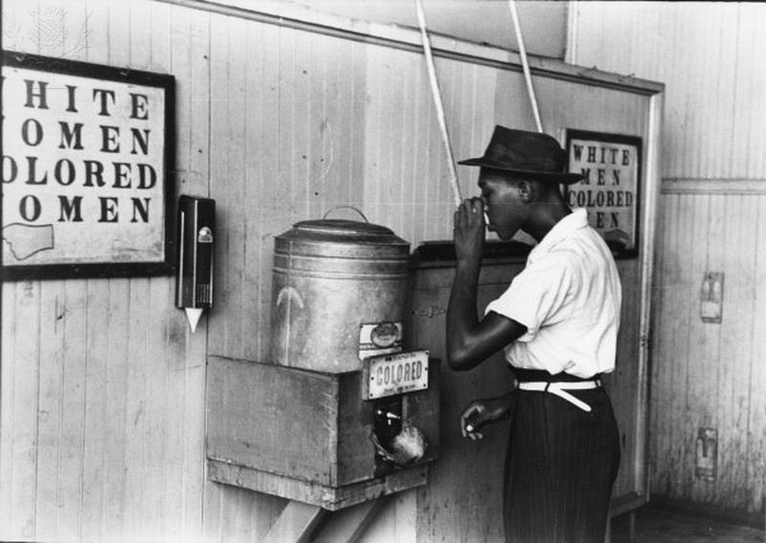
How do I get started?
How to Use the Library: Elementary, Lesson 3
Notes:
About this lesson
This lesson explains what students should do first to get ready to research. It references items and research topics from the 5th-grade inquiry arc, What is the best way to promote change?
Materials:
Getting ready to research handout (blank)
Getting ready to research handout (model)
To get ready to research (anchor chart)
ELA Standards:
W.5.8: Recall relevant information from experiences or gather relevant information from print and digital sources; summarize or paraphrase information in notes and finished work, and provide a list of sources.
W.5.7: Conduct short research projects that use several sources to build knowledge through investigation of different aspects of a topic.
W.4.8: Recall relevant information from experiences or gather relevant information from print and digital sources; take notes and categorize information, and provide a list of sources.
W.4.7: Conduct short research projects that build knowledge through investigation of different aspects of a topic.
W.3.8: Recall information from experiences or gather information from print and digital sources; take brief notes on sources and sort evidence into provided categories.
W.3.7: Conduct short research projects that build knowledge about a topic.
DC Content Power Standards:
5.DC.14.4 - List and describe the steps toward desegregation (e.g., A. Philip Randolph’s proposed 1941 March on Washington, Jackie Robinson and baseball, Truman and the Armed Forces, Adam Clayton Powell and Congress, and the integration of public schools).
C3 Framework Indicators and Common Core Standards for Literacy in History/Social Studies:
D2.His.10.3-5. Compare information provided by different historical sources about the past.

Slide 2
Guiding Questions
How should you start to research?
What should you do first?
Notes:
Teaching notes
Suggested Pacing: 1 minute
Directions:
Explain that in this lesson students will learn how to get started in their research, even when they do not know anything about their topic.
Attribution:
Previous slide - Courtesy of DC Public Library and Britannica ImageQuest.

Slide 3
Let's Review
To research. . .
Find true and relevant information.
Use information from different sources to build understanding.
Take notes to remember what is being learned.
Notes:
Teaching notes
Suggested Pacing: 1 minute
Directions:
Review the process of research.
Explain that research is a process, it is more than just doing a quick search or reading the encyclopedia.
To research we need to:
Find true and relevant information.
Use information from different sources to build understanding.
Take notes to remember what is being learned.

Slide 4
Introduction
Today you will research the challenges of desegregation.
What should I do first?
Notes:
Teaching notes
Suggested Pacing: 1 minute
Directions:
Explain that sometimes the hardest part of doing research is knowing where to start.
Before you can start looking for true and relevant information, we have to know what information to look for.

Slide 5
Connecting background knowledge
What do I already know about desegregation?
Step 1: Think about what you already know.
Notes:
Teaching notes
Suggested Pacing: 2 minutes
Directions:
Use establish classroom procedure to arrange students in groups of 2-3. Distribute Getting Ready to Research (model) handouts.
Explain that the first step in getting ready to research is to think about what we already know.
Use the steps in this and the following slides to create a class anchor chart.
Ask, "What do you already know about desegregation?"
Discuss, and have students record their thinking in the "Step 1" column on their Getting Ready to Research (model) handouts.
Student Look-Fors:
Students notice that it has the word "segregation" in it, and know that segregation was when African Americans were treated differently than white people.
Some students may not know anything about desegregation and not know what to do first.
Additional Note:
The anchor chart should remain displayed after lesson, so students may reference it whenever needed.

Slide 6
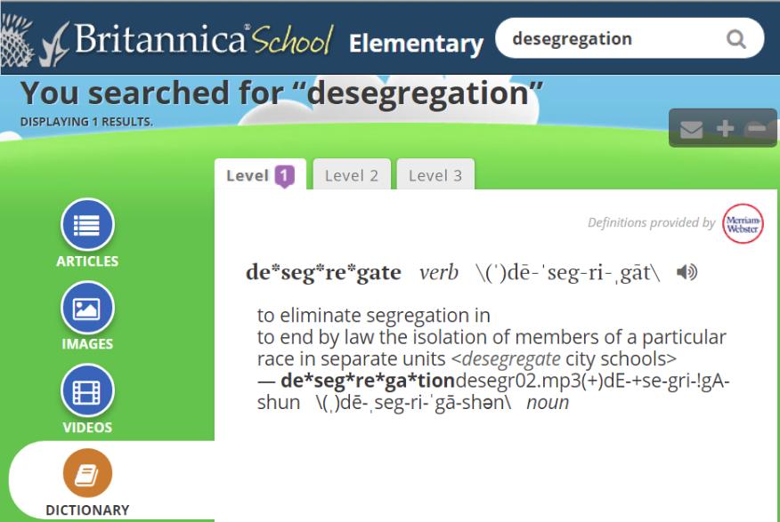
Connecting background knowledge
Notes:
Teaching notes
Suggested Pacing: 3 minutes
Directions:
Explain that if you do not know anything about a topic, you can look at something like an encyclopedia or dictionary to get a general overview of a topic. For example, this is a dictionary entry for desegregation.
Turn and talk, "What can you learn about desegregation from this source?"
Call on students to share out and instruct them to add important points to the first column of their handouts.
Optional: Create a large version of the student handout to model this process throughout the lesson.
Student Look-Fors:
It means to end segregation.
It means to pass a law that people of different races cannot be separated.
Attributions:
Britannica, "Desegregation", courtesy of the D.C. Public Library

Slide 7
Brainstorming questions
What am I trying to find out about desegregation?
Step 1: Think about what you already know.
Step 2: Brainstorm questions.
Notes:
Teaching notes
Suggested Pacing: 4 minutes
Directions:
Explain that the next step is to brainstorm questions to guide your research. This means that you need to think hard about exactly what it is you want to understand about your topic.
For example, if your topic is desegregation then you need to brainstorm questions about desegregation that you think are important.
Record this step on the Getting Ready to Research class anchor chart.
Turn and talk, "What are some questions you might ask to understand the challenges of desegregation?"
Discuss and have students jot their ideas in the "Step 2" column of their Getting Ready to Research (model) handouts.
Student Look-Fors:
Students may note that since they are researching "challenges", that desegregating must have been hard to do.
Students may discuss how because desegregation means to stop segregation, I think they want to know more about what segregation was.
Who were some of the important people involved in desegregation?
What are some of the important events involved in desegregation?

Slide 8
Brainstorm questions
Step 1: Think about what you already know.
Step 2: Brainstorm questions.
Notes:
Teaching notes
Suggested Pacing: 1 minute
Directions:
Explain that it is important to jot down your research questions on your Getting Ready to Research (model) handout so that you can remember them. You will use these questions throughout your research.

Slide 9
Keywords
Step 1: Think about what you already know.
Step 2: Brainstorm questions.
Step 3: Identify keywords.
Notes:
Teaching notes
Suggested Pacing: 2 minutes
Directions:
Explain that our final step is to use these questions to identify keywords. These are the most important words and ideas that will help us answer our questions.
Add final step to class chart.
Turn and talk, "Looking at our research questions, what are some of the keywords you see?"
Discuss and have students jot down their ideas in the "Step 3" column of their Getting Ready to Research (model) handouts.
Student Look-Fors:
Students identify "segregation" is a keyword.
Students identify "desegregation" as another keyword.

Slide 10
Keywords
Segregation
Desegregation
Challenge
Important People
Important Events
Notes:
Teaching notes
Suggested Pacing: 1 minute
Directions:
If needed, discuss keywords such as "challenge" or "hard", "important people", and "important events".
Have students add these terms to the "Step 3" column of their Getting Ready to Research (model) handout.

Slide 11
Keywords
Desegregation
Challenge
Desegregation
Important People
Desegregation
Important Events
Notes:
Teaching notes
Suggested Pacing: 1 minute
Directions:
Explain that when you start researching, you can use these keywords in many different ways. You can look for these terms in text features of books and magazines. You can also use them to search online search engines, databases, and dictionaries.

Slide 12
Keywords
What important people or events am I learning about?
Notes:
Teaching notes
Suggested Pacing: 5 minutes
Directions:
Say, "As you research and learn more, you can add to these keywords and search for more and more specific information."
Point out the "Step 3" column on the Getting Ready to Research (blank) handout.
Say, "Work with your groups to read the excerpt and find any important people or events involved in desegregation."
After giving students time to work, call on groups to share out the important people or events that they found.
Student Look-Fors:
Important people include Marian Anderson, who gave a famous concert, and Martin Luther King Jr., who gave a famous speech.
Important events include the 1963 March on Washington, the "I Have a Dream" speech, and the 1954 Supreme Court decision forcing school desegregation.
Attributions:
National Geographic, "On the Civil Rights Trail", courtesy of the D.C. Public Library

Slide 13
Keywords
Desegregation
Important People
Marion Anderson
Martin Luther King Jr.
Desegregation
Important Events
“I Have a Dream” speech
1954 Supreme Court decision
Notes:
Teaching notes
Suggested Pacing: 1 minute
Directions:
Explain that by adding these more specific keywords and phrases, students now have more specific ideas that they can research. For example, now they can search for these specific people and events to find out more about the challenges of desegregation.
If needed, model adding key words to the Getting Ready to Research (model) handout.
Attributions:
National Geographic, "On the Civil Rights Trail", courtesy of the D.C. Public Library

Slide 14
Express Your Understanding
To get ready to research I need to. . .
Step 1: Think about what you already know.
Step 2: Brainstorm questions.
Step 3: Identify keywords.
Notes:
Teaching notes
Suggested Pacing: 7 minutes
Directions:
Review the steps to get ready to research, referencing the class anchor chart.
Explain to students that they will now be working independently using their devices to research a topic. This can be a topic of their choice or an assigned topic.
Say, "Begin working to research using your devices."
Give students time to independently work through the process on their own topics. Circulate, observing that students are:
Thinking about what they already know, and looking up basic information using dictionaries or encyclopedias.
Brainstorming research questions and recording in notebooks or journals.
Identifying keywords.
Distribute Getting Ready to Research (blank) handout to students. Students demonstrate the process of thinking about what they know, brainstorming questions, and identifying keywords.
Use completed handouts as formative assessment.
Student Look-Fors:
Students demonstrate the process of thinking about what they know, brainstorming questions, and identifying keywords specific to individual student topics on their Getting to Ready to Research form.

