Slide 1
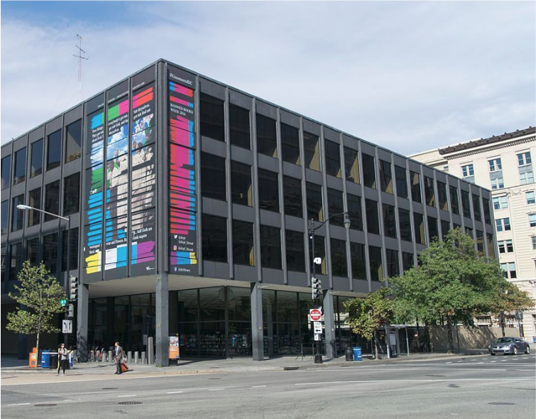
Where should I do research?
How to Use the Library: Elementary, Lesson 2
Notes:
About this lesson
This lesson explains how to use different resources to do research, including how libraries curate high-quality, relevant sources of information that include primary and secondary resources. It references items and research topics from the 5th-grade inquiry arc, What is the best way to promote change?
Materials:
All resources are the same (handout)
All resources are the same (anchor chart)
Primary source (handout)
Secondary source (handout)
To get ready to research (chart)
ELA Standards:
W.5.8: Recall relevant information from experiences or gather relevant information from print and digital sources; summarize or paraphrase information in notes and finished work, and provide a list of sources.
W.5.7: Conduct short research projects that use several sources to build knowledge through investigation of different aspects of a topic.
W.4.8: Recall relevant information from experiences or gather relevant information from print and digital sources; take notes and categorize information, and provide a list of sources.
W.4.7: Conduct short research projects that build knowledge through investigation of different aspects of a topic.
W.3.8: Recall information from experiences or gather information from print and digital sources; take brief notes on sources and sort evidence into provided categories.
W.3.7: Conduct short research projects that build knowledge about a topic.
DC Content Power Standards:
5.DC.5.9 - Students describe the African American exodus from the segregated rural South to the urbanized North.
C3 Framework Indicators and Common Core Standards for Literacy in History/Social Studies:
D2.His.9.3-5. Summarize how different kinds of historical sources are used to explain events in the past.
D2.His.10.3-5. Compare information provided by different historical sources about the past.

Slide 2
Guiding Question
Where can you find true and relevant sources?
Notes:
Teaching notes
Suggested Pacing: 1 minute
Directions:
Say, "To research you need to gather information that is true and relevant."
Ask, "Where do you start researching? What is the first thing you do? Where is the first place you go to research? Why do you start there?"
Push students to explain why they use those tools as starting points for research.

Slide 3
Let's Review
To research. . .
Find true and relevant information.
Use information from different sources to build understanding.
Take notes to remember what is being learned.
Notes:
Teaching notes
Suggested Pacing: 1 minute
Directions:
Review the process of research.

Slide 4
Introduction
I use the library!
I look on Wikipedia!
I search on Google!
Notes:
Teaching notes
Suggested Pacing: 3 minutes
Directions:
Create a class anchor chart. You will use this throughout the lesson to jot about each type of resource used to do research.
Summarize that many students use the internet to do research. Some use powerful search engines like Google or online encyclopedias like Wikipedia, while others use the school or city library.
Optional: Designate three parts of the room for students to move to depending on which resource they would use.
Ask, "Are all of these sources of information the same?"
Ask, "Are they all good places to find true and relevant information?"
Ask, "Does being easy to use make it a good source of information?"
Student Look-Fors:
Students understand that while Google and Wikipedia are easy to use, that does not mean they are the best sources of true and relevant information.

Slide 5
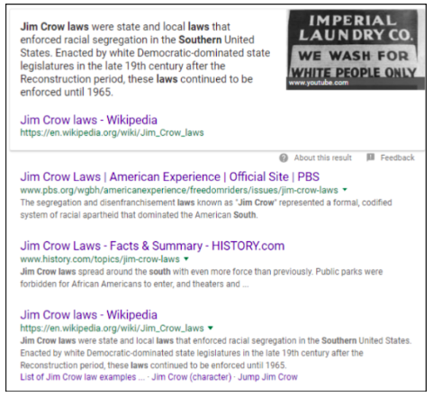
Using Google to research
I search on Google!
Notes:
Teaching notes
Suggested Pacing: 4 minutes
Directions:
Use an established classroom routine to pair students.
Pass out Are all sources the same? handout.
Say, "A Google search could be used to research to understand the impact of Jim Crow laws on African Americans in the south."
Say, "Turn and talk, What information can you find on this page?"
Point students towards the titles of each website. If needed, explain that this tells us the name of the article and often the name of the website.
Point students towards the green url, or web address, beneath each title. If needed, explain that this is the web address for that website.
Point students towards the short descriptions below each source. If needed, explain how we can skim these to get a better sense of what this source is about.
Say, "Turn and talk, why do you think these links are in this order? Why is that one first and this other one third or fourth?"
Explain that while Google is a powerful tool, it does not sort information by how true it is - it sorts information by how many keywords it has, how popular it is, and how long a website has existed.
Explain that one way to make sure you find good information when using Google, always look at the url of a source. If you can see it is a reputable, or well-known, website then it is more trustworthy than information from a website you have never heard of.
Explain that, in general, websites that end in ".org" or ".net" belong to organizations or companies that might not be trustworthy. On the other hand, websites that end in ".edu" or ".gov" belong to established schools or the government and are more trustworthy.
Add notes about Google to class anchor chart, students add notes to Are All the Sources the Same handout.
Student Look-Fors:
Students should be able to identify the title, url, and description of sources using a Google search.

Slide 6
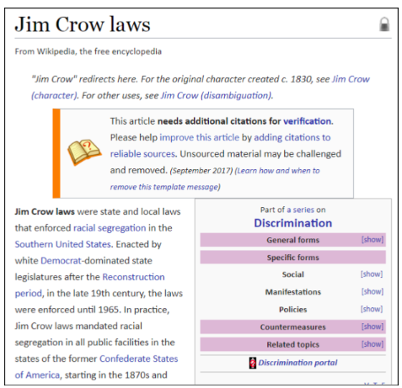
Using Wikipedia to research
I look on Wikipedia!
Notes:
Teaching notes
Suggested Pacing: 4 minutes
Directions:
Say, "Now let's take a look at what I would find if I was using Wikipedia to research. I've gone to Wikipedia, searched for 'Jim Crow laws' and pulled up this article."
Turn and talk, "What do you notice about this article? Is there anything that indicates whether this is a true and relevant source?"
Allow students time to analyze the page and discuss.
Highlight the box in the middle of the article and discuss what it means that the article needs additional citations for verification.
If needed, explain that a citation is a source of information
If needed, explain that verification is the process of making sure that something is true.
Discuss why this article would have a note saying that it needs more sources to make sure the information in it is true.
Explain that Wikipedia is a source of information, but anyone can write and edit articles. That means you can not be certain the information in a Wikipedia article is correct. Therefore it is not a citable, or reliable, source.
Add notes about Wikipedia to class anchor chart, students add notes to Are all the sources the same handout.
Student Look-Fors:
Students locate important and relevant information on the page.
Students understand the significance of the note on the page stating that this article doesn't have enough citations for reliable sources and that some information in this article may be, ". . .challenged and removed."
Attribution:
Wikipedia, "Jim Crow Laws", courtesy of Wikipedia

Slide 7
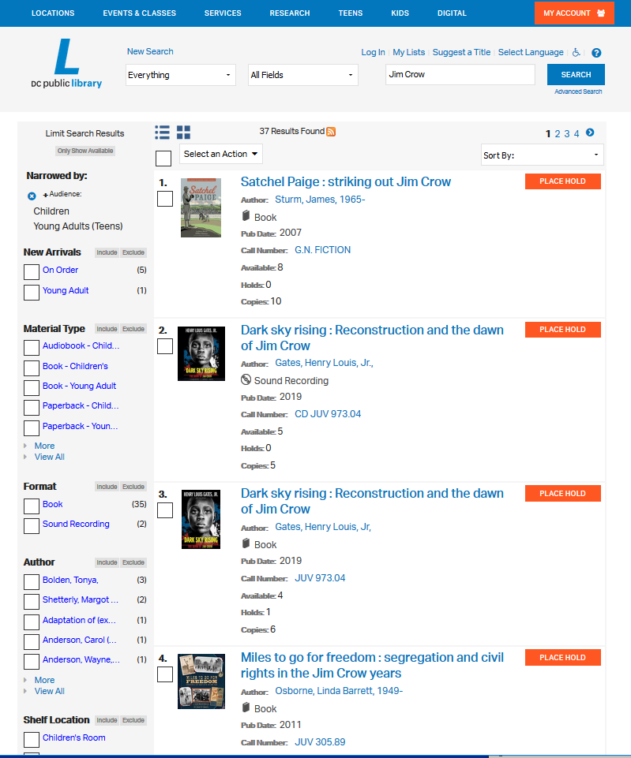
Using the library to research
I use the library!
Notes:
Teaching notes
Suggested Pacing: 3 minutes
Directions:
Students turn and talk and stop and jot, adding to handout as in previous slide. Add to Research Options chart as discussion progresses.
Ask, "What do you think would be different if we were researching using the library?"
Discuss student's preconceptions of what research at a library looks like, noting some of the different resources libraries now offer such as websites, computers, magazines, journals, and people you can ask for help (librarians)!
Explain that, unlike a search engine or an online encyclopedia, the goal of a library is to collect relevant and true information. This information can be in an actual library building that we can access by visiting and reading books, newspapers, and magazines, or it can be online through the library website.
Explain that whether it is in books or websites, all of the information in a library is curated, or specifically chosen to be there, because it is important and relevant. That makes the library a much smarter place to research than other places on the wild web.
Add notes about library to class anchor chart, students add notes to Are all the sources the same handout.
Student Look-Fors:
While using a library might not be as easy as Google or Wikipedia, it is a better source of true and relevant information.
Libraries have more than just bookshelves, but include a wide range of tools and resources including librarians that can help students find what they need.
Attribution:
"Jim Crow" and filtered by Audience for "Young Adult" and "Children"

Slide 8
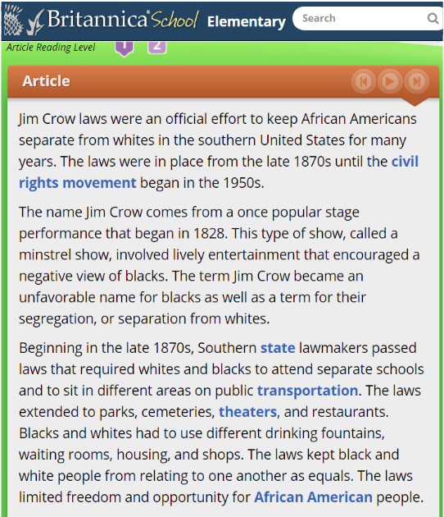
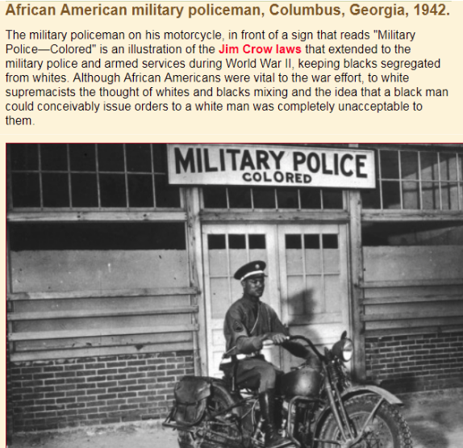
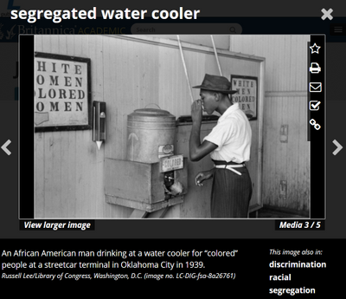
Using the library to research
D.C. Public Library Resources
Notes:
Teaching notes
Suggested Pacing: 3 minutes
Directions:
Say, "Here are some sources that I found while researching the DC Public Library website to learn more about Jim Crow laws."
Explain that, at the library, students can find many different types of resources that are both accurate (true) and relevant.
Turn and talk, "What do you notice about them?"
These include secondary resources like articles, videos, books, and encyclopedias as well as primary resources like pictures, recordings, letters, and diaries.
Student Look-Fors:
There are articles and pictures.
There are many different sources, and each source is different and gives different information about the topic.
Attributions:
Britannica, "Jim Crow Laws", courtesy of D.C. Public Library
Britannica, "segregated water cooler", courtesy of D.C. Public Library
Black Studies Center, "African American military policeman, Columbus, Georgia, 1942", courtesy of D.C. Public Library

Slide 9
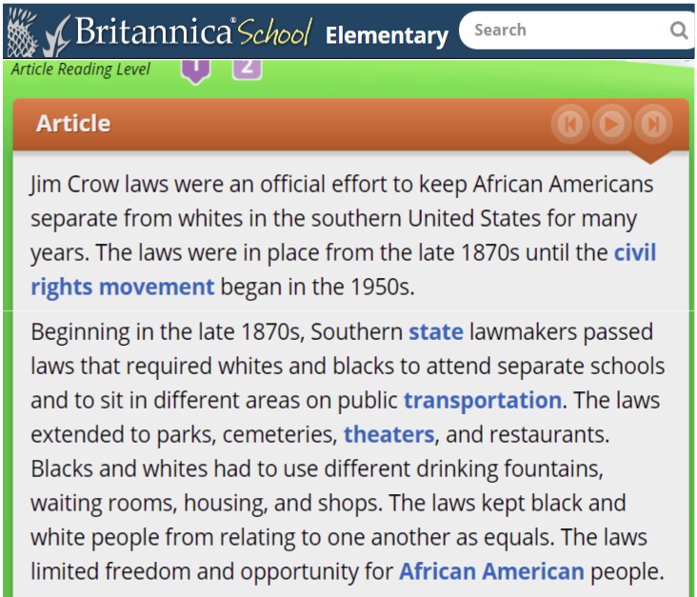
Secondary sources
What is a secondary source?
Notes:
Teaching notes
Suggested Pacing: 4 minutes
Directions:
One type of resource that we can find at a library is what is called a "secondary source".
Explain that a secondary source is created or written about a topic/subject by someone who was not actually there when it happened. For example, this article is a secondary source that was written about Jim Crow laws by someone who did not live at that time.
Group students as needed and pass out Secondary Source handout.
Ask, "What can we learn about Jim Crow laws from this secondary source?"
Students work independently or pairs to read article and jot notes at the bottom of the handout about what they learn.
Student Look-Fors:
Students understand what a secondary source is.
Students learn that Jim Crow laws were made to separate and discriminate against African Americans from the 1870s to the 1950s in the United States.
Attribution:
Britannica, "Jim Crow Laws", courtesy of D.C. Public Library

Slide 10
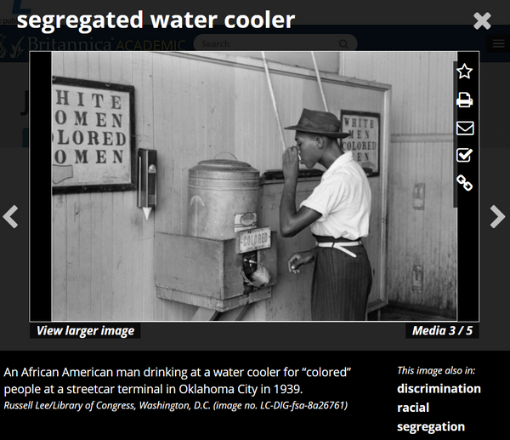
Primary sources
What is a primary source?
Notes:
Teaching notes
Suggested Pacing: 4 minutes
Directions:
Explain that a primary source is a picture, text, or any other source that was created at the time being researched.
Say, "For example, this picture is a primary source. It is a picture that was taken at the time when Jim Crow laws still existed."
Group students as needed and pass out Primary Source handout.
Ask, "What can we learn about Jim Crow laws from this primary source?"
Students work independently or in pairs to read article and jot notes about what they learn.
Student Look-Fors:
Students understand the difference between secondary and primary sources.
Jim Crow laws affected people in many ways, even water coolers were separate for African Americans!
Attribution:
Britannica, "segregated water cooler", courtesy of D.C. Public Library

Slide 11
Express Your Understanding
What is the difference between a primary source and a secondary source?
Notes:
Teaching notes
Suggested Pacing: 2 minutes
Directions:
Ask students to turn and talk about the question on the slide.
Direct students to flip their Are all the sources the same handout over or use an index card to write their answer independently.
Student Look-Fors:
A primary source is a picture, text, or any other source that was created at the time being researched.
A secondary source is created or written about a topic/subject by someone who was not actually there when it happened.

