Slide 1
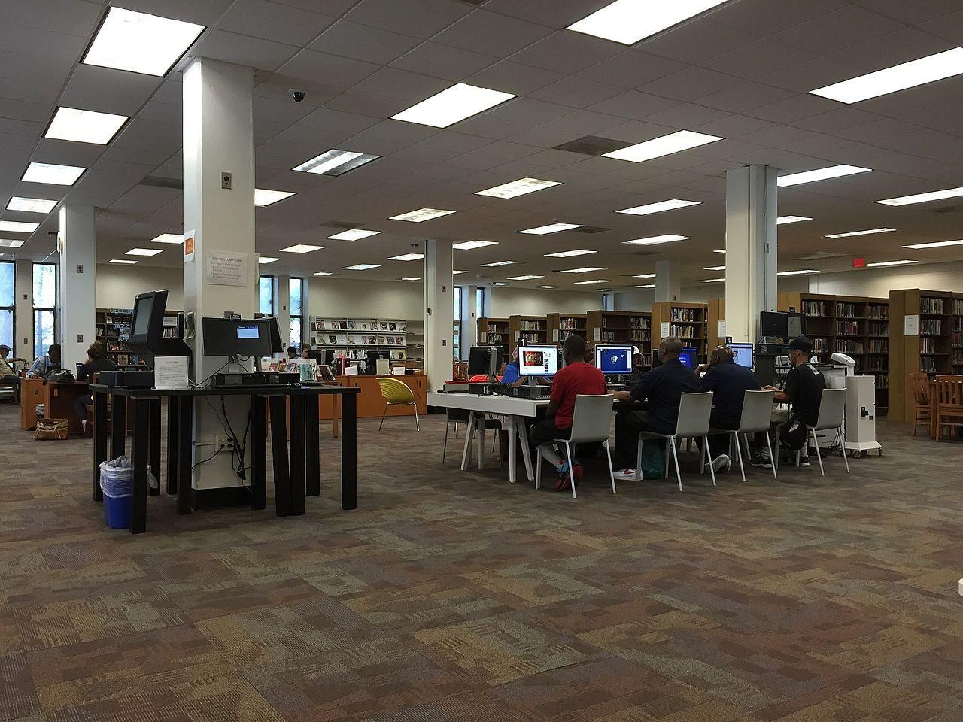
What is Research?
How to Use the Library: Elementary, Lesson 1
Notes:
About this lesson
This lesson explains the purpose and process of research. It references topics of research from the 3rd-grade inquiry arc, "Who Changes D.C.?" and the 5th-grade inquiry arc, "Does Progress Help Everyone?"
Materials:
“An Expert” anchor chart (example)
“To research” anchor chart
Use information from different sources
ELA Standards:
W.5.8: Recall relevant information from experiences or gather relevant information from print and digital sources; summarize or paraphrase information in notes and finished work, and provide a list of sources.
W.5.9: Draw evidence from literary or informational texts to support analysis, reflection, and research.
W.5.7: Conduct short research projects that use several sources to build knowledge through investigation of different aspects of a topic.
W.4.8: Recall relevant information from experiences or gather relevant information from print and digital sources; take notes and categorize information, and provide a list of sources.
W.4.9: Draw evidence from literary or informational texts to support analysis, reflection, and research.
W.4.7: Conduct short research projects that build knowledge through investigation of different aspects of a topic.
W.3.8: Recall information from experiences or gather information from print and digital sources; take brief notes on sources and sort evidence into provided categories.
W.3.7: Conduct short research projects that build knowledge about a topic.
DC Content Power Standards:
3.DC.4.2 Construct a chronological explanation of key people and events that were important in shaping the character of Washington, D.C., during the 18th, 19th, and 20th centuries.
5.DC.2.6 Explain how and why young women and children join the paid labor force
C3 Framework Indicators and Common Core Standards for Literacy in History/Social Studies:
D2.His.5.3-5. Explain connections among historical contexts and people’s perspectives at the time.

Slide 2
Guiding Questions
What is research?
How can you do research in your city?
Notes:
Teaching notes
Suggested Pacing: 1 minute
Directions:
Ask the first guiding question, "What is research?"
Ask students what they think of when they hear the word research. What images, memories, or ideas come to mind?
Ask the second guiding question, "How can you do research in your city?"
Ask students where they think they could do research in their city. What places or what tools might you need?
Say, "In this lesson, we will be learning about the answers to these questions."

Slide 3
What is research?
Research means to collect information about a topic in order to understand it.
Notes:
Teaching notes
Suggested Pacing: 1 minute
Directions:
Explain that when we research, we collect information about a certain topic so that we can understand it better or discover something new.
If needed, discuss the meaning of topic.

Slide 4
Why do we do research?
What might you be expert on?
Notes:
Teaching notes
Suggested Pacing: 3 minutes
Directions:
Say, "We do research to become experts about something. An expert is someone who has a special skill or knowledge about a topic.
Discuss with the class what things they may be experts on.
How did they become experts? What steps did they take?
What does it mean to them to be an expert at something?
How is an expert at something different than a non-expert?
Use student responses to create an anchor chart: An Expert. . .
Access an example An Expert. . . anchor chart in Additional Materials tab.
Directions:
Students recognize that becoming an expert takes work - it is not something you can become overnight.
Students recognize that experts have authoritative knowledge on certain topics. That means that if someone is an expert on something, other people can go to them for help.

Slide 5
The Process of Research
Find true and relevant information.
Use information from different sources to build understanding.
Take notes to remember what is being learned.
Notes:
Teaching notes
Suggested Pacing: 1 minute
Directions:
Explain that research is a process, it is more than just doing a quick search or reading the encyclopedia.
To research:
Find true and relevant information.
Use information from different sources to build understanding.
Take notes to remember what is being learned.
Create a To research. . . class anchor chart and add to it throughout the lesson as you discuss each step.
Access To research. . . example anchor chart in Additional Materials tab.

Slide 6
Find True and Relevant Information
How do I know if something is true?
How do I know if something is relevant?
Notes:
Teaching notes
Suggested Pacing: 2 minutes
Directions:
Explain that finding true and relevant information is the foundation of good research.
Ask, "If someone is telling us a story, how do we know if that story is true if we were not there?"
Lead class discussion.
Say, "Relevant means to be connected to what is being talked about or done."
Ask, "Why would it be important for information to be relevant in research?"
Add responses to To research. . . class anchor chart.
Student Look-Fors:
Is the person telling the story a trustworthy person? Was s/he there when it happened?
If a story isn't realistic or sounds crazy, it might not be true.
Does it fit with things that you already know are true?
It is important to use relevant information to stay on topic and do not start gathering facts and ideas that are not important.

Slide 7
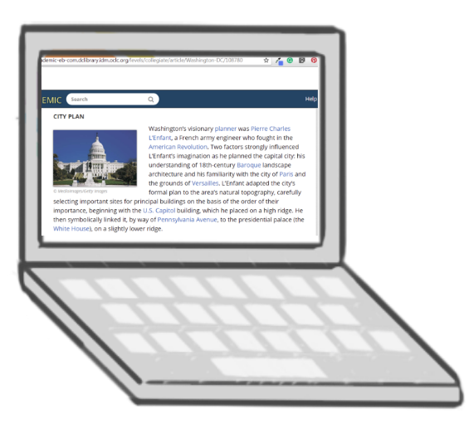
Find True and Relevant Information
Where did this source come from?
Does this fit with what I know?
Notes:
Teaching notes
Suggested Pacing: 1 minute
Directions:
Say, "True means to be correct, accurate, or real."
Explain that we can usually figure out if something is true by asking ourselves some questions as we research.
Some questions we might ask are . . .
Where did this source come from?
Does this fit with what I know?

Slide 8
Find True and Relevant Information
Notes:
Teaching notes
Suggested Pacing: 5 minutes
Directions:
Say, "For example, imagine you are doing research about the key events and people in Washington D.C.'s history. As part of your research, you are trying to find out more about how the city of Washington D.C. was built. In your research, you come across this source."
Pause and click play to play the short video.
This looks interesting, but how is it a source you should use in your research? How can you tell if it is reliable? What should you ask yourself?"
Allow class time to discuss.
Ask, "How can I tell where this source came from?"
Say, "I can see that this was is a presentation that was created by someone, but I don't know who that person is. They could be a student just learning about Washington D.C. for the first time or someone who doesn't know anything about the city."
Ask, "Does this sound realistic? Does it fit with what I know?"
Re-watch video. Note that it appears very vague, does not sound very professional, and does not contain important details.
Explain that this is not a reliable source. It may contain some true information, but it is from a source that we are not familiar with and doesn't seem to fit with what we already know about Washington D.C.
Student Look-Fors:
Source is from a presentation. It may contain some information, but we do not know who wrote it or if that information is true.
Attribution:
"Washington D.C. in a nutshell", courtesy of Prezi.

Slide 9
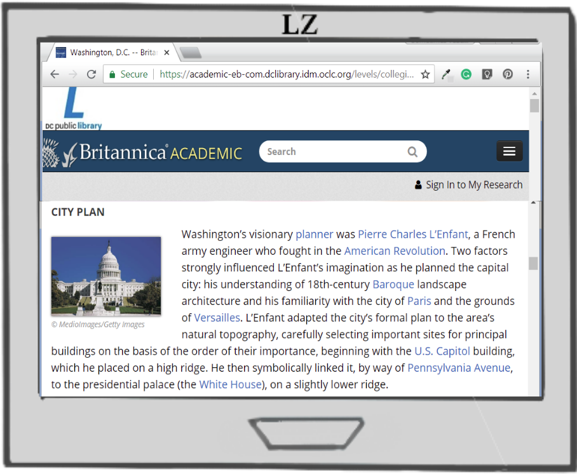
Find True and Relevant Information
Notes:
Teaching notes
Suggested Pacing: 4 minutes
Directions:
Depending on the time you have or your students' level of need, group students into small groups of 2-3.
Say, "Work with your group to evaluate this source. Remember to ask yourself, 'Where did this source come from? and, 'Does this fit with what I know?'"
Call students back together for a class discussion. Allow students or groups to share their evaluation of this source.
Student Look-Fors:
Identify that this is a reliable source because it is from a well-known, reputable website: the encyclopedia Britannica. It is also from a reliable source, the D.C. Public Library.
Trustworthy source because it fits with other information they already know about Washington D.C.
Attribution:
Britannica, "Washington D.C.", courtesy of D.C. Public Library

Slide 10
The Process of Research
Find true and relevant information.
Use information from different sources to build understanding.
Take notes to remember what is being learned.
Notes:
Teaching notes
Suggested Pacing: 1 minute
Directions:
Explain that the next step in the process of research is to use information from different sources to build our understanding.
Ask, "If you were trying to see if a story you heard was true, would you ask just one person about it or would you try and ask may different people?"
Ask, "Why would it be important to use more than one source when we do research?"
Add student responses to To research. . . class anchor chart.
Pass out Using Information From Different Sources handouts to groups.
Student Look-Fors:
Talking with many different people reveals different perspectives or opinions on what happened.
Talking to one source might not be sufficient (source may be wrong).
Learning from several different sources helps find new ideas about a topic.

Slide 11
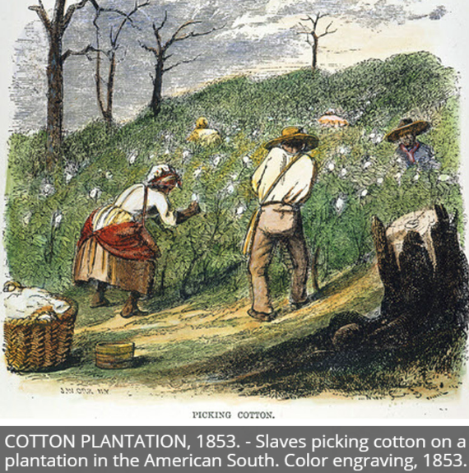
Use Information From Different Sources
Notes:
Teaching notes
Suggested Pacing: 2 minutes
Directions:
Say, "For example, if you were researching the role of cotton in the American slave trade you might pull up a source like this."
Say, "We can learn more about the connection between slavery and cotton by looking at the information we can see here."
Turn and talk, "What can we learn about the role of cotton in the slave trade by looking at this image?"
Allow students time to discuss and jot their ideas in the first column of the Use Information from Different Sources handout, then lead a class discussion.
Explain that to really understand our topic, students cannot stop here. To become an expert on this topic students need to push themselves to look at more than one source.
Student Look-Fors:
The title of the image is "Cotton Plantation" and that the caption tells us that slaves were picking the cotton, which indicates that cotton was an important part of the slave trade.
Attribution:
"Cotton Plantation, 1883", Britannica, courtesy of D.C. Public Library

Slide 12
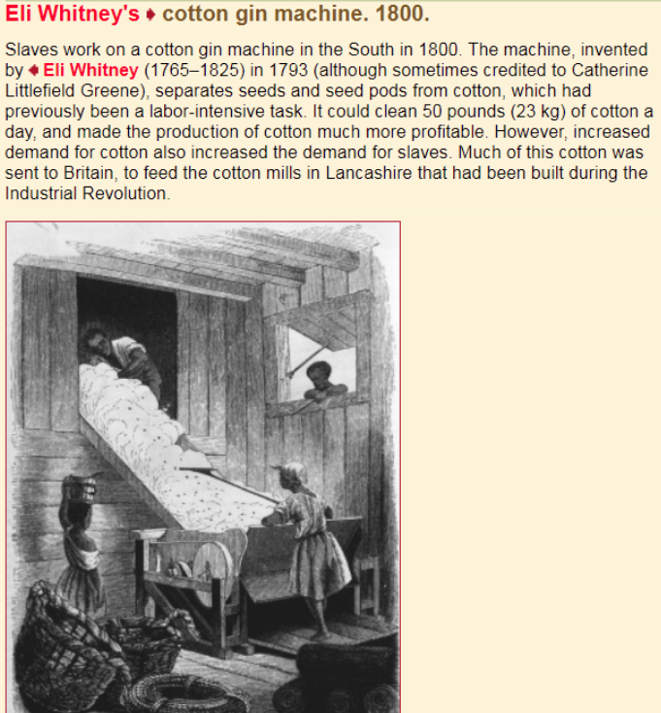
Use Information From Different Sources
Notes:
Teaching notes
Suggested Pacing: 5 minutes
Directions:
Say, "Now let's look at a source to build our knowledge!"
Read text aloud as students follow along.
Turn and talk, "What different information can we learn from this source about the role of cotton in the American slave trade?"
Give students time to discuss and add information to the first column of the Use Information from Different Sources handout.
How does this build on, or add to, what we learned from our last source?"
Give students time to discuss and add information to the second column of the Use Information From Different Sources handout.
Student Look-Fors:
Slaves were used to work with cotton, and that the cotton gin machine allowed fewer slaves to produce more cotton. However, this led to more and more people wanting slaves.
The more cotton that was produced, the more people wanted/needed slaves.
Attribution:
Black Studies Center, "Eli Whitney's cotton gin machine. 1800.", courtesy of D.C. Public Library

Slide 13
The Process of Research
Find true and relevant information.
Use information from different sources to build understanding.
Take notes to remember what is being learned.
Notes:
Teaching notes
Suggested Pacing: 1 minute
Directions:
Explain that the next step in the process of research is to record what we learn so that we can remember it.

Slide 14
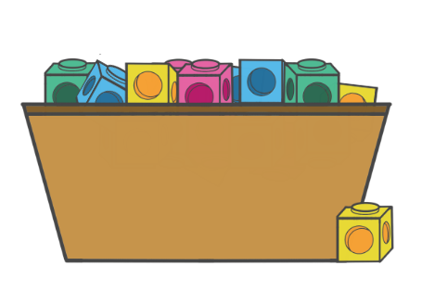
Record What We Learn
How can I organize all this information?
Notes:
Teaching notes
Suggested Pacing: 1 minute
Directions:
Say, "To do this, you need to organize the information we gather. One way to do this is to sort big ideas into categories. As you gather true and relevant information from different sources, you can add what we learn to each category."
Say, "Imagine that all the facts you gather as you research are like blocks. If you just throw them all together without organizing them, you will not be able to find the information you need later."

Slide 15
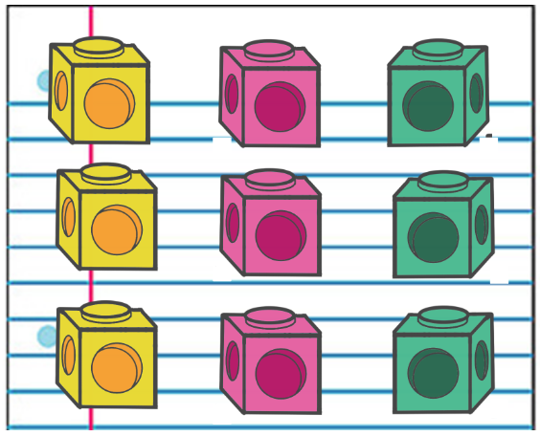
Record What We Learn
Notes:
Teaching notes
Suggested Pacing: 1 minute
Directions:
Say, "There are many different ways you can organize your research notes that we will learn about later. The important thing is to group information into categories. This will help you to think about and remember what you are learning on your journey to become an expert on a topic!"
Add to To research. . . class anchor chart.

Slide 16
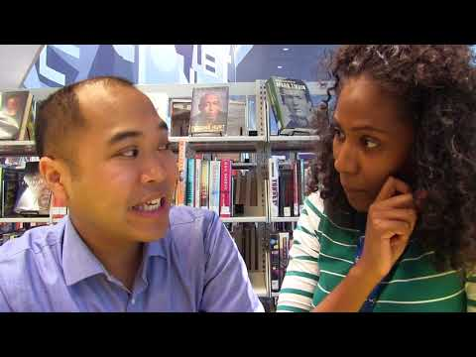
How Can I Do Research in My City?
Notes:
Teaching notes
Suggested Pacing: 1 minute
Directions:
Watch video about researching in the library.
Attribution:
Use of Library

