Slide 1
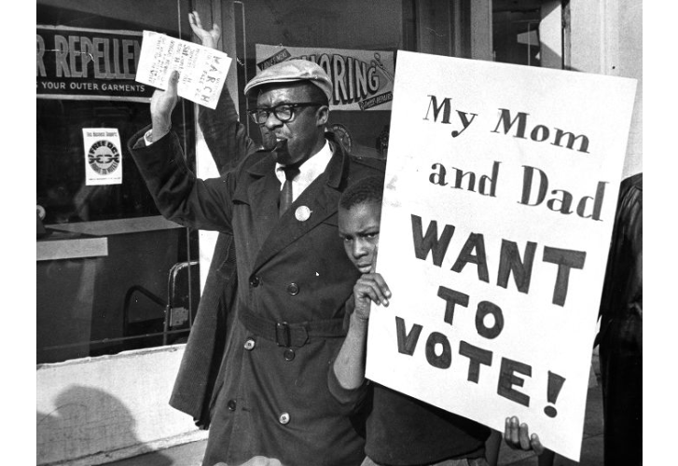
Statehood for Washington, D.C.
Home Rule: Grade 3, Lesson 7
Notes:
About this lesson
This lesson focuses on the differences between home rule and statehood, specifically pertaining to Washington, D.C.
Students . . .
learn what statehood means.
review the Home Rule Act of 1973 and H.R. 51: The D.C. Statehood Bill.
compare and contrast statehood and D.C. Home Rule.
explain how Washington, D.C. would change if it became a state.
Materials:
Statehood and Home Rule Venn Diagram (blank)
Statehood and Home Rule Venn Diagram (completed)
ELA Standards:
SL.3.1.d: Explain their own ideas and understanding in light of the discussion.
SL.3.1: Engage effectively in a range of collaborative discussions (one-on-one, in groups, and teacher-led) with diverse partners on grade 3 topics and texts, building on others' ideas and expressing their own clearly.
W.3.2.a: Introduce a topic and group related information together; include illustrations when useful to aiding comprehension.
RI.3.3: Describe the relationship between a series of historical events, scientific ideas or concepts, or steps in technical procedures in a text, using language that pertains to time, sequence, and cause/effect.
DC Content Power Standards:
D2.Civ.4.3-5. Explain how groups of people make rules to create responsibilities and protect freedoms.
D2.Civ.5.3-5. Explain the origins, functions, and structure of different systems of government, including those created by the U.S. and state constitutions.
C3 Framework Indicators and Common Core Standards for Literacy in History/Social Studies:
3.2: Students understand the basic structure of the Washington, D.C. government.

Slide 2
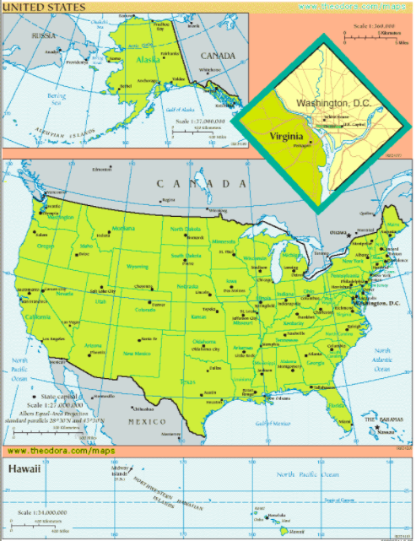
The United States
Fourth largest country in the world
Made up of 50 states and the District of Columbia
48 states lie between Canada (to the north of the U.S.) and Mexico (to the south of the U.S.)
Alaska, northwest of Canada
Hawaii, a group of islands in the Pacific Ocean
Notes:
Teaching notes
Suggested Pacing: 2 minutes
Directions:
Say, “The United States is the fourth largest country in the world.
The United States is made up of 50 states and the District of Columbia.
Forty-eight of the states lie between Canada, which is north of the U.S. and Mexico, which is to the south of the U.S. Alaska is the 49th state and it is northwest of Canada.
Hawaii, the 50th state, is a group of islands in the Pacific Ocean.”
Attribution:
Map of the United States

Slide 3
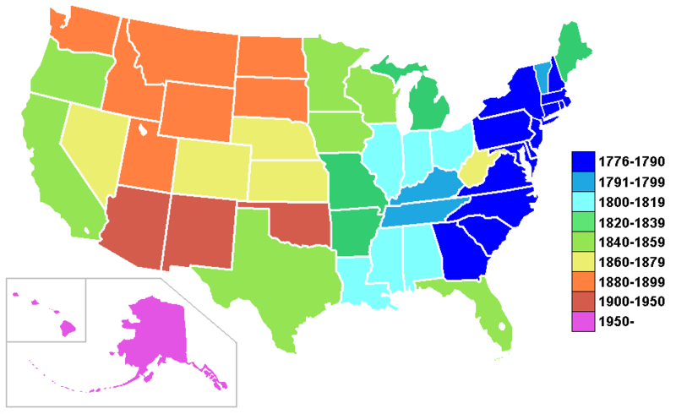
What is statehood?
State governments are elected by the people of that state
States are represented by voting in the U.S. Congress
Notes:
Teaching notes
Suggested Pacing: 2 minutes
Directions:
Say, “Each of our 50 states has achieved statehood. This map shows when each state achieved statehood.
What does statehood mean? In each state, the government is elected by the people who live in that state. This means that the state holds their own elections to decide who they best think will govern them and represent them.
Some of the elected representatives in each state work in Washington, D.C. as members of Congress.
In the United States, each state has voting representation. That means each state has the opportunity to vote on important issues and determine how our national government works too.”
Attribution:
US states by date of statehood.

Slide 4
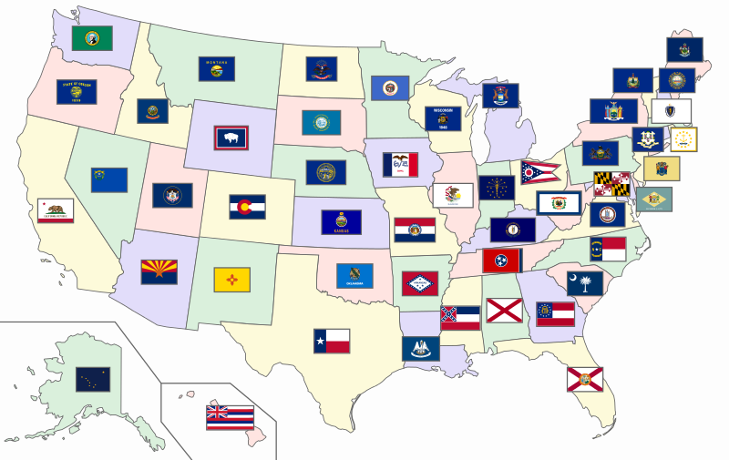
More about statehood
States have the power to create their own laws
States enforce laws
States vote on their budget based on their needs
Notes:
Teaching notes
Suggested Pacing: 2 minutes
Directions:
Say, “On a state level, the elected representatives work to govern and make decisions for the people in their states.
Each state has the power to create its own laws. States enforce or make sure people follow these laws and then decide what happens when the laws are broken.
States also vote on their budget or their plan for spending money to run the government according to their needs.
This is a map of the different flags for each state. It gives you a good picture of how different each state is.”
Attribution:
Map of the United States with flags.

Slide 5
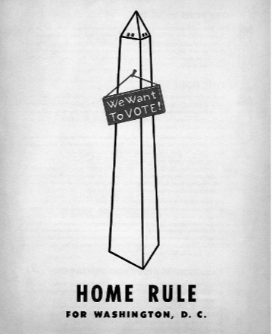
Let's Review
The Home Rule Act of 1973 gave certain powers to Washington, D.C.
Citizens have the power to elect a Mayor and a District Council
District Council can pass local laws
New laws need approval of Congress
Notes:
Teaching notes
Suggested Pacing: 2 minutes
Directions:
Say, “Remember that Washington, D.C. serves a special role in the United States as the nation’s capital.
According to the Constitution, the nation's capital city must be in a district, not a state. It also allows Congress to govern the capital city, the District of Columbia. This means that self-governance did not exist in Washington, D.C. before 1973.
With the Home Rule Act of 1973, the citizens of Washington, D.C. gained certain powers. Washington, D.C. now had the right to elect a mayor.
The citizens also had the right to elect a district council. A council is a group of people elected to manage a city or district. This council had the ability to pass laws. These were all steps in the right direction for self-governance.”
Attribution:
Home rule for Washington, D.C. poster. Washingtoniana Ephemera Collection. DC Public Library.

Slide 6
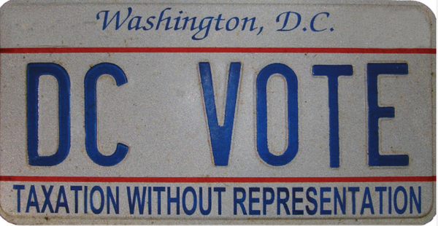
Let's Review
The Home Rule Act of 1973 gave certain powers to Washington, D.C.
Budget needs approval of Congress
D.C. is represented in U.S. Congress by a non-voting representative
Notes:
Teaching notes
Suggested Pacing: 1 minute
Directions:
Say, “Despite the new freedoms the Home Rule Act of 1973 gave Washington, D.C., it still did not gain complete independence.
Its budget still needs approval by Congress. Also, D.C. gained a representative in Congress, but that representative can not actually vote.”
Attribution:
DC VOTE license plate. District of Columbia. Department of Motor Vehicles. Washingtoniana Ephemera Collection. DC Public Library.

Slide 7
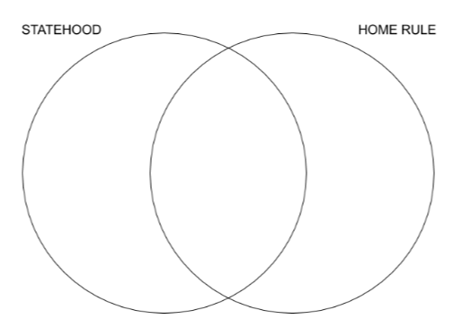
How is Home Rule different from Statehood?
Think about what you already know about Washington, D.C. Home Rule. Compare and contrast Statehood and D.C. Home Rule? What is the same? What is different? Complete the Venn Diagram with a partner.
Notes:
Teaching notes
Suggested Pacing: 4 minutes
Directions:
Hand out the Statehood and Home Rule Venn Diagram.
Say, “Think about what you already know about Washington, D.C. Home Rule.
Compare and contrast Statehood and D.C. Home Rule? What is the same?
What is different? Complete the Venn Diagram with a partner."
Students record their answers on the Statehood and Home Rule Venn Diagram.
Student Look-fors:
Student responses will vary.
See completed example.
Attribution:
Conversation Clipart

Slide 8
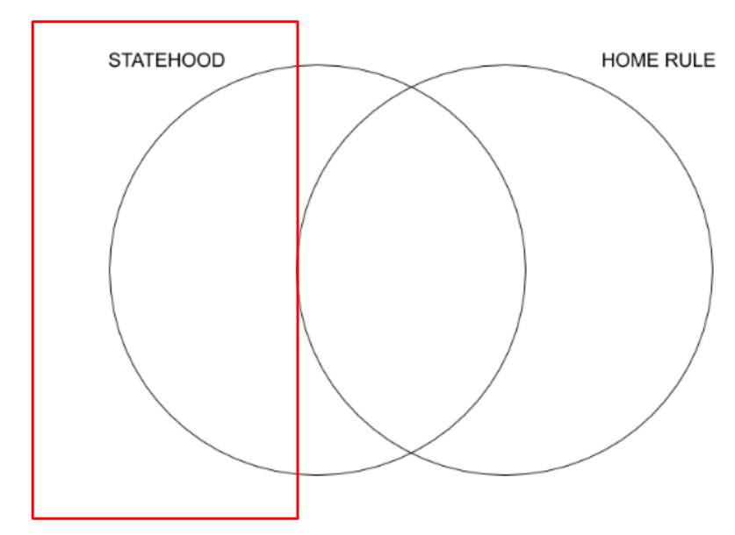
Let's Review!
Statehood
State governments are elected by the people of that state
Represented by voting in the U.S. Congress
Power to create their own laws
Vote on their budget based on their needs
Notes:
Teaching notes
Suggested Pacing: 2 minutes
Directions:
Review the Statehood and Home Rule Venn Diagram.
Say, “Let’s review your thinking. Make changes as needed on your Venn diagram. Be sure that your information is correct.
Let's look at the 'Statehood' side of the Venn diagram first."
Student Look-fors:
See completed example.

Slide 9
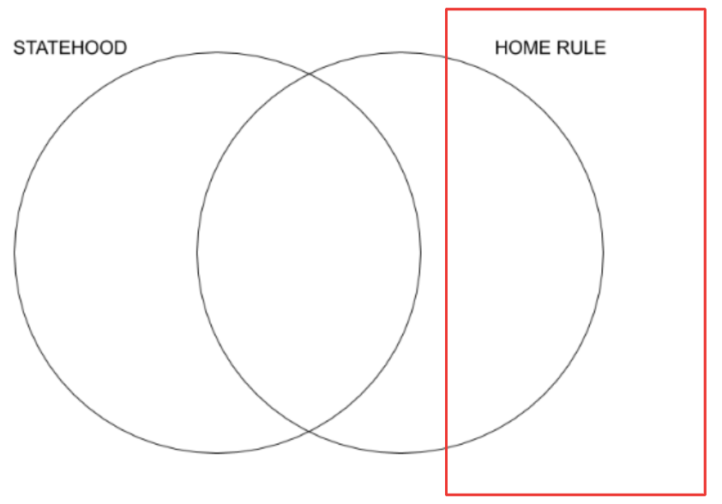
Let's Review!
Home Rule
Represented in U.S. Congress but no vote
Laws need approval of Congress
Budget needs approval of Congress
Notes:
Teaching notes
Suggested Pacing: 2 minutes
Directions:
Review the Statehood and Home Rule Venn Diagram.
Say, “Now let's look at the "Home Rule" side of the Venn diagram."
Student Look-fors:
See completed example.

Slide 10
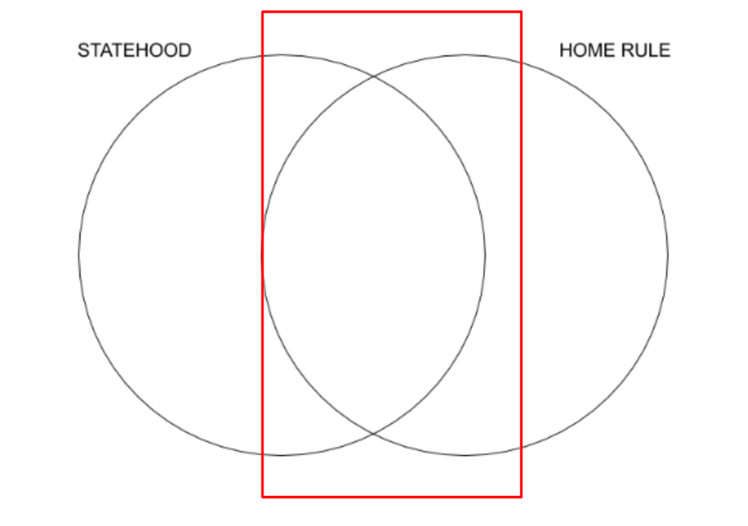
Let's Review!
Same
Power to elect a mayor
Notes:
Teaching notes
Suggested Pacing: 1 minute
Directions:
Review the Statehood and Home Rule Venn Diagram.
Say, "Finally, let's take a look at what both Statehood and Home Rule Venn Diagram have in common.
Look at the middle of the Venn diagram where the two circles intersect or come together."
Student Look-fors:
See completed example.

Slide 11
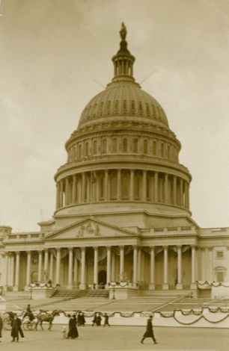
How Statehood Becomes a Law
Laws begin as ideas that are written down and explained
This written down idea becomes a bill
Senators or representatives introduce bills in Congress
Bills are voted on by the Congress
If Congress passes a bill, it goes to the President to be signed into law
Notes:
Teaching notes
Suggested Pacing: 2 minutes
Directions:
Say, “When people in the United States have ideas about something they want to see happen across the country, they send those ideas to the House of Representatives or the Senate, which are the two parts of the US Congress.
These ideas come from people in different states across the country, and the ideas are turned into bills.
Bills are then voted on by the Congress. If Congress passes a bill, it goes to the President to be signed into law.
The only way for the District of Columbia to become a state is if a new law is passed by the US Congress."
Attribution:
U.S. Capitol, Washington, D.C., March 4, 1913. Ross, Willard R., 1860-1948, Willard R. Ross Postcard Collection. DC Public Library.

Slide 12
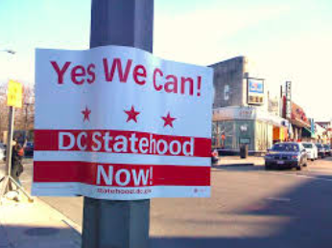
Attempts at Statehood
Bills for D.C. Statehood have been introduced to Congress more than 12 times
Only two bills have made it to a vote, in 1993 and 2020
The 1993 bill did not pass
The 2020 bill passed the House of Representatives
Notes:
Teaching notes
Suggested Pacing: 1 minute
Directions:
Say, “Since the Home Rule Act of 1973, bills for D.C. Statehood have been introduced to Congress more than 12 times.
Only two bills have made it to a vote, in 1993 and 2020.
The 1993 bills did not pass
The 2020 bill passed the House of Representatives."
Attributions:
Man and child in Free D.C. march. Evening Star (Washington, D.C.). Washington Star Photograph Collection. DC Public Library.
DC Statehood Now. Michelle Kinsey Bruns.

Slide 13
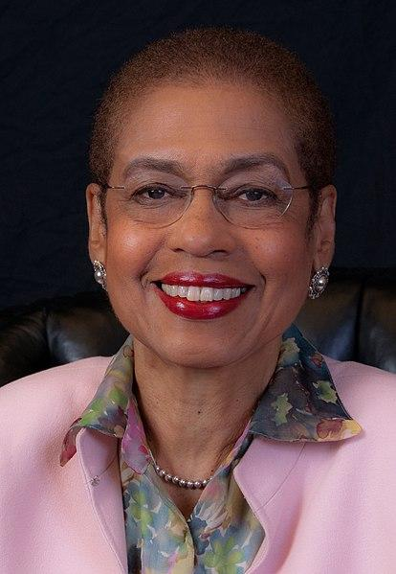
Delegate Eleanor Holmes Norton
Delegate to United States House of Representatives since 1991
Introduced the D.C. Statehood Bill in January 2019
First time since 1993 that Congress voted on D.C. becoming the 51st state
Notes:
Teaching notes
Suggested Pacing: 1 minute
Directions:
Say, “Eleanor Holmes Norton has been Washington, D.C.’s delegate to the United States House of Representatives since 1991.
She introduced H.R. 51, the D.C. Statehood Bill, in January of 2019. The Statehood Bill was passed in the House on June 26, 2020.
This was the first time since 1993 that Congress voted on D.C. becoming the 51st state.”
Attribution:
US House Office of Photography / Public domain

Slide 14

Express Your Understanding!
What would change if Washington, D.C. became a state? Think about the differences between Home Rule and Statehood.
Notes:
Teaching notes
Suggested Pacing: 3 minutes
Directions:
As a formative assessment, students are asked to turn and talk in order to explain what would change in Washington, D.C. if it became a state.
Prompt students to turn and talk to their partners about the question.
Conduct a whole class discussion calling on a few students to share their thinking.
Remind students to think about the differences between Home Rule and Statehood by referring to their Statehood and Home Rule Venn Diagram.
Student Look-fors:
Student responses will vary.
The government of D.C. will be elected by the people of that new state.
D.C. will have power to create its own laws.
D.C. will enforce laws according to its needs.
D.C. will vote on its budget.
D.C. will have representation with the power to vote in the U.S. Congress.
Attribution:
D.C. Wants To Become The 51st State. And Here’s How It Plans On Going About It.

