Slide 1
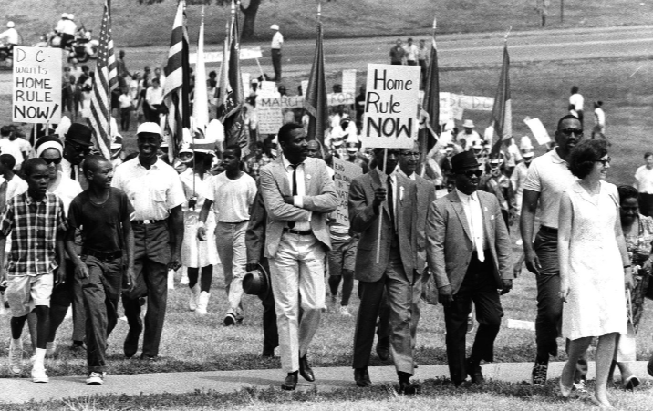
Home Rule Day Rally: July 17, 1966
Home Rule: Grade 3, Lesson 5
Notes:
About this lesson
This lesson focuses on the Washington, D.C. protests that revolved around the district gaining independence as a state.
Students . . .
make connections between various groups of community members and leaders who protested for D.C.'s independence.
complete a Who, What, Where, Why, When graphic organizer to track their thinking across the lesson.
express their understanding with an exit ticket, stating what the impact of the Home Rule Day Rally was to the District of Columbia Home Rule Act.
Materials:
Breaking Down Home Rule Day Rally (blank)
Breaking Down Home Rule Day Rally (completed)
Exit Ticket (blank)
Exit Ticket (completed)
ELA Standards:
SL.3.1.d: Explain their own ideas and understanding in light of the discussion.
SL.3.1: Engage effectively in a range of collaborative discussions (one-on-one, in groups, and teacher-led) with diverse partners on grade 3 topics and texts, building on others' ideas and expressing their own clearly.
W.3.2.d: Provide a concluding statement or section.
W.3.2.b: Develop the topic with facts, definitions, and details.
RI.3.3: Describe the relationship between a series of historical events, scientific ideas or concepts, or steps in technical procedures in a text, using language that pertains to time, sequence, and cause/effect.
DC Content Power Standards:
3.2: Students understand the basic structure of the Washington, D.C. government.
3.2.2: Explain why it is necessary for communities to have governments (e.g., governments provide order and protect rights).
3.2.3: Identify the different ways people in a community can influence their local government (e.g., by voting, running for office, testifying at hearings, or participating in meetings).
3.4. Emphasizing the most significant differences, students describe Washington, D.C. at the end of the 18th, 19th, and 20th centuries.
3.4.5. Identify and research outstanding statements of moral and civic principles made in Washington, D.C., as well as the leaders who delivered them, that contributed to the struggle to extend equal rights to all Americans (e.g., Lincoln and his second inaugural address, Frederick Douglass and his speech against lynching at the Metropolitan AME Church, Martin Luther King Jr. and his speeches at the Lincoln Memorial in 1957 and 1963, and Rodolfo “Corky” Gonzales at the Poor People’s March).
C3 Framework Indicators and Common Core Standards for Literacy in History/Social Studies:
D2.Civ.3.3-5: Examine the origins and purposes of rules, laws, and key U.S. constitutional provisions.
D2.Civ.4.3-5: Explain how groups of people make rules to create responsibilities and protect freedoms.
D2.Civ.5.3-5: Explain the origins, functions, and structure of different systems of government, including those created by the U.S. and state constitutions.
D2.Civ.12.3-5: Explain how rules and laws change society and how people change rules and laws.
D2.Civ.14.3-5: Illustrate historical and contemporary means of changing society.

Slide 2
Let's Discuss
What do people do when they are treated unfairly?
Notes:
Teaching notes
Suggested Pacing: 2 minutes
Directions:
Use an established classroom routine to pair students or use elbow partners.
Say, “Think about this question. What do people do when they are treated unfairly? Turn to your partner and discuss your thinking.”
Conduct a whole class discussion calling on a few students to share their thinking.
Student Look-Fors:
Student answers will vary.
Students might share that people organize into groups with the same goal when they feel that they are not being treated fairly.
Attribution:
Conversation Clipart

Slide 3
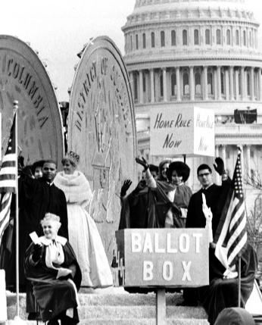
Let's Review
Home Rule: the government of an area by its own citizens
Washington, D.C. was governed by Congress
Washington, D.C. citizens lacked freedom of self-governance
Notes:
Teaching notes
Suggested Pacing: 1 minute
Directions:
Say, “Let’s review the definition of home rule. Home rule is the government of an area by its own citizens."
From 1790 until 1973, Washington, D.C. was not governed by its own citizens.
The Constitution stated that Washington, D.C. would be governed by the US Congress. The citizens of Washington, D.C. lacked the freedom of self-governance.”
Attribution:
Community Archives, DC Public Library

Slide 4
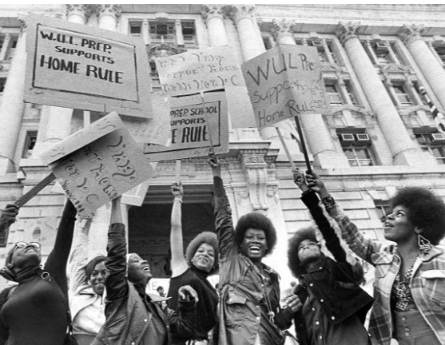
Turn and Talk
How do you think the citizens of Washington, D.C. felt about being ruled by Congress?
Notes:
Teaching notes
Suggested Pacing: 2 minutes
Directions:
Say “Let’s think about the impact. How do you think the citizens of Washington, D.C. felt about being ruled by Congress? Turn to your partner and discuss your thinking.”
Prompt students to turn and talk to their partners about the question.
Conduct a whole class discussion calling on a few students to share their thinking.
Student Look-fors:
Student answers will vary.
People in Washington, D.C. felt they were not being treated fairly, especially compared to Americans in the states
Attribution:
WUL Prep students at a home rule rally. Evening Star (Washington, D.C.). Washington Star Photograph Collection. DC Public Library.

Slide 5
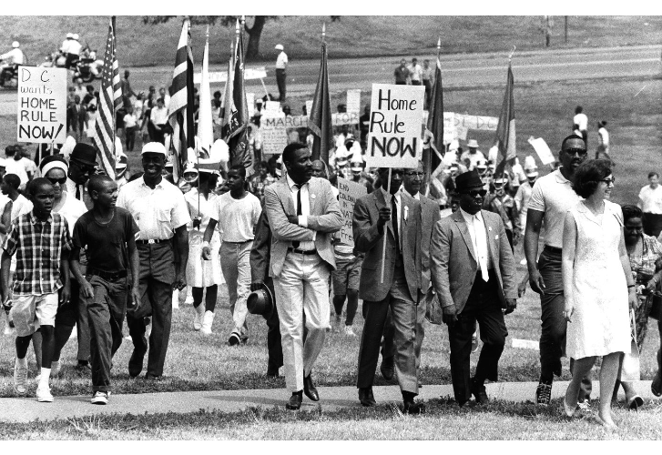
What is a rally?
How do people unite to support their beliefs?
Rally:
Form of a protest
Event where many people gather together for a common purpose
Unites people to support an idea they believe in
Notes:
Teaching notes
Suggested Pacing: 2 minutes
Directions:
Say, “A rally is an event where many people gather together for a common purpose. During a rally, many people unite to support an idea they all believe in.”
Attribution:
Marchers in the Home Rule Day rally. Evening Star (Washington, D.C.). Washington Star Photograph Collection. DC Public Library.

Slide 6
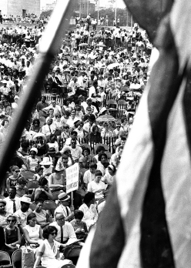
What was the Home Rule Day Rally?
Event sponsored by Youth Organizations for Home Rule in D.C.
4,000 people
32 speakers
Notes:
Teaching notes
Suggested Pacing: 2 minutes
Directions:
Say, “Let's break down a specific rally that took place to support Washington, D.C. Home Rule."
Provide students with the Breaking Down Home Rule Day Rally organizer.
Say, "The Home Rule Day Rally was an event sponsored by an organization called the Youth Organizations for Home Rule in D.C.
4,000 people attended.
32 speakers supported the idea of Home Rule for Washington, D.C."
Ask students to record an answer to the question, “What was the Home Rule Day Rally?” on the “what” row of their Breaking Down Home Rule Day Rally organizer.
Refer to Breaking Down Home Rule Day Rally organizer (completed) as needed.
Attribution:
Community Archives, DC Public Library

Slide 7
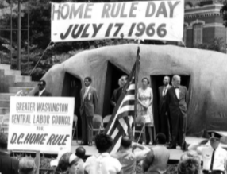
When did the Home Rule Day Rally take place?
The Home Rule Day Rally took place on July 17, 1966
The District of Columbia Home Rule Act became a law on December 24, 1973
Notes:
Teaching notes
Suggested Pacing: 3 minutes
Directions:
Say, “The Home Rule Day Rally took place on July 17, 1966."
Ask students to record an answer to the question, “When did the Home Rule Day Rally take place?” on the “when” row of their Breaking Down Home Rule Day Rally organizer.
Say, “Later in this lesson we will think about the contribution this rally had on passing the Home Rule Act, which became the law in Washington, D.C.
It’s important to recognize that the Home Rule Act became a law in 1973.
How many years after the Home Rule Day Rally did Home Rule become a law in Washington, D.C.?
What does this number say about the fight for home rule?”
Student Look-fors:
Student answers will vary.
There were 7 years between the Home Rule Day Rally and the passing of the District of Columbia Home Rule Act.
The fight for Home Rule in D.C. took a long time, and the residents protested and rallied for many years.
Attribution:
Community Archives, DC Public Library

Slide 8
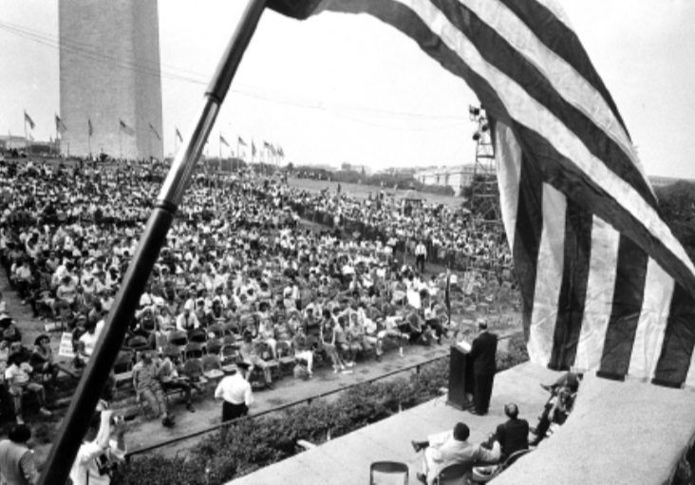
Where did the Home Rule Day Rally take place?
The Home Rule Day Rally took place on the National Mall
Notes:
Teaching notes
Suggested Pacing: 3 minutes
Directions:
Say, “The Home Rule Day Rally took place on the National Mall. Congress debated Home Rule in the Capitol Building during the Rally.
A debate is a discussion between two people or groups who disagree on an important subject."
Ask students to record an answer to the question, “Where did the Home Rule Day Rally take place?” on the “where” row of their Breaking Down Home Rule Day Rally organizer.
Attribution:
Community Archives, DC Public Library

Slide 9
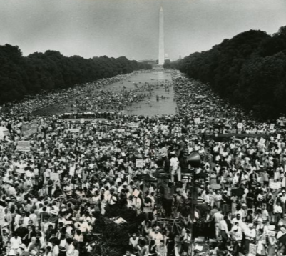
The National Mall
Located in front of the U.S. Capitol
Heart of the three branches of U.S. government
Large open area
Easy for people to walk to and gather
Notes:
Teaching notes
Suggested Pacing: 1 minute
Directions:
Draw student attention to the image of the National Mall.
Say, "The National Mall is a national park located in front of the U.S. Capitol, where Congress meets, and the heart of our three branches of government.
It is a large open area that is easy for people to walk to and gather.
Therefore, many protests and rallies happen at the National Mall."
Attribution:
Poor People's Campaign demonstrators at the Lincoln Memorial Reflecting Pool. Schumaker, Byron. Evening Star (Washington, D.C.). Washington Star Photograph Collection. DC Public Library.

Slide 10
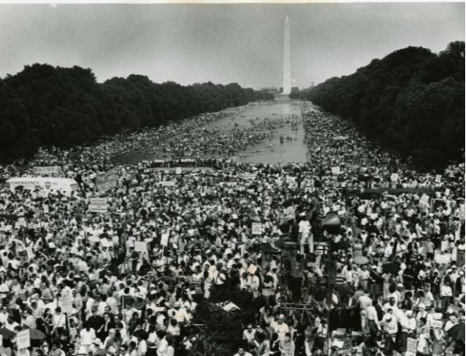
Turn and Talk
What makes this location an important place for protests and rallies? Why do you think the rally took place on the National Mall?
Notes:
Teaching notes
Suggested Pacing: 1 minute
Directions:
Say, “What makes this location an important place for protests and rallies? Why do you think the rally took place on the National Mall?
Turn to your partner and discuss your thinking."
Conduct a whole class discussion, calling on a few students to share their thinking.
Student Look-fors:
Student answers will vary.
The National Mall is located in front of the U.S. Capitol, which is the heart of the three branches of U.S. government.
Important decisions are made at the U.S. Capitol so protesting and rallying there shows the government what people care about.
The National Mall is a large open area, so it is easy for people to walk to and gather.
Additional Note:
One of the most important factors why political marches and events take place on the National Mall is that they are regulated by the National Park Service. By its mission, the Park Service is required to protect free speech rights of U.S. citizens.
Attribution:
Poor People's Campaign demonstrators at the Lincoln Memorial Reflecting Pool. Schumaker, Byron. Evening Star (Washington, D.C.). Washington Star Photograph Collection. DC Public Library.

Slide 11
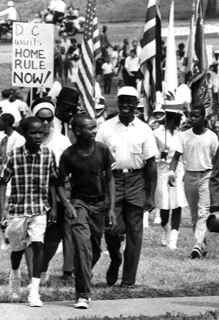
Who were the protestors at Home Rule Day Rally?
Young supporters of Home Rule
Civil rights activists
Senators
Notes:
Teaching notes
Suggested Pacing: 2 minutes
Directions:
Say, “Some of the protestors at the Home Rule Day Rally were young supporters of Home Rule in Washington, D.C.
There were also many civil rights activists involved. Civil rights activists want to change unfair laws.
Many senators and elected officials who decide laws spoke at the Home Rule Day Rally as well. They wanted to be sure that people in Congress were involved.”
Ask students to record an answer to the question, “Who were the protestors at the Home Rule Day Rally?” on the “who” row of their Breaking Down Home Rule Day Rally organizer.
Attribution:
Marchers in the Home Rule Day rally. Evening Star (Washington, D.C.). Washington Star Photograph Collection. DC Public Library.

Slide 12
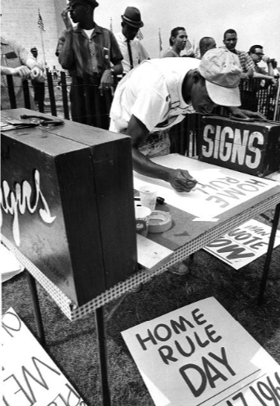
Turn and Talk
Why did the Home Rule Day Rally of 1966 happen?
Notes:
Teaching notes
Suggested Pacing: 2 minutes
Directions:
Say, “Let’s put together everything you’ve learned in this lesson about the Home Rule Day Rally of 1966. Why do you think that the rally happened?”
Prompt students to turn and talk to their partners about the question.
Conduct a whole class discussion calling on a few students to share their thinking.
Students record their responses on the Breaking Down Home Rule Day Rally organizer.
Student Look-fors:
The Home Rule Day Rally happened because people believed that by bringing awareness to the situation in Washington, D.C., they could solve the problem.
Attribution:
Sign painter Herbert Parham at the Home Rule Day rally. Evening Star (Washington, D.C.). Washington Star Photograph Collection. DC Public Library.

Slide 13
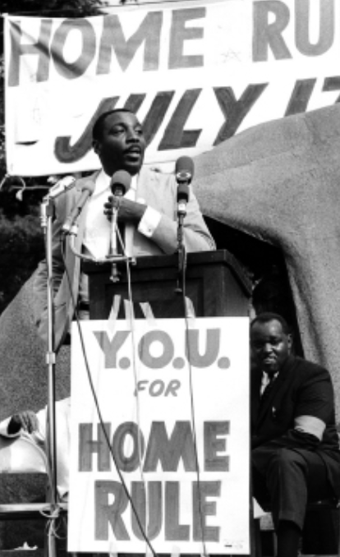
Turn and Talk
How did Home Rule Day Rally contribute to the D.C. Home Rule Act?
Home Rule Day Rally: July 17, 1966
D.C. Home Rule Act: December 24, 1973
Notes:
Teaching notes
Suggested Pacing: 2 minutes
Directions:
Say, “Now that you understand what a rally is, think about the impact of the Home Rule Day Rally.
Remember that the rally took place 7 years before the Home Rule Act became a law.
How do you think the Home Rule Day Rally contributed to the passing of the Home Rule Act?
Turn to your partner and discuss your thinking."
Prompt students to turn and talk to their partners about the question.
Conduct a whole class discussion calling on a few students to share their thinking.
Students record their responses on the Breaking Down Home Rule Day Rally organizer.
Student Look-fors:
The large number of people who attended the Home Rule Day Rally reflected how important Home Rule was to the entire community.
If only 20 people had protested, it would have been unlikely that the issue would have captured any attention.
Because the Home Rule Day Rally showed D.C.’s lack of representation to people outside of Washington, D.C., it helped the cause gain more support.
Attribution:
Community Archives, DC Public Library

Slide 14
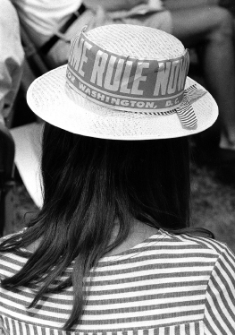
Express Your Understanding!
What was the Home Rule Day Rally, and why was it an important contribution to the District of Columbia Home Rule Act of 1973?
Notes:
Teaching notes
Suggested Pacing: 3 minutes
Directions:
Hand out a copy of the exit ticket.
As a formative assessment, students are asked to complete a quick-write to the following question: "What was the Home Rule Day Rally, and why was it an important contribution to the District of Columbia Home Rule Act of 1973?"
Collect exit tickets as formative assessment.
Student Look-fors:
Student responses will vary.
See completed example.
Attribution:
Community Archives, DC Public Library

