Slide 1
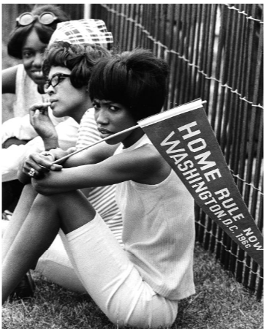
Timeline of D.C. Home Rule History
Home Rule: Grade 3, Lesson 4
Notes:
About this lesson
This lesson focuses on the timeline of Home Rule events from the establishment of the nation’s capital in 1790 through the District of Columbia Home Rule Act of 1973.
Students . . .
track the events discussed in the lesson on a timeline handout.
summarize Washington, D.C.’s journey to Home Rule.
Materials:
Entrance Ticket (blank)
Entrance Ticket (completed)
Timeline of DC Home Rule History (blank)
Timeline of DC Home Rule History (completed)
ELA Standards:
SL.3.1.d: Explain their own ideas and understanding in light of the discussion.
SL.3.1: Engage effectively in a range of collaborative discussions (one-on-one, in groups, and teacher-led) with diverse partners on grade 3 topics and texts, building on others' ideas and expressing their own clearly.
W.3.2.d: Provide a concluding statement or section.
W.3.2.b: Develop the topic with facts, definitions, and details.
RI.3.3: Write narratives to develop real or imagined experiences or events using effective technique, descriptive details, and clear event sequences.
DC Content Power Standards:
3.2: Students understand the basic structure of the Washington, D.C. government.
C3 Framework Indicators and Common Core Standards for Literacy in History/Social Studies:
D2.Civ.4.3-5. Explain how groups of people make rules to create responsibilities and protect freedoms.
D2.Civ.5.3-5. Explain the origins, functions, and structure of different systems of government, including those created by the U.S. and state constitutions.
Attribution:
Supporters at the Home Rule Day rally. Evening Star (Washington, D.C.). Washington Star Photograph Collection. DC Public Library.

Slide 2
Let's Review
What is Home Rule, and why was Home Rule so important to the residents of Washington?
Notes:
Teaching notes
Suggested Pacing: 4 minutes
Directions:
Use an established classroom routine to pair students or use elbow partners.
Provide students with the Entrance Ticket (blank).
Say, “What is Home Rule, and why was Home Rule so important to the residents of Washington?”
Students should record their answers on the Entrance Ticket.
Prompt students to turn and talk to their partners about the question.
Conduct a whole class discussion calling on a few students to share their thinking.
Refer to Entrance Ticket (completed) as needed.
Student Look-fors:
Student responses will vary.
See completed example.
Home rule is the government of an area by its own citizens.
Residents of Washington, D.C. wanted the right to self-govern.
They did not want Congress making decisions for them.
The citizens protested for home rule.
Attribution:
Supporters at the Home Rule Day rally. Evening Star (Washington, D.C.). Washington Star Photograph Collection. DC Public Library.

Slide 3
Timeline of Home Rule History
A timeline is a way of displaying a list of events in the order they happened
Time order is also called chronological order
Notes:
Teaching notes
Suggested Pacing: 1 minute
Directions:
Say, “In this lesson, we are going to take a look at the history of Home Rule in Washington, D.C. To do this, we are going to keep track of those events on a timeline.
A timeline is a way of displaying a list of events in the order they happened.
Time order is also called chronological order.”
Hand out the Timeline of Home Rule History (blank) handout.
Show students where they will keep track of the different events that occurred in Home Rule History.
Refer to Timeline of Home Rule History (complete) handout.

Slide 4
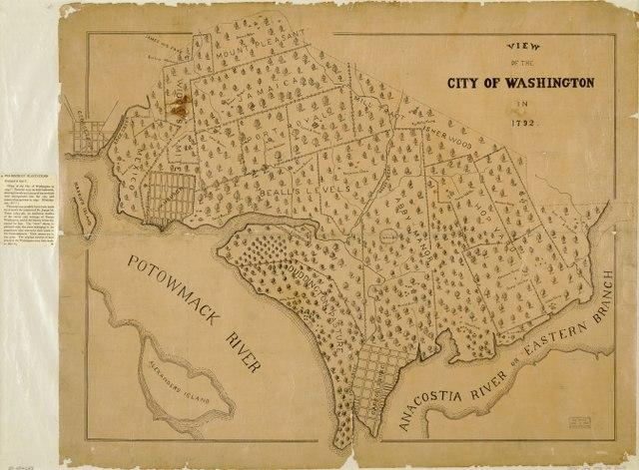
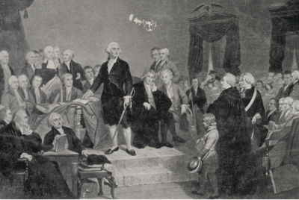
Timeline of Home Rule History: 1790
City of Washington and the Territory of Columbia were established
Formed from land that came from Maryland and Virginia
Notes:
Teaching notes
Suggested Pacing: 2 minutes
Directions:
Say, “The City of Washington and the Territory of Columbia were established in the year 1790. The Territory was formed from land that came from Maryland and Virginia."
Ask students to record the following date and details on the Timeline of Home Rule History handout:
1790
City of Washington and the Territory of Columbia established
Formed from land that came from Maryland and Virginia
Attributions:
Library of Congress Geography and Map Division, Washington, DC.
George Washington takes his oath of office during his inauguration. Historic Image Collection. DC Public Library

Slide 5
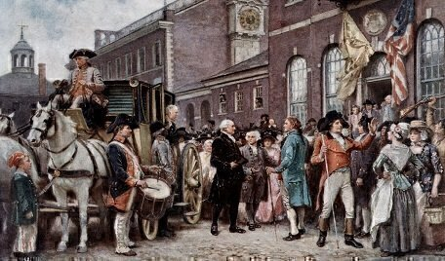
Timeline of Home Rule History: 1800
Capital of the United States moved from Philadelphia to the City of Washington
Notes:
Teaching notes
Suggested Pacing: 2 minutes
Directions:
Say, “In 1800, the Capital of the United States moved from Philadelphia to the City of Washington. At this point, the City of Washington was officially the Nation’s Capital. The Capitol building was not completely constructed at this time.”
Ask students to record the following date and details on the Timeline of Home Rule History handout:
1800
Capital of the United States moved from Philadelphia to the City of Washington
Attribution:
Washington's Inauguration at Philadelphia

Slide 6
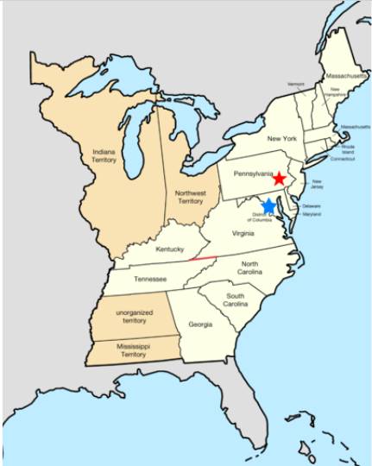
Turn and Talk
Why do you think the capital was moved from Philadelphia to the City of Washington?
Notes:
Teaching notes
Suggested Pacing: 2 minutes
Directions:
Say, “Let’s think about this event for a minute. Why do you think the capital was moved from Philadelphia to the City of Washington?
Look at the map to guide your thinking. The red star on the map represents the City of Philadelphia. The blue star represents the City of Washington.
Turn to your partner and discuss your thinking."
Prompt students to turn and talk to their partners about the question.
Conduct a whole class discussion calling on a few students to share their thinking.
Student Look-fors:
Student responses will vary.
The capital moved south to the City of Washington so that it was closer to the middle of the United States.
Attribution:
Golbez / CC BY-SA

Slide 7
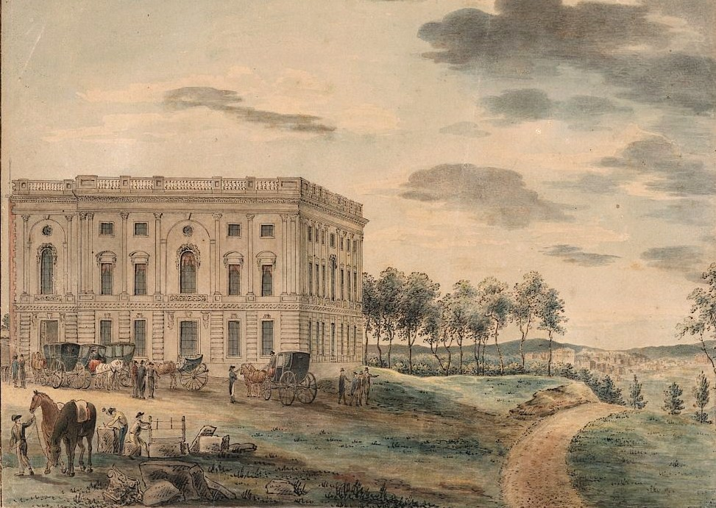
Timeline of Home Rule History: 1802
Citizens protested for self-government
President gave the City of Washington a mayor
Notes:
Teaching notes
Suggested Pacing: 2 minutes
Directions:
Say, “In 1802, the citizens of the City of Washington started protesting for self-government. They wanted the opportunity to govern themselves.
Congress also allowed the City of Washington to have a mayor; that mayor needed to be appointed by the President.”
Ask students to record the following date and details on the Timeline of Home Rule History handout:
1802
Citizens protested for self-government
President gave the City of Washington a mayor
Attribution:
Washington DC

Slide 8
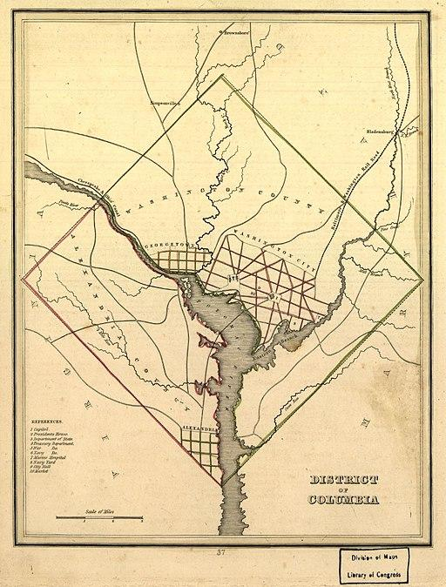
Timeline of Home Rule History: 1871
The Organic Act of 1871:
​​​​​​​Combined Alexandria, Georgetown, and the City of Washington, which would become the District of Columbia
Notes:
Teaching notes
Suggested Pacing: 2 minutes
Directions:
Say, “After the Civil War, the City of Washington’s population grew quickly. Even though so many people were living there, the City was not in good shape. It still had dirt roads and problems keeping the city clean.
Congress needed to make a change, especially because the City of Washington was the nation’s capital. Congress passed the Organic Act of 1871.
The Organic Act combined Alexandria, Georgetown, and the City of Washington.
The area became the District of Columbia. Alexandria was formerly in Virginia. Georgetown was formerly in Maryland."
Ask students to record the following event and detail on the Timeline of Home Rule History handout:
Organic Act of 1871
Combined Alexandria, Georgetown, and the City of Washington, which would become the District of Columbia
Attribution:
Unknown author / Public domain

Slide 9
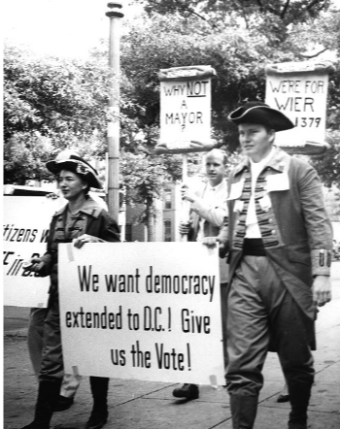
Turn and Talk
Why did the citizens of Washington, D.C. push for self-government?
Notes:
Teaching notes
Suggested Pacing: 2 minutes
Directions:
Say, “From 1948 until 1966, the citizens of Washington, D.C. pushed for self-government. Why do you think the citizens would push for self-government? Turn to your partner and discuss you thinking."
Prompt students to turn and talk to their partners about the question.
Conduct a whole class discussion calling on a few students to share their thinking.
Student Look-fors:
Student responses will vary.
The citizens would want the freedom to make their own laws and choices rather than have Congress and the President make those decisions for them.
Attribution:
D.C. residents march for home rule in colonial costumes. Evening Star (Washington, D.C.). Washington Star Photograph Collection. DC Public Library.

Slide 10
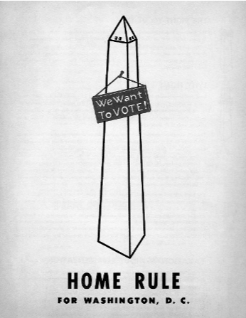
Timeline of Home Rule History: 1948 to 1966
Home Rule bills introduced in Congress but none passed
Struggle for D.C. Home Rule continued
Notes:
Teaching notes
Suggested Pacing: 2 minutes
Directions:
Say, “When people in the United States have ideas about something they want to see happen across the country, they send those ideas to the House of Representatives or the Senate, which are the two parts of the US Congress.
These ideas come from people in different states across the country, and the ideas are turned into Bills. Bills are then voted on by the Congress.
If Congress passes a bill, it goes to the President to be signed into law.
Between 1948 to 1966, six bills were introduced in Congress to provide some form of home rule for the District. They never became laws, and the struggle for D.C. Home Rule continued.”
Ask students to record the following dates and details to the Timeline of Home Rule History handout:
1948 to 1966
Home Rule bills introduced in Congress but none passed
Struggle for D.C. Home Rule continued
Attribution:
Home rule for Washington, D.C. poster.Washingtoniana Ephemera Collection. DC Public Library.

Slide 11
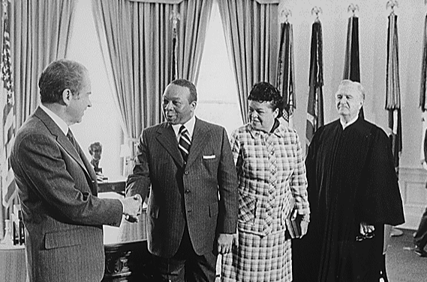
Timeline of Home Rule History: 1967
Walter Washington became Mayor-Commissioner
Notes:
Teaching notes
Suggested Pacing: 2 minutes
Directions:
Say, “In 1967, President Johnson convinced Congress to remove the three-commissioner government. Washington, D.C. had a presidentially appointed Mayor-Commissioner, Walter Washington.
Unlike all other mayors, Washington had the title of mayor but was not elected by the people. This moved the District a step closer to home rule.”
Ask students to record the following date and detail to the Timeline of Home Rule History handout:
1967
Walter Washington became Mayor-Commissioner
Attribution:
Jack E. Kightlinger, White House Photographer / Public domain

Slide 12
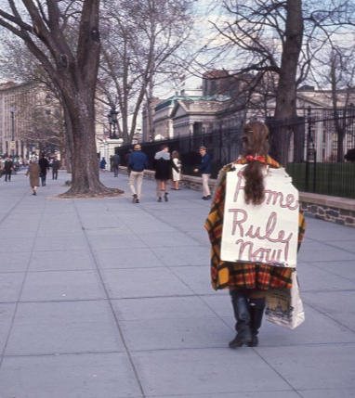
Timeline of Home Rule History: 1970
Earned right to elect a representative to Congress, but could not vote
Had the chance to elect a representative to Congress
Notes:
Teaching notes
Suggested Pacing: 2 minutes
Directions:
Say, “In 1970, citizens of Washington D.C. were given the right to elect a representative to Congress. This representative could not vote. For the first time in 100 years, Washingtonians had the chance to elect a representative to Congress.”
Ask students to record the following date and details on the Timeline of Home Rule History handout:
1970
Earned right to elect a representative to Congress, but could not vote
Had the chance to elect a representative to Congress
Attributions:
Woman protesting for Home Rule outside of White House. Crain, Darrell C., 1910-1995. Darrell C. Crain, Jr. Photograph Collection. DC Public Library.DC Public Library.

Slide 13
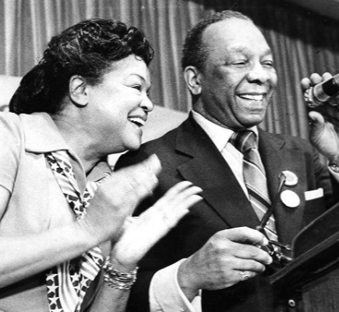
Timeline of Home Rule History: 1973
The District of Columbia Home Rule Act became a United States federal law
Walter Washington became the first Home Rule Mayor of Washington, D.C.
Notes:
Teaching notes
Suggested Pacing: 2 minutes
Directions:
Say, “On December 24, 1973, the hard work of all those who fought for D.C. Home Rule paid off. The District of Columbia Home Rule Act became a federal law.
With this law, the citizens of Washington, D.C. gained certain powers. This was an extremely important turning point in Washington, D.C.’s fight for representation.
After almost 200 years, Washington, D.C. had the right to elect a mayor.
Walter Washington became the first Home Rule Mayor of Washington, D.C.
The citizens also had the right to elect a district council. A council is a group of people elected to manage a city or district. This council had the ability to pass laws.”
Ask students to record the following date and details on the Timeline of Home Rule History handout:
1973
The District of Columbia Home Rule Act became a United States federal law
Walter Washington became the first Home Rule Mayor of Washington, D.C.
Attributions:
Walter and Bennetta Washington celebrate on election night. Evening Star (Washington, D.C.). Washington Star Photograph Collection. DC Public Library.

Slide 14
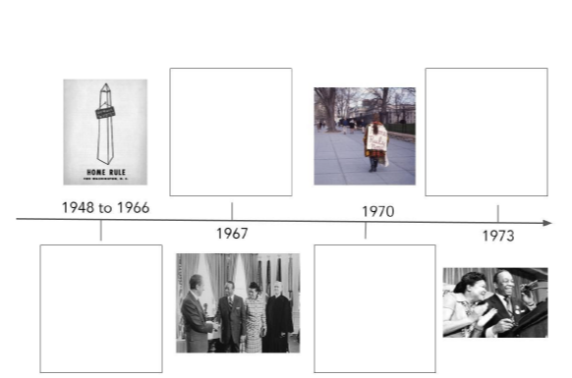
Express Your Understanding
With your partner, tell the story of how Washington, D.C. achieved Home Rule using the timeline as a resource.
Notes:
Teaching notes
Suggested Pacing: 3 minutes
Directions:
As a formative assessment, students are asked to tell the story of how Washington, D.C. achieved Home Rule using the timeline as a resource.
Student Look-fors:
Students should be able to describe the history of D.C. Home Rule by referring to their timeline.
Students who have not completed timeline should add information from their partner’s timeline.

