Slide 1
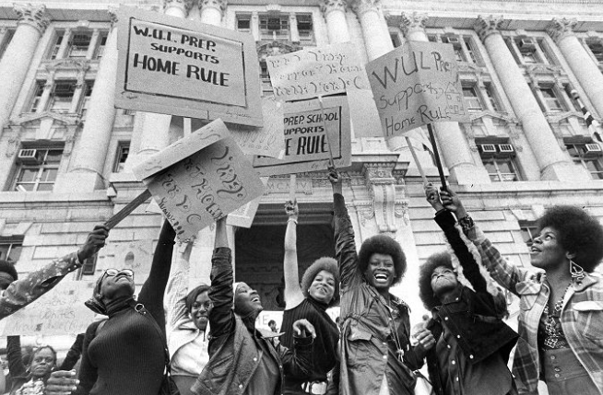
What is D.C. Home Rule?
Home Rule: Grade 3, Lesson 3
Notes:
About this lesson
This lesson focuses on the District of Columbia Home Rule Act of 1973 and its passing.
Students . . .
explain how the Home Rule Act provided Washington, D.C. with greater autonomy.
identify the restrictions that were held in place after the Home Rule Act of 1973 was passed.
Materials:
Vocabulary Log (blank)
Vocabulary Log (completed)
Home Rule T-Chart (blank)
Home Rule T-Chart (completed)
Exit Ticket (blank)
Exit Ticket (completed)
ELA Standards:
SL.3.1.d: Explain their own ideas and understanding in light of the discussion.
SL.3.1: Engage effectively in a range of collaborative discussions (one-on-one, in groups, and teacher-led) with diverse partners on grade 3 topics and texts, building on others' ideas and expressing their own clearly.
W.3.2.d: Provide a concluding statement or section.
W.3.2.b: Develop the topic with facts, definitions, and details.
RI.3.7: Use information gained from illustrations (e.g., maps, photographs) and the words in a text to demonstrate understanding of the text (e.g., where, when, why, and how key events occur).
RI.3.4: Determine the meaning of general academic and domain-specific words and phrases in a text relevant to a grade 3 topic or subject area.
RI.3.3: Describe the relationship between a series of historical events, scientific ideas or concepts, or steps in technical procedures in a text, using language that pertains to time, sequence, and cause/effect.
DC Content Power Standards:
3.2: Students understand the basic structure of the Washington, D.C. government.
3.2.1: Describe its duties, organizational structures, and functions.
3.2.2: Explain why it is necessary for communities to have governments (e.g., governments provide order and protect rights).
C3 Framework Indicators and Common Core Standards for Literacy in History/Social Studies:
D2.Civ.3.3-5. Examine the origins and purposes of rules, laws, and key U.S. constitutional provisions.
D2.Civ.4.3-5. Explain how groups of people make rules to create responsibilities and protect freedoms.
D2.Civ.5.3-5. Explain the origins, functions, and structure of different systems of government, including those created by the U.S. and state constitutions.

Slide 2
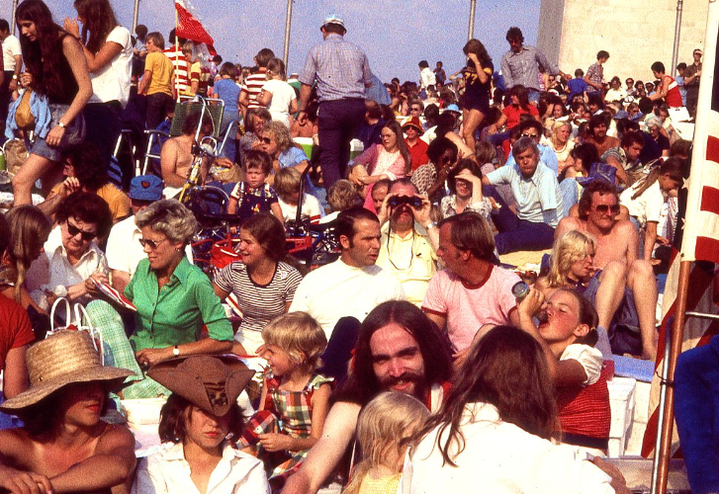
Let’s Discuss
Why is it important for citizens to have a say in how their government works?
Notes:
Teaching notes
Suggested Pacing: 2 minutes
Directions:
Use an established classroom routine to pair students or use elbow partners.
Say, “Why is it important for people to have a say in how their government works?”
Prompt students to turn and talk to their partners about the question.
Conduct a whole class discussion calling on a few students to share their thinking.
Student Look-Fors:
It is important for people to have a say in their government so that citizens have a voice in the issues that impact their lives.
It is also important because it provides citizens with an opportunity to represent themselves and speak up for what they believe in.
The United States is a democracy.
Democracy means “rule by the people” and in order to have democracy, the people need to have a say in how the government is run.
Attribution:
Bicentennial crowd by Washington Monument. Crain, Darrell C., 1910-1995. Darrell C. Crain, Jr. Photograph Collection. DC Public Library.

Slide 3
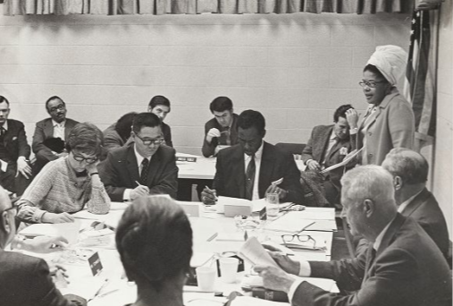
Self-Governance
Self-governance: giving the people in a group or community control over decisions
Notes:
Teaching notes
Suggested Pacing: 2 minutes
Directions:
Say, “When we talk about people having a say in how their government works, we are talking about 'self-governance.' Self-governance gives the people in a group or community control over decisions. This is democracy.”
Provide students with the Vocabulary Log (blank).
Ask students to record the following definition on the Vocabulary Log next to the term.
Self-governance
giving the people in a group or community control over decisions
Refer to the Vocabulary Log (completed) as needed.
Attribution:
DC Public Library Board of Trustees name Martin Luther King Jr. Memorial Library. DC Public Library, Special Collections, DC Public Library Archives - MLK Library ca 1972. DC Public Library.

Slide 4
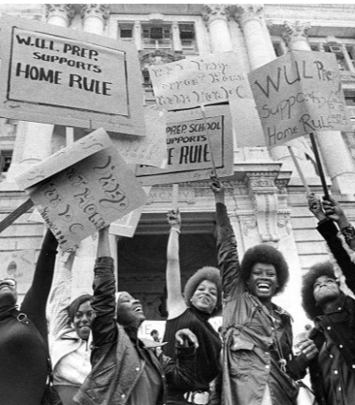
Why is Self-Governance Important?
Gives citizens a role in decision-making
Gives members of a community the right and ability to make the rules of daily life
Gives citizens a voice in the issues that impact their lives
Notes:
Teaching notes
Suggested Pacing: 2 minutes
Directions:
Say, “Self-governance is important for many reasons. First of all, it gives citizens a role in decision-making. Citizens can come together to make decisions that will benefit their communities.
Additionally, self-governance gives citizens the right and ability to govern themselves.
Finally, self-governance gives citizens a voice in the issues that impact their lives. Rather than having choices made for them, citizens can represent themselves and speak up for what they believe in.”
Attribution:
WUL Prep students at a home rule rally. Evening Star (Washington, D.C.) Washington State Photograph Collection. DC Public Library.

Slide 5
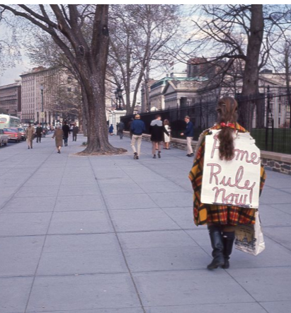
Congress and Washington, D.C.
Washington, D.C. was founded as a district
The Constitution said Washington, D.C. would be governed by Congress
The citizens of Washington, D.C. do not have the freedom of self-governance
Notes:
Teaching notes
Suggested Pacing: 1 minute
Directions:
Say, “Washington, D.C. serves a special role in the United States as the nation’s capital. According to the Constitution, the nation's capital city must be in a district, not a state.
It also allows Congress to govern the capital city, the District of Columbia. This means that self-governance did not exist in Washington, D.C.”
Attribution:
Woman protesting for Home Rule outside of White House. Crain, Darrell C., 1910-1995. Darrell C. Crain, Jr. Photograph Collection. DC Public Library.

Slide 6
Let's Discuss
How did the lack of self-governance impact the citizens of Washington, D.C.?
Notes:
Teaching notes
Suggested Pacing: 2 minutes
Directions:
Say, “How do you think a lack of self-governance impacted the citizens of Washington, D.C.?"
Prompt students to turn and talk with their partners about the question.
Conduct a whole class discussion, calling on a few students to share their thinking.
Student Look-fors:
Residents may have felt powerless.
They may have felt frustrated because they could not control how their own city was governed.
Attribution:
Conversation Clipart

Slide 7
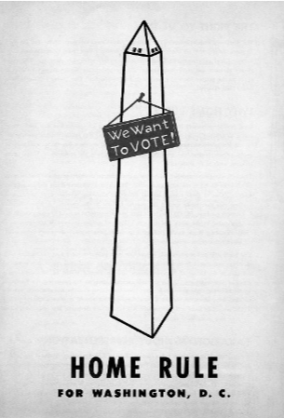
Impact on Washingtonians
D.C. wanted the right to self-govern
The citizens did not want Congress making decisions for them
They protested for home rule
Home rule is the government of a region by its own citizens
Notes:
Teaching notes
Suggested Pacing: 2 minutes
Directions:
Say, “Many people in Washington, D.C. refused to accept their lack of self-governance.They wanted the same rights that people in other states had, even though the federal government was in their city.
Many protests for the right to self-govern took place in Washington, D.C. Washingtonians wanted the right to govern themselves instead of allowing Congress to make decisions for them. They wanted home rule. Home rule is the government of a region by its own citizens.”
Ask students to record the following definition on the Vocabulary Log next to the term.
Home rule
government of a region by its own citizens
Attribution:
Home rule for Washington, D.C. poster. Washingtoniana Ephemera Collection. DC Public Library.

Slide 8
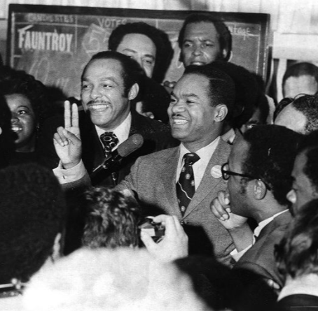
Home Rule Act passed
Congressman Walter Fauntroy led the efforts to gain home rule.
The District of Columbia Home Rule Act became a United States federal law on December 24, 1973.
President Richard Nixon signed the Home Rule Act into law.
Notes:
Teaching notes
Suggested Pacing: 1 minute
Directions:
Say, “Walter Fauntroy, a United States Congressman, led the citizens of Washington, D.C. and fought tirelessly for home rule.
The persistence and hard work of Washington, D.C. paid off. On December 24, 1973, President Richard Nixon signed the District of Columbia Home Rule Act into law.”
Attribution:
Reverend Walter Fauntroy flashes V for victory. Evening Star (Washington, D.C.). Washington Star Photograph Collection. DC Public Library.

Slide 9
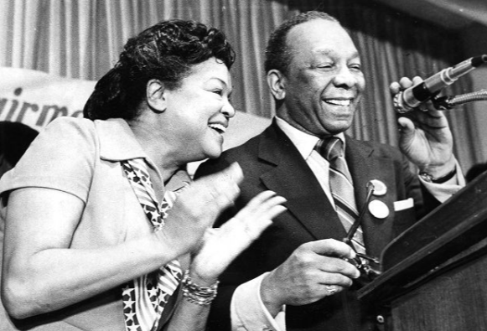
Moving Toward Self-Governance
The Home Rule Act of 1973 gave certain powers to Washington, D.C.
Elect a Mayor
Elect a District Council
District Council can pass local laws
Notes:
Teaching notes
Suggested Pacing: 3 minutes
Directions:
Say, “With the Home Rule Act of 1973, the citizens of Washington, D.C. gained certain powers. Washington, D.C. now had the right to elect a mayor. Walter Washington became the first mayor of Washington, D.C.
The citizens also had the right to elect a district council. A council is a group of people elected to manage a city or district. This council had the ability to pass laws.
These were all steps in the right direction for self-governance.”
Provide students with a copy of the Home Rule T-Chart (blank).
Ask students to record the following bullet notes on their Home Rule T-Chart in the “Moving Toward Self-Governance” column.
Elect a Mayor
Elect a District Council
District Council can pass local laws
Refer to the Home Rule T-Chart (completed) handout as needed.
Attribution:
Walter and Bennetta Washington celebrate on election night. Evening Star (Washington, D.C.). Washington Star Photograph Collection. DC Public Library.

Slide 10
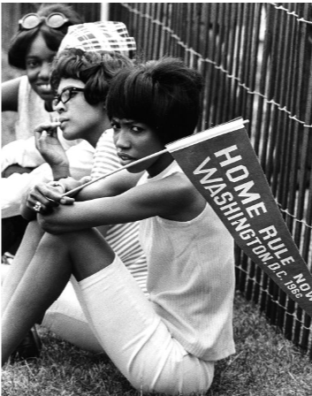
Remaining Restrictions
Some restrictions were still held in place after the Home Rule Act of 1973 was passed
The District's new laws still needed approval of Congress
The District's budget needed approval of Congress
Notes:
Teaching notes
Suggested Pacing: 3 minutes
Directions:
Say, “Unfortunately, some restrictions were still held in place after the Home Rule Act of 1973 was passed. The District Council could pass laws, but only if they also had the approval of Congress.
The citizens could also determine their own budget, or how they would spend money for the district. However, this budget also needed to be approved by Congress.
Even though Washington, D.C. had moved a few steps closer, they were still lacking what they needed to truly self-govern."
Ask students to record the following bullet notes on their Home Rule T-Chart in the “Restrictions Remain” column.
New laws still needed approval of Congress
Budget needed approval of Congress
Attribution:
Supporters at the Home Rule Day rally. Evening Star (Washington, D.C.). Washington Star Photograph Collection. DC Public Library.

Slide 11
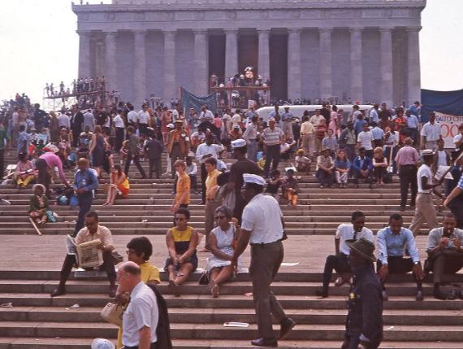
Let's Discuss
How did the Home Rule Act of 1973 move Washington, D.C. closer to self-governance?
In what ways did the Home Rule Act of 1973 continue to restrict the citizens of Washington, D.C.?
Notes:
Teaching notes
Suggested Pacing: 4 minutes
Directions:
Use an established classroom routine to pair students or use elbow partners.
Say, “How did the Home Rule Act of 1973 move Washington, D.C. closer to self-governance? In what ways did the Home Rule Act of 1973 continue to restrict the citizens of Washington, D.C.?”
Prompt students to turn and talk to their partners about the question.
Conduct a whole class discussion calling on a few students to share their thinking.
Student Look-fors:
The Home Rule Act of 1973 moved Washington, D.C. toward self-governance by giving the district the power to elect a mayor and elect a district council. The Home Rule Act also gave the newly formed District Council the ability to pass local laws.
The Home Rule Act of 1973 continued to restrict the citizens of Washington, D.C. by requiring Congressional approval for the District’s budget and for new laws.
Attribution:
Solidarity Day protesters on steps of Lincoln Memorial. Crain, Darrell C., 1910-1995. Darrell C. Crain, Jr. Photograph Collection. DC Public Library.Library.

Slide 12
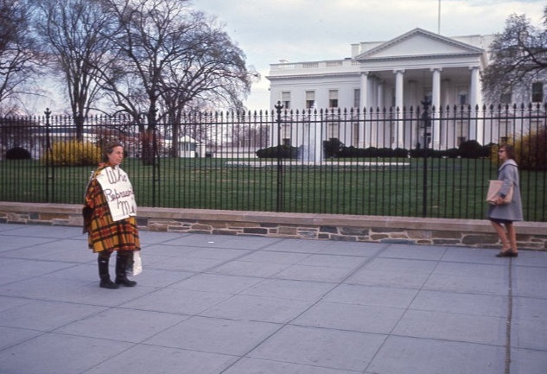
Express Your Understanding!
What impact did the Home Rule Act of 1973 have on self-governance for Washington, D.C.?
Notes:
Teaching notes
Suggested Pacing: 4 minutes
Directions:
Hand out a copy of the Exit Ticket (blank).
As a formative assessment, students are asked to complete a quick-write to the following question: "What impact did the Home Rule Act of 1973 have on self-governance for Washington, D.C.?”
Collect exit tickets as formative assessment.
Student Look-fors:
Student responses will vary.
See completed example.
Attribution:
Woman protests for Home Rule outside of White House. Crain, Darrell C., 1910-1995. Darrell C. Crain, Jr. Photograph Collection. DC Public Library.

