Slide 1
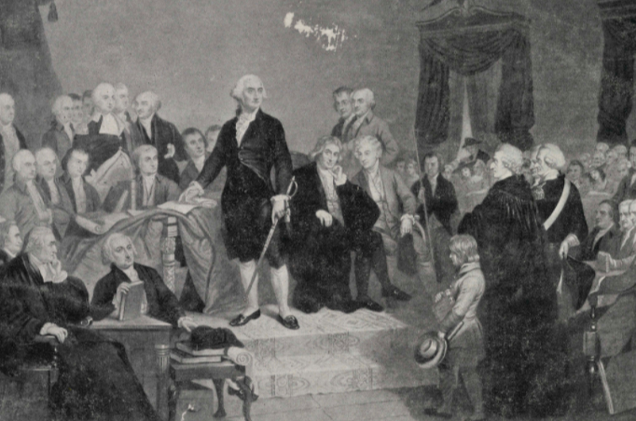
Why is Washington, D.C. a District?
Home Rule: Grade 3, Lesson 2
Notes:
About this lesson
This lesson focuses on the Constitutional decision to designate Washington, D.C. as a district rather than as a state. Students will be able to explain why the Framers of the Constitution decided to deny Washington, D.C. statehood.
Students . . .
track new terms on a vocabulary log.
identify the areas surrounding Washington, D.C. by filling in a map.
express their understanding with a formative exit ticket.
Materials:
Map of Washington DC Area (blank)
Map of Washington DC Area (completed)
Vocabulary Log (blank)
Vocabulary Log (completed)
Exit Ticket (blank)
Exit Ticket (completed)
ELA Standards:
SL.3.1.d: Explain their own ideas and understanding in light of the discussion.
W.3.2.d: Provide a concluding statement or section.
W.3.2.b: Develop the topic with facts, definitions, and details.
RI.3.7: Describe the relationship between a series of historical events, scientific ideas or concepts, or steps in technical procedures in a text, using language that pertains to time, sequence, and cause/effect.
RI.3.3: Use information gained from illustrations (e.g., maps, photographs) and the words in a text to demonstrate understanding of the text (e.g., where, when, why, and how key events occur).
DC Content Power Standards:
3.2: Students understand the basic structure of the Washington, D.C. government.
3.2.1: Describe its duties, organizational structures, and functions.
3.2.2: Explain why it is necessary for communities to have governments (e.g., governments provide order and protect rights).
C3 Framework Indicators and Common Core Standards for Literacy in History/Social Studies:
D2.Civ.3.3-5. Examine the origins and purposes of rules, laws, and key U.S. constitutional provisions.
D2.Civ.4.3-5. Explain how groups of people make rules to create responsibilities and protect freedoms.
D2.Civ.5.3-5. Explain the origins, functions, and structure of different systems of government, including those created by the U.S. and state constitutions.

Slide 2
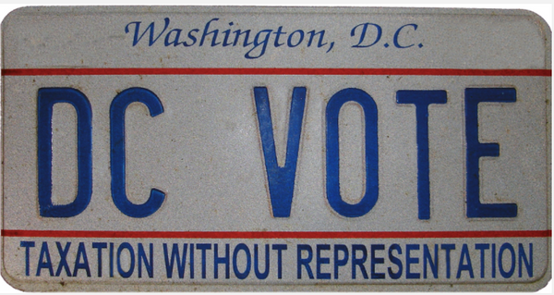
Let's Discuss!
How is Washington, D.C. different from the 50 states in the United States?
Maryland and Virginia are states.
Washington, D.C. is a district.
Notes:
Teaching notes
Suggested Pacing: 2 minutes
Directions:
Use an established classroom routine to pair students or use elbow partners.
Say, “How is Washington, D.C. different from the 50 states in the United States?”
Prompt students to turn and talk to their partners about the question.
Conduct a whole class discussion calling on a few students to share their thinking.
Student Look-Fors:
Student responses will vary.
Washington is not part of a state; it is a separate district called the District of Columbia.
The city and the district take up the same space.
D.C. residents do not have the same rights that American citizens in the 50 states do.
Washington, D.C. does not have a voice in Congress because representatives to Congress are elected only by Americans living in the 50 states.
Attribution:
DC VOTE license plate. District of Columbia. Department of Motor Vehicles. Washingtoniana Ephemera Collection. DC Public Library.

Slide 3
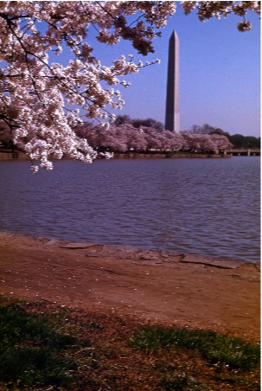
Let's Review
Washington, D.C.
not part of a state
a separate district called the District of Columbia
the city and the district take up the same space
residents of Washington, D.C. do not have a voice in Congress
Notes:
Teaching notes
Suggested Pacing: 1 minute
Directions:
Say, “Let’s review some basic facts about Washington, D.C. To begin, Washington, D.C. is not part of a state. It is actually a separate district called the District of Columbia. The city and the district take up the same space.
Remember also that unlike residents of states, residents of Washington, D.C. do not have a voice in Congress.
In today's lesson, we will learn about why Washington, D.C. is a district and not a state."
Provide students with the Map of Washington. D.C. Area (blank) handout and the Vocabulary Log (blank) handout.
Refer to the Map of Washington. D.C. Area (completed) handout and the Vocabulary Log (completed) handout as needed.
Attribution:
Cherry tree blooms on the Tidal Basin overlooking the Washington Monument. Crain, Darrell C., 1910-1995. Darrell C. Crain, Jr. Photograph Collection. DC Public Library.

Slide 4
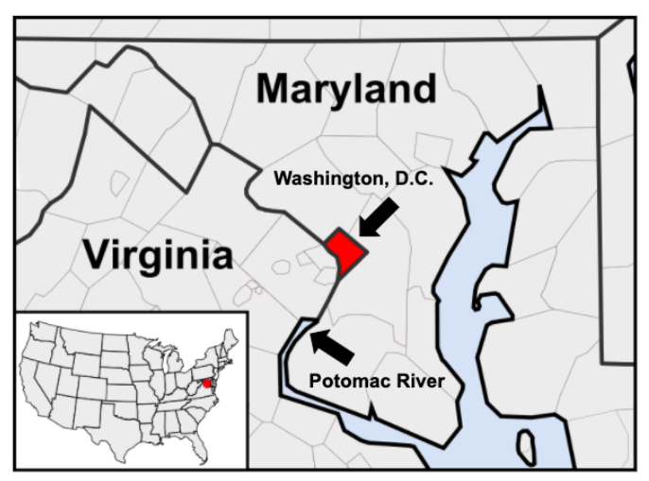
The Nation’s Capital: Washington, D.C.
Notes:
Teaching notes
Suggested Pacing: 3 minutes
Directions:
Say, “Let’s also review some geography to get an idea of the area surrounding Washington, D.C.
The dark shaded area in the middle is Washington, D.C. To the north and east is the state of Maryland. To the west is the state of Virginia. The Potomac River is also west and east of Washington, D.C.
In 1791, both Maryland and Virginia donated land to form the District of Columbia.”
Ask students to record the missing information on their Map of Washington. D.C. Area (blank) handout.
Maryland
Virginia
Washington, D.C.
Potomac River
Attribution:
USA_Counties.svg

Slide 5
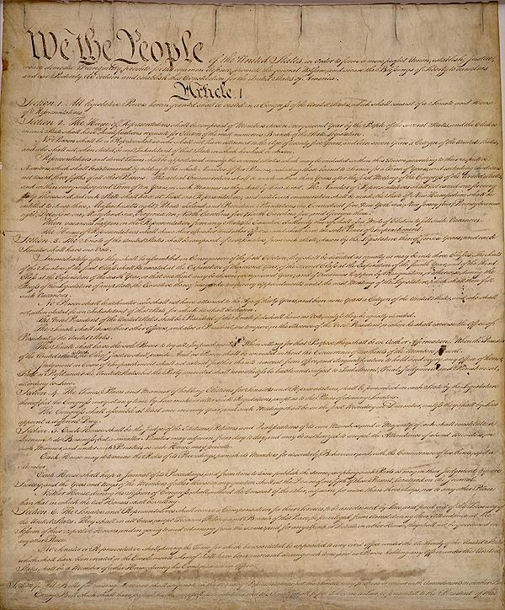
What is the Constitution?
highest law in the United States
all other laws come from the Constitution
explains how the government works
Notes:
Teaching notes
Suggested Pacing: 2 minutes
Directions:
Say, “When we want to understand why Washington, D.C. did not become a state in the first place, we need to look back at the United States Constitution. What is the Constitution?”
Ask students to record the following definition on the Vocabulary Log (blank) handout next to the term.
Constitution
highest law in the United States
all other laws come from the Constitution
explains how the government works
Attribution:
Constitutional Convention / Public domainCollection. DC Public Library.

Slide 6
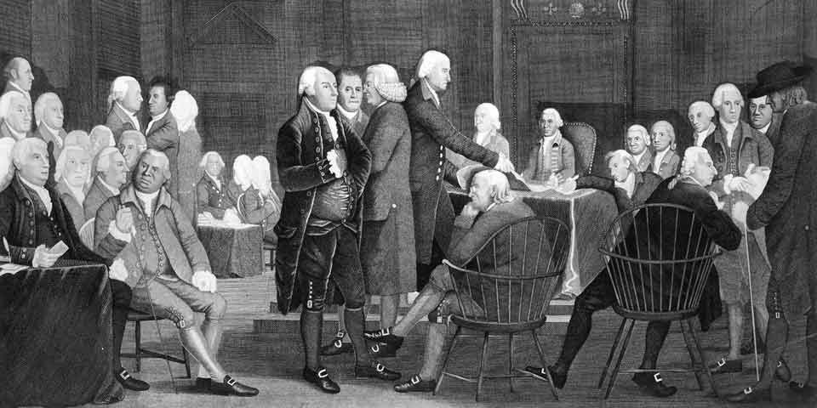
The Framers of the Constitution
a group of men who wrote the Constitution as a new way of running the country
Notes:
Teaching notes
Suggested Pacing: 2 minutes
Directions:
Say, "The Framers of the Constitution came together in 1787. The Framers were a group of men who were not happy with the way the United States was running as a new country. They planned to make changes by writing the Constitution.
George Washington and Benjamin Franklin were two Framers of the Constitution.”
Ask students to record the following definition on the Vocabulary Log (blank) handout next to the term.
Framers of the Constitution
a group of men who wrote the Constitution as a new way of running the country
Attribution:
Assembly Room of Independence Hall. NPS photo.

Slide 7
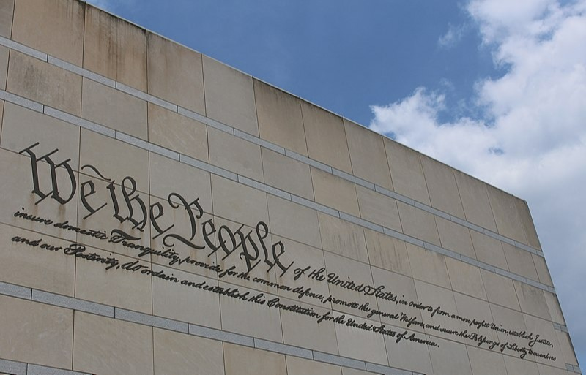
Parts of the Constitution
Preamble
states the goals and purposes of the government
Articles
main part that describe how the government is set up
Sections and clauses
divide up the articles to make them easier to understand
Amendments
changes that were made
Notes:
Teaching notes
Suggested Pacing: 4 minutes
Directions:
Say, “The Constitution is a very long document that is split into parts. The first part is called the Preamble. The Preamble states the goals and purposes of the government.
The Preamble is followed by seven Articles. Articles are the main parts of the Constitution. They describe how the government is set up. The Articles are divided into sections and clauses that make them easier to understand.
Finally, the Constitution includes Amendments. Amendments are the changes that have been made to the Constitution.”
Ask students to record the following definitions on the Vocabulary Log (blank) handout next to the terms.
Preamble
states the goals and purposes of the government
Articles
main part that describe how the government is set up
Sections and clauses
divide up the articles to make them easier to understand
Amendments
changes that were made
Attributions:
Housefinch1787 / CC BY-SA
Constitutional Convention / Public domain

Slide 8
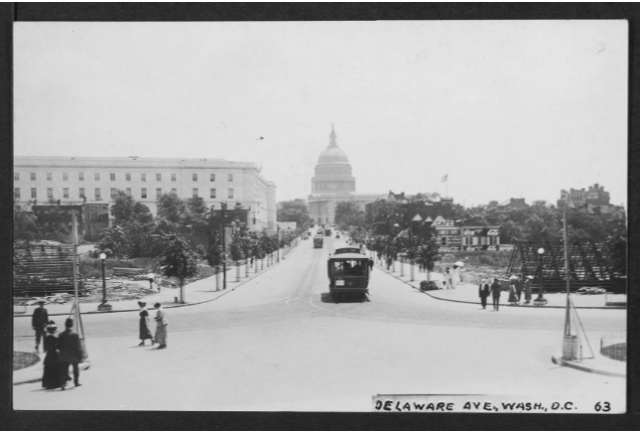
What is a capital?
A city that is home to a government
Every state has a capital
The capital city of the United States is Washington, D.C.
Notes:
Teaching notes
Suggested Pacing: 2 minutes
Directions:
Say, “One word we need to understand before we focus on the Constitution is capital. What is a capital? A capital is a city that is home to a government. Every state and country has a capital. The capital city of the United States is Washington, D.C.”
Ask students to record the following definition on the Vocabulary Log (blank) handout next to the term.
Capital
a city that is home to a government
Attribution:
Delaware Avenue, Washington, D.C. - 63. Ross, Willard R., 1860-1948. Willard R. Ross Postcard Collection. DC Public Library.

Slide 9
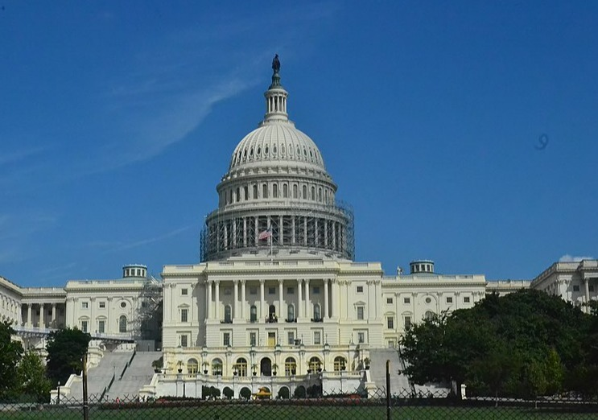
The Constitution and America’s Capital
Article 1, Section 8, Clause 17 - Powers of Congress.
declares that the country’s capital city must be in a district, not a state
allows Congress to govern the capital city, the District of Columbia
Notes:
Teaching notes
Suggested Pacing: 2 minutes
Directions:
Say, ”So what does the Constitution say about America’s capital? Article 1, Section 8, Clause 17 of the Constitution is about the Powers of Congress.
It states that our country's capital city must be in a district, not a state. It also allows Congress to govern the capital, the District of Columbia.”
Attribution:
KelliMays / CC BY-SA

Slide 10
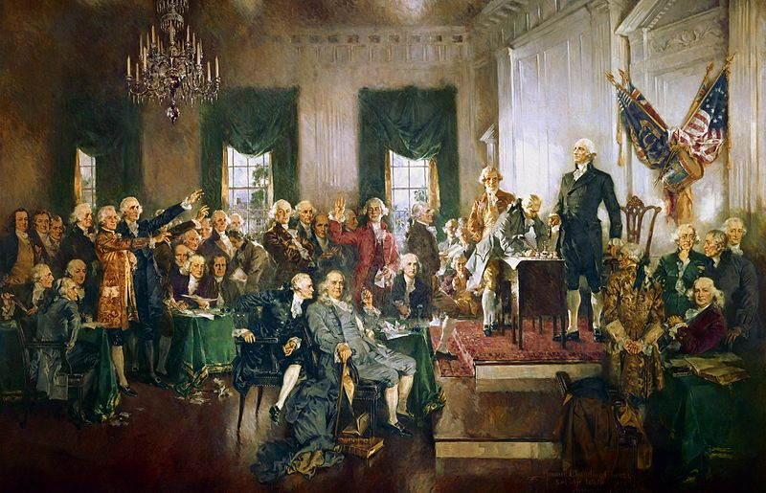
Turn and Talk
Why would the Framers of the Constitution want Congress to be able to govern the District of Columbia?
Notes:
Teaching notes
Suggested Pacing: 2 minutes
Directions:
Use an established classroom routine to pair students or use elbow partners.
Say, “Why would Framers of the Constitution want Congress to be able to govern the District of Columbia?”
Prompt students to turn and talk to their partners about the question.
Conduct a whole class discussion calling on a few students to share their thinking.
Student Look-Fors:
Student responses will vary.
The Framers would want Congress to be able to govern the District of Columbia because it was so close to the nation’s capital.
Attribution:
Howard Chandler Christy / Public domain

Slide 11
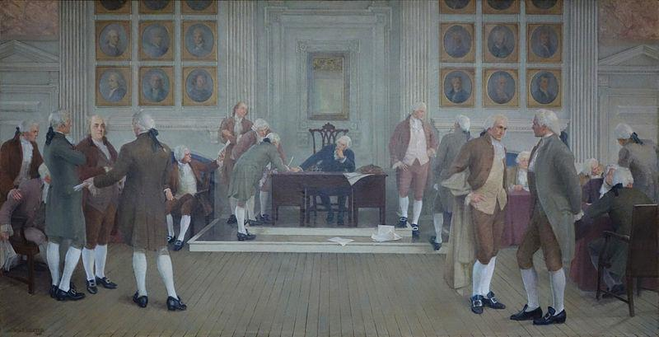
Concerns of the Framers
Members of the government would feel loyal to the capital and this would influence their decision-making
Notes:
Teaching notes
Suggested Pacing: 1 minute
Directions:
Say, “The Framers of the Constitution were concerned that if the capital were to be a state, the members of the government would feel loyal to the capital and this would influence their decision-making.
This means that they might make decisions that were more in favor of Washington, D.C. than in favor of the entire United States.”
Attribution:
Daderot / Public domain

Slide 12
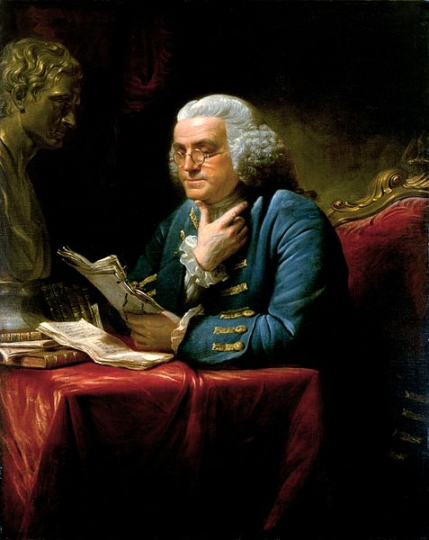
Concerns of the Framers
Representatives might stop or interrupt the way the government ran to get what they wanted
Notes:
Teaching notes
Suggested Pacing: 1 minute
Directions:
Say, “The Framers of the Constitution also worried that if the District of Columbia became a state, representatives would be able to stop or interrupt the way the government ran to get what they wanted, simply because they live in the nation’s capital.”
Attribution:
David Martin / Public domain

Slide 13
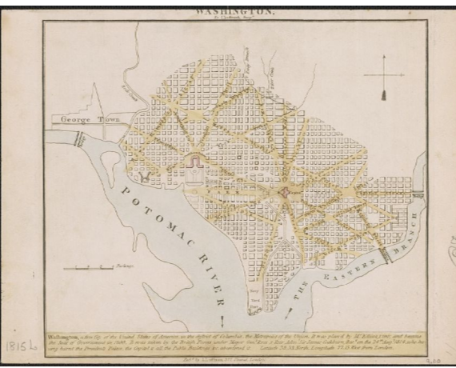
Concerns of the Framers
The District of Columbia could not be a state because it was too close to the heart of the government
Notes:
Teaching notes
Suggested Pacing: 1 minute
Directions:
Say, “Finally, the Framers of the Constitution decided that the District of Columbia could not be a state because it was so close to the heart of our nation’s government.
I​​​​​​nstead, Congress would govern D.C., taking away governing power from D.C.’s own residents.”
Attribution:
Washington. Luffman, J. (John), 1756-1846. Washingtoniana Map Collection. DC Public Library.

Slide 14
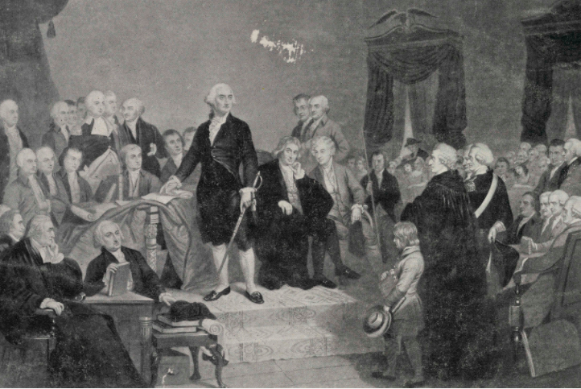
Express Your Understanding!
Why did the Framers of the Constitution decide to make Washington, D.C. a district rather than a state?
Notes:
Teaching notes
Suggested Pacing: 2 minutes
Directions:
Use an established classroom routine to pair students or use elbow partners.
Say, “Why would Framers of the Constitution want Congress to be able to govern the District of Columbia?”
Prompt students to turn and talk to their partners about the question.
Conduct a whole class discussion calling on a few students to share their thinking.
Student Look-Fors:
Student responses will vary.
The Framers would want Congress to be able to govern the District of Columbia because it was so close to the nation’s capital.
Attribution:
Howard Chandler Christy / Public domain

