Slide 1
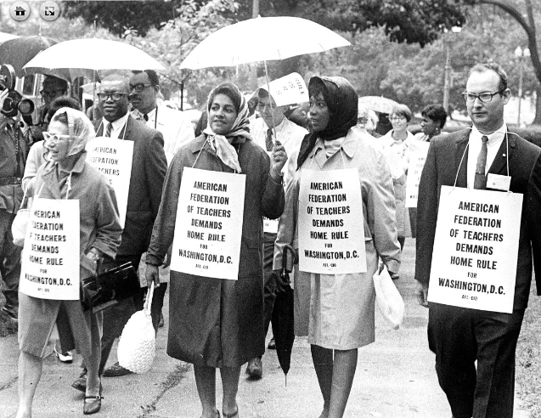
United in the Home Rule Movement
Home Rule: Grade 3, Lesson 10
Notes:
About this lesson
This lesson focuses on different groups of Washingtonians who came together to fight for their right to Home Rule.
Students . . .
identify ways in which individuals can unite as one voice toward a common cause.
respond to the following prompt: “Why is it important for individuals to unite as one voice toward a common cause?”
Materials:
United in the Home Rule Movement organizer (blank)
United in the Home Rule Movement organizer (completed)
Exit Ticket (blank)
Exit Ticket (completed)
ELA Standards:
SL.3.1.d: Explain their own ideas and understanding in light of the discussion.
SL.3.1: Engage effectively in a range of collaborative discussions (one-on-one, in groups, and teacher-led) with diverse partners on grade 3 topics and texts, building on others' ideas and expressing their own clearly.
W.3.2.d: Provide a concluding statement or section.
W.3.2.b: Develop the topic with facts, definitions, and details.
RI.3.7: Use information gained from illustrations (e.g., maps, photographs) and the words in a text to demonstrate understanding of the text (e.g., where, when, why, and how key events occur).
RI.3.4: Determine the meaning of general academic and domain-specific words and phrases in a text relevant to a grade 3 topic or subject area.
RI.3.3: Describe the relationship between a series of historical events, scientific ideas or concepts, or steps in technical procedures in a text, using language that pertains to time, sequence, and cause/effect.
DC Content Power Standards:
3.2.3: Identify the different ways people in a community can influence their local government (e.g., by voting, running for office, testifying at hearings, or participating in meetings).
3.4.5: Identify and research outstanding statements of moral and civic principles made in Washington, D.C., as well as the leaders who delivered them, that contributed to the struggle to extend equal rights to all Americans (e.g., Lincoln and his second inaugural address, Frederick Douglass and his speech against lynching at the Metropolitan AME Church, Martin Luther King Jr. and his speeches at the Lincoln Memorial in 1957 and 1963, and Rodolfo “Corky” Gonzales at the Poor People’s March).
C3 Framework Indicators and Common Core Standards for Literacy in History/Social Studies:
D2.Civ.14: Illustrate historical and contemporary means of changing society.
D2.His.2: Compare life in specific historical time periods to life today.
D2.His.3.3-5. Generate questions about individuals and groups who have shaped significant historical changes and continuities.

Slide 2
Let's Discuss
How do citizens make a change?
Notes:
Teaching notes
Suggested Pacing: 3 minutes
Directions:
Use an established classroom routine to pair students or use elbow partners.
Say, "How do citizens make a change?"
Prompt students to turn and talk to their partner about the question.
Conduct a whole class discussion, calling on a few students to share their thinking.
Student Look-Fors:
Uniting together with a shared purpose
Sharing their ideas to reach a goal
Protest to influence government's point of view
Rally by residents gathering together in support of a specific change
Campaign to push government to make the change
Attribution:
Conversation Clipart

Slide 3
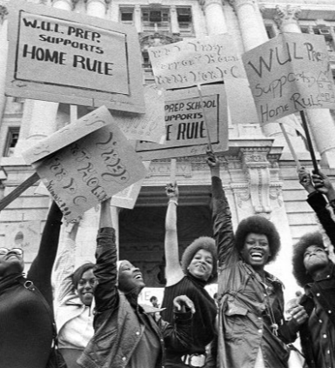
Citizens for Change
Change is possible when . . .
citizens with a shared goal create a movement for that change
people from different walks of life repeatedly act upon their right to demonstrate for a change
Notes:
Teaching notes
Suggested Pacing: 1 minute
Directions:
Say, “In a democracy, the people have a say in how the government is run.
Change is possible in a democracy when citizens with a shared goal create a movement for that change.
People from different walks of life repeatedly act upon their right to demonstrate for a change.”
Attribution:
WUL Prep students at a home rule rally. Evening Star (Washington, D.C.). Washington Star Photograph Collection. DC Public Library.

Slide 4
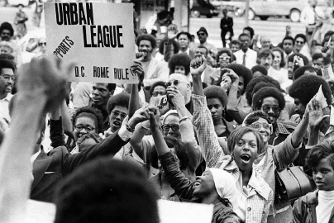
Let's Review
Politicians run campaigns to become elected into office
Citizens also campaign for change by working for a shared goal
A campaign begins when people feel strongly about an issue and act together to change it
Notes:
Teaching notes
Suggested Pacing: 1 minute
Directions:
Say, “Let’s review the concept of a campaign.
Politicians run campaigns to become elected into office.
On the other hand, citizens can also campaign for change by working for a shared goal.
A campaign begins when people feel strongly about an issue and want to change it.”
Attribution:
Community Archives, DC Public Library

Slide 5
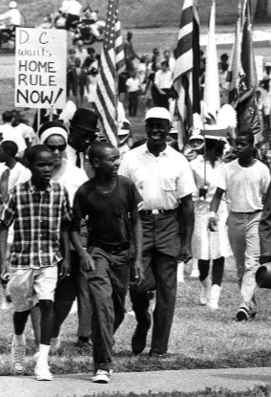
Campaigning for Change
Campaigns organize to build movements that pressure the government to make a change
People might campaign to:
support the election of politicians
change opinions
stop bad decisions
Notes:
Teaching notes
Suggested Pacing: 1 minute
Directions:
Say, “In society, campaigns build movements to pressure the government to make a change.
People might campaign to encourage politicians to support something, to change opinions on an issue, or to stop bad decisions from being made.”
Attribution:
Marchers in the Home Rule Day rally. Evening Star (Washington, D.C.). Washington Star Photograph Collection. DC Public Library.

Slide 6
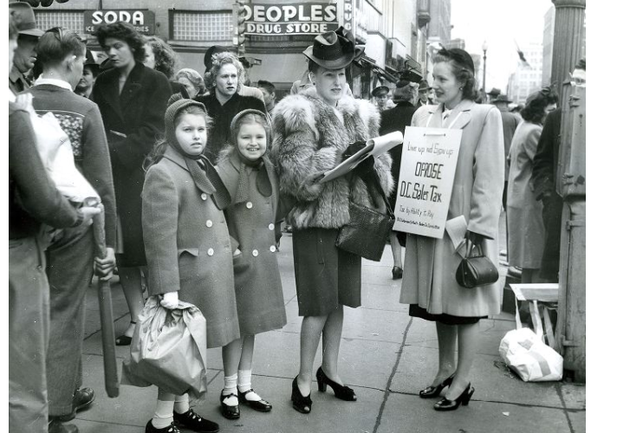
Movements
Campaigns create movements by inviting like-minded people to participate in . . .
Rallies
Protests
Parades
Drives
Signature campaigns
Notes:
Teaching notes
Suggested Pacing: 2 minutes
Directions:
Say, “People who are part of a movement are like-minded. They share common beliefs about the focus of the movement. A movement like DC home rule gets more and more people to think about an issue and participate in making the change.
In order to voice their beliefs and share their ideas, people involved in a movement participate in specific events like rallies and protests.
Parades and drives are additional ways that groups of people unite to show that they feel strongly about an issue and want to see change.
Signature campaigns take place when signatures of people who support the movement are collected.”
Attribution:
League of Women Shoppers signature campaign. Evening Star (Washington, D.C.). Washington Star Photograph Collection. DC Public Library.

Slide 7
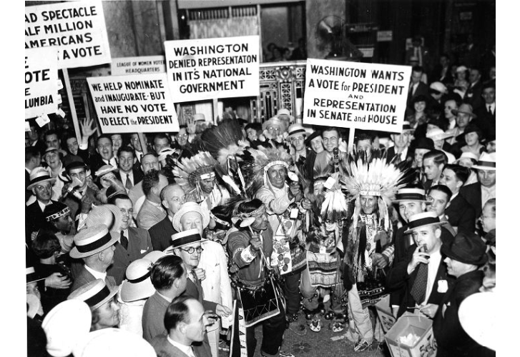
Politicians and Movements
Politicians weigh the costs and benefits of either ignoring the will of the people or making the change happen.
Notes:
Teaching notes
Suggested Pacing: 1 minute
Directions:
Say, “After a movement takes place and the people have made their want for change clear, politicians have to weigh the costs and benefits of either ignoring the will of the people or making the change happen.
If a politician ignores the will of the people, the impact can be negative because the people will feel that the government does not represent them and may impact how they vote in the next election.
If a politician makes a change, they need to be sure that the change will benefit their citizens.”
Attribution:
​​​​​​​Protest at the Democratic National Convention Evening Star (Washington, D.C.). Washington Star Photograph Collection. DC Public Library.

Slide 8
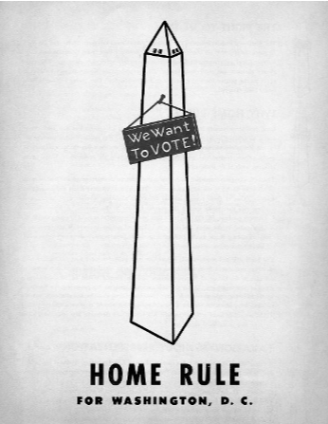
Who joined the Home Rule Movement?
Different groups of Washingtonians came together to fight for Home Rule
Teachers and students
Native Americans
Women
Young people
Civil rights advocates
Notes:
Teaching notes
Suggested Pacing: 1 minute
Directions:
Say, “People from different backgrounds repeatedly act upon their right to demonstrate for a change.
During Washington D.C.'s fight for Home Rule, different groups of people came together to work for the same cause.
These different groups of people all wanted the same things, Home Rule for Washington, D.C."
Provide students with United in the Home Rule Movement Organizer (blank).
Refer to United in the Home Rule Movement Organizer (completed) as needed.
Attribution:
Home rule for Washington, D.C. poster. Washingtoniana Ephemera Collection. DC Public Library.

Slide 9
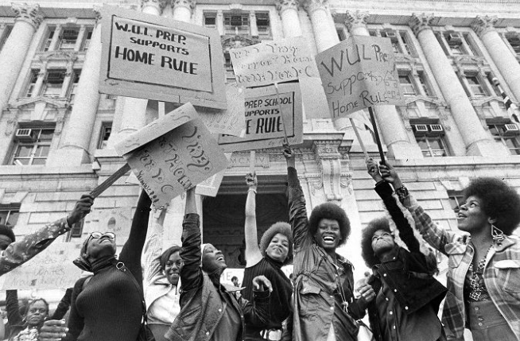
Teachers and Students
Before the Home Rule Act, school board members were federally appointed instead of elected
Residents did not have a say in who would govern the schools
Teachers and students united in the Home Rule Movement to secure a school board that was best for schools
Notes:
Teaching notes
Suggested Pacing: 2 minutes
Directions:
Say, “Before the Home Rule Act, school board members were federally appointed.
Citizens did not have a say in who would govern the schools.
Teachers and students united in the Home Rule Movement to secure a school board that was best for schools."
Ask students to record “Teacher and Students” next to the corresponding pictures on their United in the Home Rule Movement Organizer (blank)
Attribution:
Members of the American Federation of Teachers march for home rule. Evening Star (Washington, D.C.). Washington Star Photograph Collection. DC Public Library.
WUL Prep students at a home rule rally. Evening Star (Washington, D.C.). Washington Star Photograph Collection. DC Public Library.

Slide 10
Turn and Talk
Why is having an elected school board important?
Notes:
Teaching notes
Suggested Pacing: 2 minutes
Directions:
Use an established classroom routine to pair students or use elbow partners.
Say, "Why is having an elected school board important?"
Prompt students to turn and talk to their partners about the question.
Conduct a whole class discussion, calling on a few students to share their thinking.
Student Look-Fors:
Having an elected school board gives citizens the opportunity to vote for the members.
Citizens can vote for people who will make the changes they want to see.
Attribution:
Conversation Clipart

Slide 11
Native Americans
Not guaranteed the right to vote until 1962
United in the Home Rule Movement to make sure all U.S. citizens were represented in Congress
Notes:
Teaching notes
Suggested Pacing: 2 minutes
Directions:
Say, “Native Americans did not earn United States citizenship until 1924 and were not guaranteed the right to vote until 1962.
Native Americans understood how important Home Rule was for Washington, D.C.
Native Americans united in the Home Rule Movement to make sure all U.S. citizens were represented in Congress.”
Ask students to record “Native Americans” next to the corresponding pictures on their United in the Home Rule Movement Organizer (blank).
Attribution:
Protest at the Democratic National Convention Evening Star (Washington, D.C.). Washington Star Photograph Collection. DC Public Library.

Slide 12
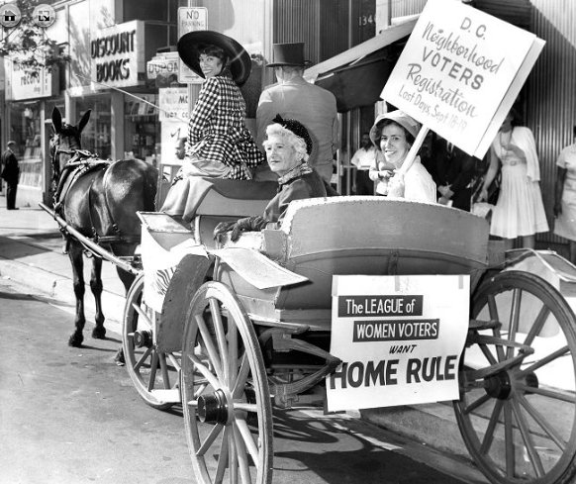
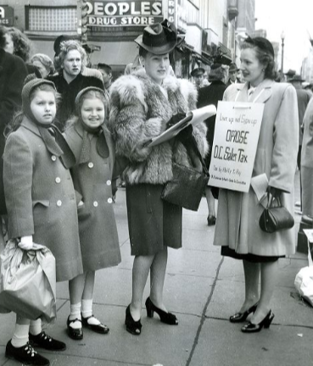
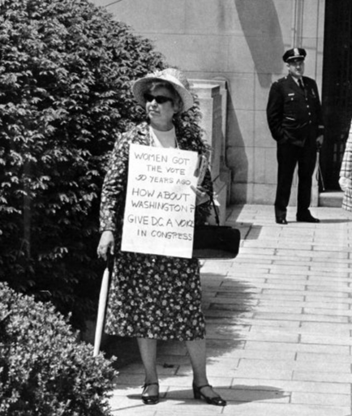
Women
Did not earn the right to vote in the U.S. until 1920
Thought it was unfair that Washingtonians did not have the right to vote
Joined the Home Rule Movement to push for voting rights for all Americans
Notes:
Teaching notes
Suggested Pacing: 2 minutes
Directions:
Say, “Women did not earn the right to vote until 1920.
After not having representation in Congress for so long, women felt that it was unfair for Washingtonians not to have the right to vote.
Women joined the Home Rule Movement to push for voting rights for all people.”
Ask students to record “Women” next to the corresponding pictures on their United in the Home Rule Movement Organizer (blank).
Attribution:
Charlotte Price, Nettie Ottenber, and Jane Hammer of the League of Women Voters ride in a carriage during a voter registration drive. Evening Star (Washington, D.C.). Washington Star Photograph Collection. DC Public Library.
League of Women Shoppers signature campaign. Evening Star (Washington, D.C.). Washington Star Photograph Collection. DC Public Library.
Community Archives, DC Public Library

Slide 13
Turn and Talk
Why did women feel strongly about Home Rule in Washington, D.C.?
Notes:
Teaching notes
Suggested Pacing: 2 minutes
Directions:
Use an established classroom routine to pair students or use elbow partners.
Say, “Why did women feel strongly about Home Rule in Washington, D.C.?"
Prompt students to turn and talk to their partners about the question.
Conduct a whole class discussion, calling on a few students to share their thinking.
Student Look-Fors:
Women did not have the right to vote for many years.
Women understood how valuable the right to vote is.
Women wanted equal voting rights for all people.
Attribution:
Conversation Clipart

Slide 14
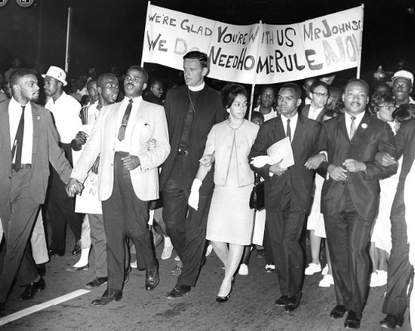
Civil Rights Advocates
Fought for political and social freedoms to ensure equality for all Americans
Notes:
Teaching notes
Suggested Pacing: 2 minutes
Directions:
Say, “Civil rights are the political and social freedoms that ensure equality to all citizens.
Civil rights advocates work to be sure that race or income does not impact a person's civil rights, making the United States a country where all people have access to opportunities.
Because the citizens of Washington, D.C did not have representation in Congress like so many other Americans, their civil rights were being denied.
Civil rights advocates felt strongly about Home Rule for D.C. because they wanted citizens to be treated fairly with representation in Congress.”
Ask students to record “Civil Rights Advocates” next to the corresponding pictures on their United in the Home Rule Movement Organizer (blank).
Attribution:
Community Archives, DC Public Library
Reverend Martin Luther King Jr., Reverend Walter Fauntroy, Right Reverend Paul Moore Jr., Reverend Ralph David Abernathy, and Reverend Andrew Young at the March for Home Rule. Evening Star (Washington, D.C.). Washington Star Photograph Collection. DC Public Library.

Slide 15
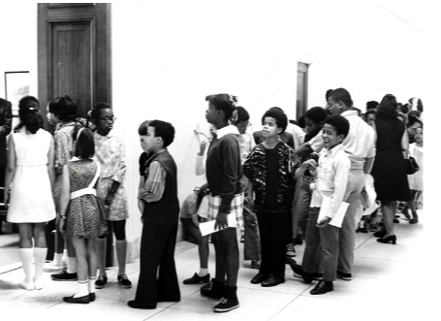
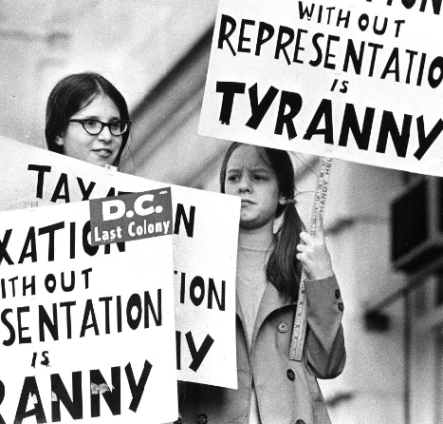
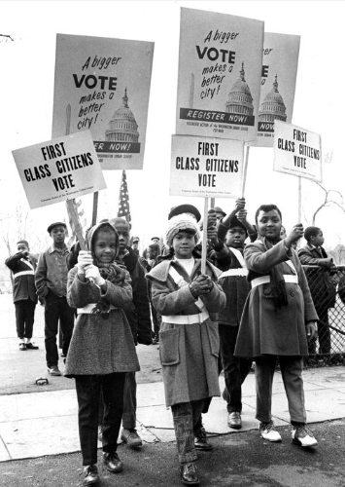
Young People
Young people are an important part of any movement or campaign
Young people joined the fight to earn representation for D.C.
All citizens have the ability to make a difference, especially when they work together
Notes:
Teaching notes
Suggested Pacing: 2 minutes
Directions:
Say, “Young people are an important part of any movement or campaign.
Young people joined the fight to earn representation for D.C.
All citizens have the ability to make a difference, especially when they work together."
Ask students to record “Young People” next to the corresponding pictures on their United in the Home Rule Movement Organizer (blank).
Attribution:
Community Archives, DC Public Library
Girls marching in the League of Women Voters parade. Evening Star (Washington, D.C.). Washington Star Photograph Collection. DC Public Library.
Yvonne Brock, Yolanda Wade, and Deborah Powell in the Get Out to Register parade. Historic Image Collection. DC Public Library.

Slide 16
Turn and Talk
As a young person, what can you do to create change in your community, your country, and your world?
Notes:
Teaching notes
Suggested Pacing: 2 minutes
Directions:
Use an established classroom routine to pair students or use elbow partners.
Say, “As a young person, what can you do to create change in your community, your country, and your world?"
Prompt students to turn and talk to their partners about the question.
Conduct a whole class discussion, calling on a few students to share their thinking.
Student Look-Fors:
Be aware of decisions being made locally and federally.
Attend protest and rallies.
Write letters to representative and senators about issues you care about.
Attribution:
Conversation Clipart

Slide 17
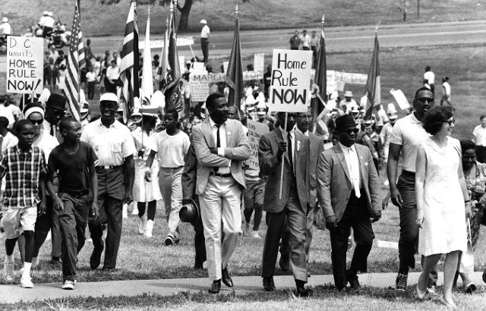
Express Your Understanding!
Why is it important for individuals to unite as one voice toward a common cause?
Notes:
Teaching notes
Suggested Pacing: 3 minutes
Directions:
Provide each student with an Exit Ticket.
Say, “Why is it important for individuals to unite as one voice toward a common cause? Write your response on your exit ticket.”
Collect exit tickets as formative assessment.
Student Look-Fors:
Student responses will vary.
See completed example.
Attribution:
Marchers in the Home Rule Day rally. Evening Star (Washington, D.C.). Washington Star Photograph Collection. DC Public Library.

