Slide 1
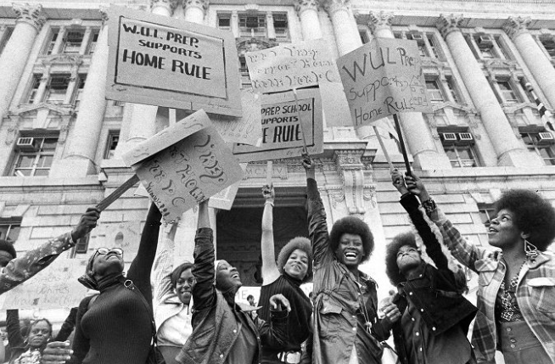
The 23rd Amendment and Home Rule
Home Rule: Grade 12, Lesson 5
Notes:
About this lesson
This lesson focuses on the impact of the 23rd Amendment on D.C. Home Rule.
Students . . .
investigate how amendments can be made to the United States Constitution.
learn about the 23rd Amendment and its ratification.
consider how the 23rd Amendment was the first step toward giving D.C. citizens a greater voice in their governance.
Materials:
Exit Ticket (blank)
Exit Ticket (completed)
ELA Standards:
SL.11-12.1: Initiate and participate effectively in a range of collaborative discussions (one-on-one, in groups, and teacher-led) with diverse partners on grades 11-12 topics, texts, and issues, building on others' ideas and expressing their own clearly and persuasively.
W.11-12.4: Produce clear and coherent writing in which the development, organization, and style are appropriate to task, purpose, and audience. (Grade-specific expectations for writing types are defined in standards 1-3 above.)
W.11-12.2: Write informative/explanatory texts to examine and convey complex ideas, concepts, and information clearly and accurately through the effective selection, organization, and analysis of content.
RI.11-12.7: Integrate and evaluate multiple sources of information presented in different media or formats (e.g., visually, quantitatively) as well as in words in order to address a question or solve a problem.
DC Content Power Standards:
12.DC.16: Students identify key milestones and efforts that led to greater self-government and suffrage for Washington, D.C. residents.
12.DC.22.6: Review the reasons why Washington, D.C. residents do not have voting representation in Congress, and assess the prospects for current efforts to get congressional representation for the District.
C3 Framework Indicators and Common Core Standards for Literacy in History/Social Studies:
D2.Civ.3.9-12. Analyze the impact of constitutions, laws, treaties, and international agreements on the maintenance of national and international order.
D2.Civ.4.9-12. Explain how the U.S. Constitution establishes a system of government that has powers, responsibilities, and limits that have changed over time and that are still contested.
D2.Civ.12.9-12. Analyze how people use and challenge local, state, national, and international laws to address a variety of public issues.
D2.Civ.14.9-12. Analyze historical, contemporary, and emerging means of changing societies, promoting the common good, and protecting rights.

Slide 2
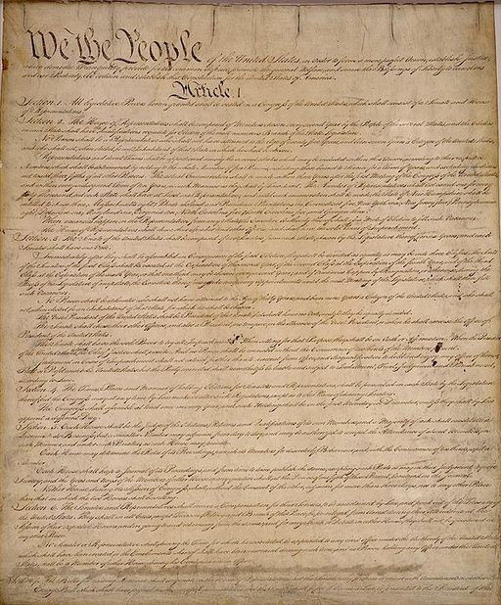
Let's Discuss
Why is the Constitution known as a living document?
Notes:
Teaching notes
Suggested Pacing: 3 minutes
Directions:
Use an established classroom routine to pair students or use elbow partners.
Say, “Why is the Constitution known as a living document?”
Prompt students to turn and talk to their partners about the question.
Conduct a whole class discussion calling on a few students to share their thinking.
Student Look-Fors:
Student answers may vary.
The Constitution is known as a “living” document because it can be amended, which means revised or corrected.
Attribution:
Constitutional Convention / Public domain

Slide 3
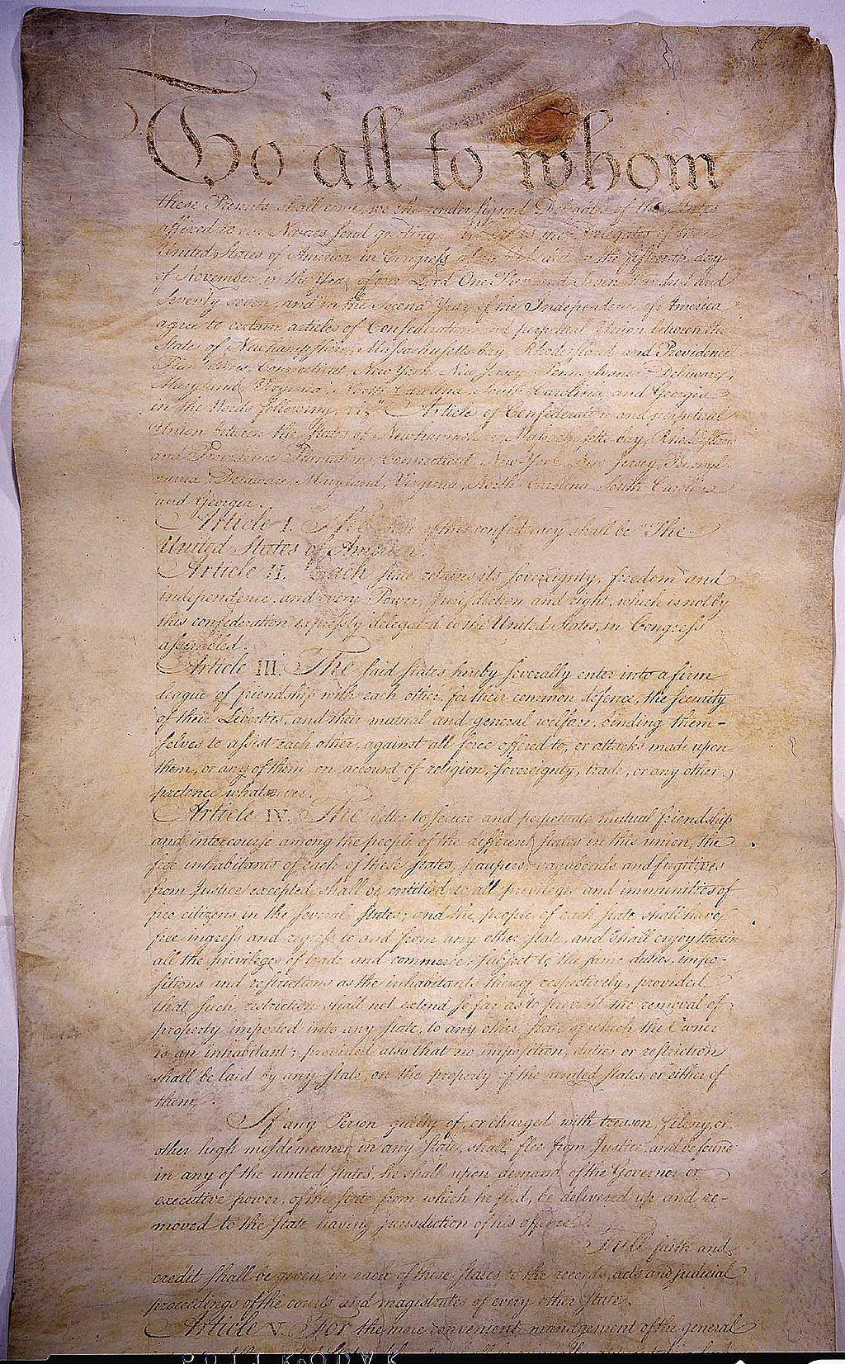
The First Constitution
The Articles of Confederation functioned as the first constitution of the United States
Congress had power over military and foreign affairs
Congress did not have power over states
Congress could not:
Enforce laws
Raise tax money
Elect a president
Notes:
Teaching notes
Suggested Pacing: 1 minute
Directions:
Say, “Effective in 1781, the Articles of Confederation functioned as the first constitution of the United States.
According to this document, the only branch of government was a Congress with one house.
While Congress had power over military and foreign affairs, it did not have control over the affairs of each state.
Additionally, Congress could not enforce laws, raise tax money, or elect a president.“
Attribution:
The Government of the United States / Public domain

Slide 4
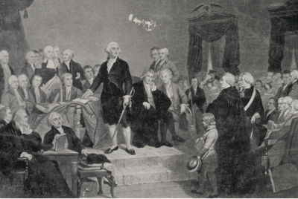
The United States Constitution
Framers of the Constitution
A group of men who wrote the Constitution as a new way of running the country
Constitution replaced Articles of Confederation in 1789
Highest law in the United States
Details the national frame of the government
Notes:
Teaching notes
Suggested Pacing: 2 minutes
Directions:
Say, “It became clear that the Articles were too weak to create a functioning central government, and this inspired what we now know as the Constitution.
The Framers of the Constitution, including George Washington and Benjamin Franklin, came together in 1787 to draft the new document.
The Framers were dissatisfied with the way the United States was running as a new country. The Framers sought to make changes through the creation of the Constitution.
The Constitution is the highest law in the United States. All laws in this country must follow the Constitution’s guidance. This document details the national frame of the government."
Attribution:
George Washington takes his oath of office during his inauguration. Historic Image Collection. DC Public Library.

Slide 5
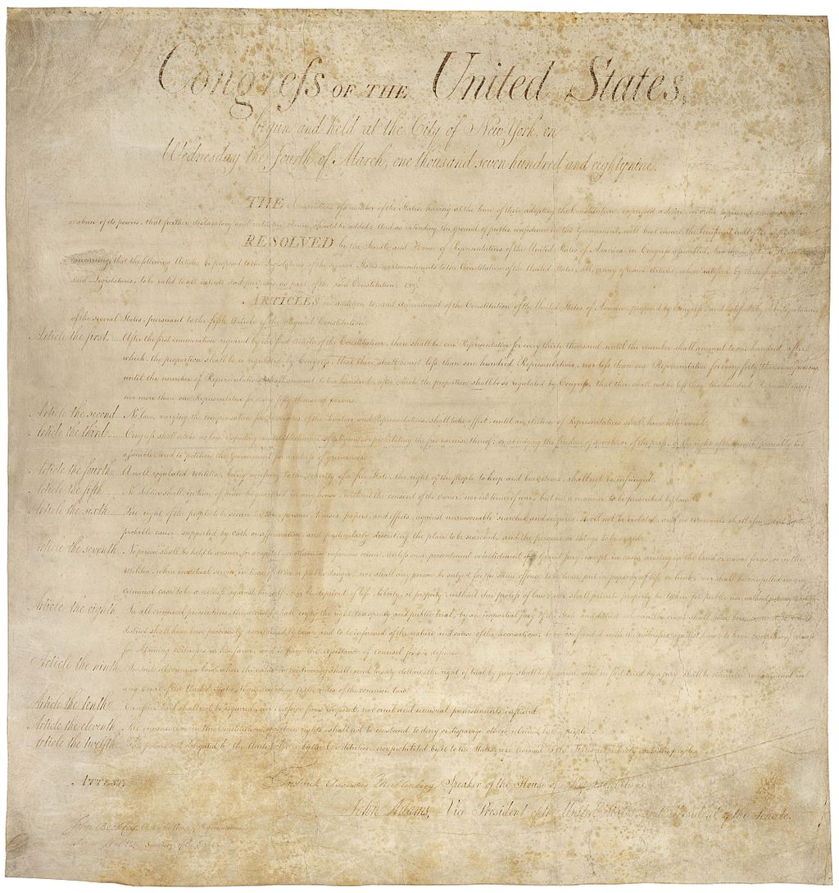
The Bill of Rights
First ten amendments
Protect freedom of speech, freedom of religion, the right to keep and bear arms, the freedom of assembly and the freedom to petition
Notes:
Teaching notes
Suggested Pacing: 1 minute
Directions:
Say, “The first ten amendments are called the Bill of Rights.
They protect freedom of speech, freedom of religion, the right to keep and bear arms, the freedom of assembly and the freedom to petition.
Although not included in the first Constitution, these ten amendments are considered the most important freedoms for Americans.
Americans are entitled to these rights.”
Attribution:
1st United States Congress / Public domain

Slide 6
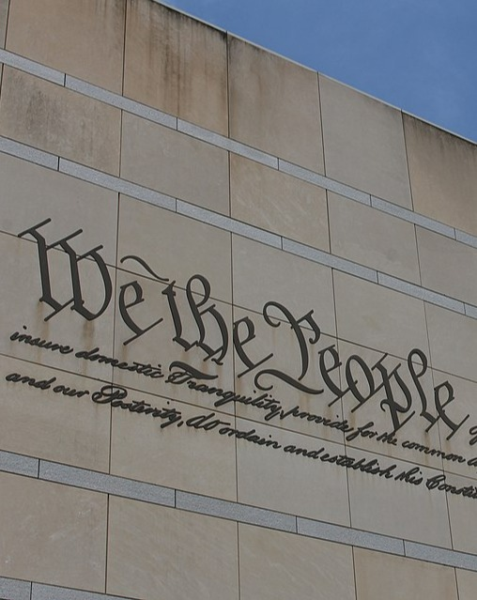
Constitutional Amendments
Two ways to propose and ratify an amendment:
Option 1
Two-thirds of both houses of Congress vote to propose an amendment
Three-fourths of the state legislatures must approve to ratify the amendment
Option 2
Two-thirds of the state legislatures to ask Congress to call a national convention
Ratifying conventions of three-fourths of the states must approve
Notes:
Teaching notes
Suggested Pacing: 2 minutes
Directions:
Say, “An amendment to the Constitution is a change to the original content of the document that was approved in 1788.
This change could be an improvement, a correction or a revision.
There are only two ways to propose and ratify, or give legal approval to, amendments to the Constitution.
In order to propose an amendment, two-thirds of both houses of Congress vote to propose an amendment.
In order to ratify an amendment, three-fourths of the state legislatures must approve the amendment.
Another way to propose and ratify an amendment is for two-thirds of the state legislatures to ask Congress to call a national convention. Ratifying conventions in three-fourths of the states must approve.
Only 27 Amendments to the Constitution have been approved.
Six have been disapproved, and thousands of amendments have been discussed.”
Attribution:
Housefinch1787 / CC BY-SA

Slide 7
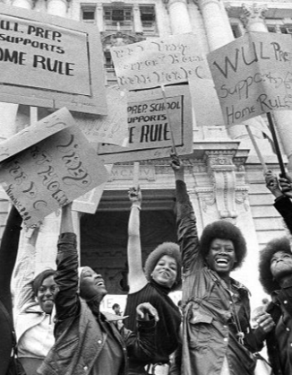
Constitutional Amendments
Framers wanted stable ground rules
Realized that the nation would face obstacles and hurdles as the country grew
An amendment must be an idea that has a major impact affecting all Americans or securing rights of citizens
Notes:
Teaching notes
Suggested Pacing: 1 minute
Directions:
Say, “The Framers wrote the Constitution because they felt that the country needed to rest on stable ground rules. However, they also realized that their young nation would face obstacles and hurdles as the country grew.
That is why the Constitution is a living document, and amendments can be made.
Amending the Constitution is not an easy task. This was done purposefully by the Framers of the he Constitution.
An idea for a Constitutional amendment must be an idea that has a major impact affecting all Americans or securing rights of citizens.”
Attribution:
WUL Prep students at a home rule rally. Evening Star (Washington, D.C.). Washington Star Photograph Collection. DC Public Library.

Slide 8
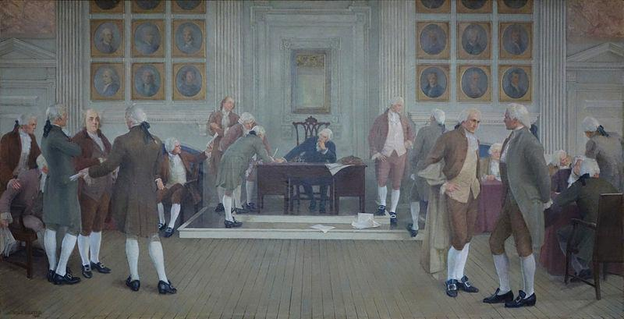
Turn and Talk
What ideas to improve America are worth a Constitutional amendment?
Notes:
Teaching notes
Suggested Pacing: 3 minutes
Directions:
Use an established classroom routine to pair students or use elbow partners.
Ask, “What ideas to improve America are worth a Constitutional amendment?”
Prompt students to turn and talk to their partners about the question.
Conduct a whole class discussion calling on students to share their thinking.
Student Look-fors:
Student answers may vary.
Americans are entitled to the freedoms provided by the Constitution.
If the Constitution is found to violate one of these freedoms, an amendment might be necessary.
Attribution:
Daderot / Public domain

Slide 9
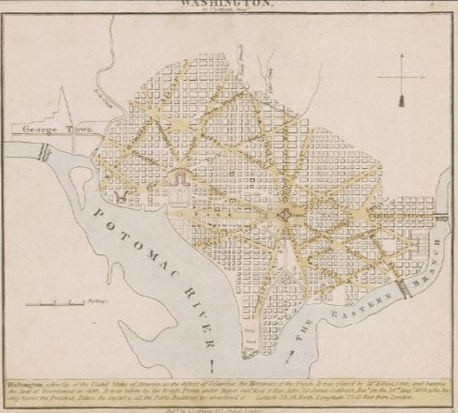
The Constitution and Washington, D.C.
Article 1, Section 8, Clause 17 of the Constitution focuses on the Powers of Congress
Country's capital city must be in a district, not a state
Allows Congress to govern the capital
Decision driven by concerns of the Constitutional Framers
Notes:
Teaching notes
Suggested Pacing: 2 minutes
Directions:
Say, “Article 1, Section 8, Clause 17 of the Constitution focuses on the Powers of Congress. It states that the country's capital city must be in a district, not a state. It also allows Congress to govern the capital, the District of Columbia. There were several reasons for this decision.
First, the Framers of the Constitution were concerned that if the capital were to be a state, the loyalties of members of the government would influence their decision-making.
Secondly, the Constitutional Framers also worried that if the District of Columbia became a state, representatives would interfere with government procedure to get what they wanted, simply because they live in the Nation’s Capital.
Finally, the Framers of the Constitution decided that the District of Columbia could not be a state because it was so close to the heart of the nation’s government. Instead, Congress would govern D.C., taking away governing power from D.C.’s own residents.”
Attribution:
Washington. Luffman, J. (John), 1756-1846, Washingtoniana Map Collection. DC Public Library.

Slide 10
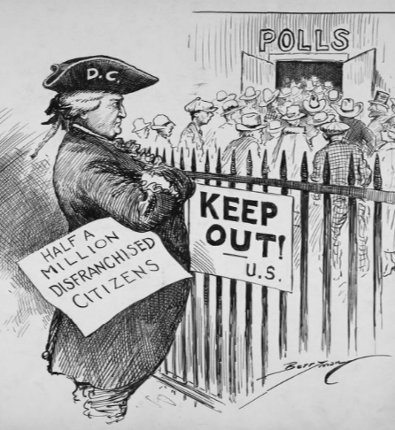
Washington, D.C. Voting Rights
Washington, D.C. is a federal district rather than a state
Denied the privilege of voting for federal officials prior to 1960
Notes:
Teaching notes
Suggested Pacing: 2 minutes
Directions:
Say, “According to the Constitution, Washington, D.C. is a federal district rather than a state. Therefore, the people who live in the District of Columbia are not citizens of a state.
Even though the residents of Washington, D.C. pay taxes to the federal government and serve in the United States military, they were denied the privilege of voting for federal officials prior to 1960.”
Attribution:
​​​​​​​Barred! Berryman, Clifford Kennedy, 1869-1949, Clifford Berryman Cartoon Collection. DC Public Library.

Slide 11
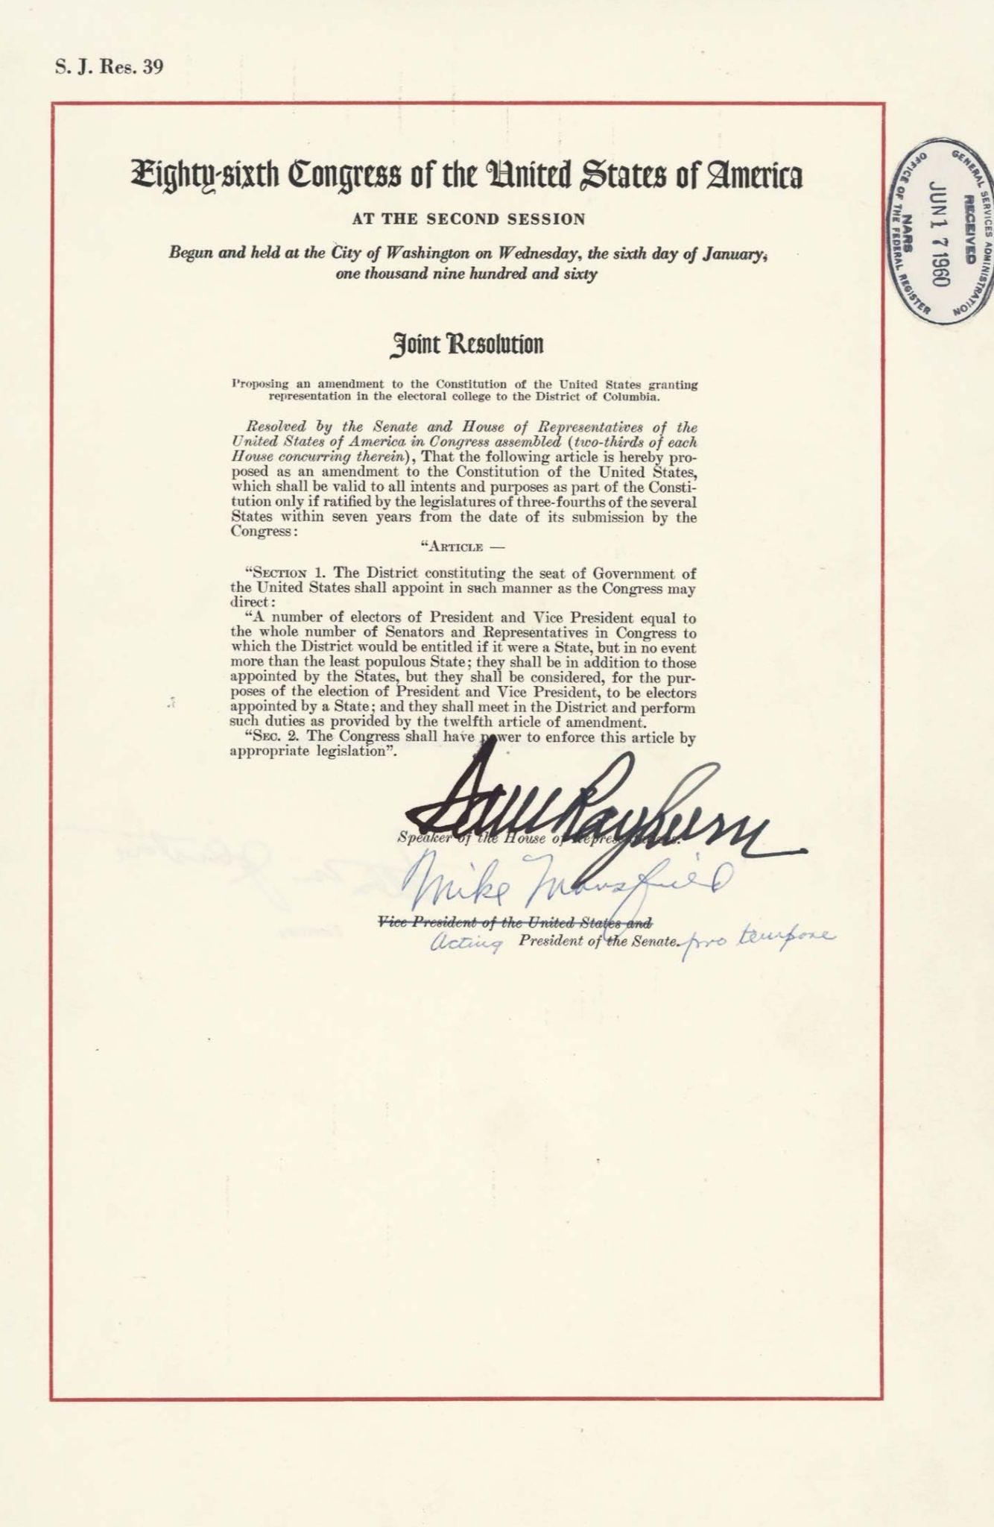
The 23rd Amendment
Proposed by the 86th Congress on June 16, 1961
Written so residents of D.C. were able to vote for President and Vice President of the United States
Notes:
Teaching notes
Suggested Pacing: 2 minutes
Directions:
Say, “The 23rd Amendment was proposed by the 86th Congress on June 16, 1961.
The Amendment was written so that the residents of the District were able to vote for President and Vice President of the United States.
Remember that before the 23rd Amendment, citizens of Washington, D.C. could only vote for those offices if they were registered to vote in one of the States.
This qualification was written in the U.S. Constitution, which stated that voters must be citizens of one of the United States to participate in federal elections.”
Attribution:
Copy of the proposed twenty-third amendment to the Constitution. United States. Congress (86th, 2nd session: 1960), Washingtoniana Ephemera Collection, DC Public Library.

Slide 12
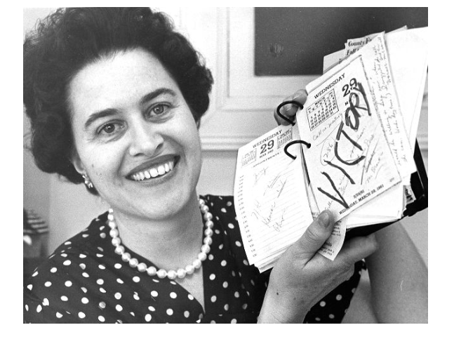
Ratification of the 23rd Amendment
March 29, 1961
Gave District residents a vote in presidential elections
Three electoral votes
Second most quickly ratified amendment in history of Constitution
Notes:
Teaching notes
Suggested Pacing: 2 minutes
Directions:
Say, “On March 29, 1961, the two-thirds majority of states ratified the 23rd Amendment, and it became law. Hawaii was the first state to approve, and Ohio was the final vote.
Through the ratification of this amendment, Washington, D.C. became the only entity other than the states to have representation in the Electoral College.
The Amendment gave District residents a vote in presidential elections. Washington was allocated electoral votes equal to the number of the least-populated state. This equaled three votes.
A step toward giving D.C. citizens greater voice in their governance, the 23rd Amendment was the second most quickly ratified amendment in the history of the Constitution.”
Attribution:
Velma Coontz writes VICTORY in lipstick on her calendar. Evening Star (Washington, D.C.), Washington Star Photograph Collection. DC Public Library.

Slide 13
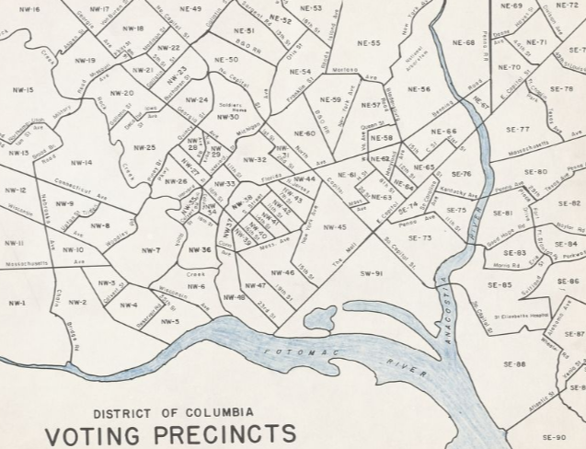
Political Impact of the 23rd Amendment
At the time of the 23rd Amendment’s passage, Washington, D.C. was politically neutral
After the ratification of the 23rd Amendment, the District moved toward the Democratic Party
Notes:
Teaching notes
Suggested Pacing: 2 minutes
Directions:
Say, “Washington, D.C. residents voted for the first time in the 1964 presidential election when Lyndon Johnson earned its three electoral votes.
At the time of the 23rd Amendment’s passage, Washington, D.C. was politically neutral.
After the ratification of the 23rd Amendment, the District moved dramatically toward the Democratic Party.
Since 1964, Washington, D.C.’s three electoral votes have been sent to the Democratic candidate in every presidential election.”
Attribution:
District of Columbia, voting precincts, approved by the Board of Elections. District of Columbia. Board of Elections, Washingtoniana Map Collection. DC Public Library.

Slide 14
Express Your Understanding!
How was the 23rd Amendment the first step toward giving D.C. citizens a greater voice in their governance?
Notes:
Teaching notes
Suggested Pacing: 5 minutes
Directions:
Hand out a copy of the exit ticket.
As a formative assessment, students write a response to the following question: "How was the 23rd Amendment the first step toward giving D.C. citizens a greater voice in their governance?"
Student Look-Fors:
Student answers will vary.
See completed handout.
Attribution:
It Hardly Seems Possible political cartoon. Historic Image Collection. DC Public Library.

