Slide 1
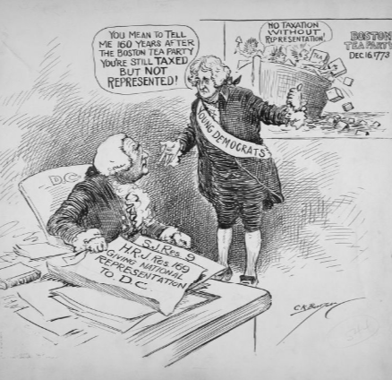
The Political Cartoons of Clifford Berryman
Home Rule: Grade 12, Lesson 3
Notes:
About this lesson
In this lesson, students will further investigate the motto “Tax Without Representation” by analyzing political cartoons created by award winning cartoonist Clifford Berryman.
Students . . .
understand the purpose of a political cartoon and practice using a political cartoon analysis tool.
practice analyzing two cartoons.
use the analysis tool to independently analyze a third cartoon.
Materials:
Political Cartoon Analysis Practice (blank)
Political Cartoon Analysis Practice (completed)
Exit Ticket (blank)
Exit Ticket (completed)
ELA Standards:
SL.11-12.1: Initiate and participate effectively in a range of collaborative discussions (one-on-one, in groups, and teacher-led) with diverse partners on grades 11-12 topics, texts, and issues, building on others' ideas and expressing their own clearly and persuasively.
W.11-12.4: Produce clear and coherent writing in which the development, organization, and style are appropriate to task, purpose, and audience. (Grade-specific expectations for writing types are defined in standards 1-3 above.)
W.11-12.2: Write informative/explanatory texts to examine and convey complex ideas, concepts, and information clearly and accurately through the effective selection, organization, and analysis of content.
RI.11-12.7: Integrate and evaluate multiple sources of information presented in different media or formats (e.g., visually, quantitatively) as well as in words in order to address a question or solve a problem.
DC Content Power Standards:
12.DC.22.6: Review the reasons why Washington, D.C. residents do not have voting representation in Congress, and assess the prospects for current efforts to get congressional representation for the District.
C3 Framework Indicators and Common Core Standards for Literacy in History/Social Studies:
D2.Civ.3.9-12. Analyze the impact of constitutions, laws, treaties, and international agreements on the maintenance of national and international order.
D2.Civ.4.9-12. Explain how the U.S. Constitution establishes a system of government that has powers, responsibilities, and limits that have changed over time and that are still contested.
D2.Civ.12.9-12. Analyze how people use and challenge local, state, national, and international laws to address a variety of public issues.
D2.Civ.14.9-12. Analyze historical, contemporary, and emerging means of changing societies, promoting the common good, and protecting rights.

Slide 2
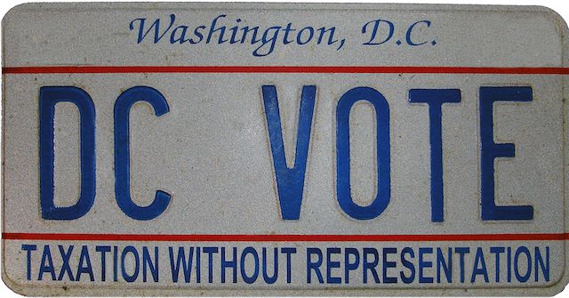
Let's Discuss
Why is the motto “Taxation Without Representation” relevant for past and present citizens of Washington, D.C.?
Notes:
Teaching notes
Suggested Pacing: 3 minutes
Directions:
Use an established classroom routine to pair students or use elbow partners.
Say, “What has made the motto “Taxation Without Representation” relevant for past and present citizens of Washington, D.C.?”
Prompt students to turn and talk to their partners about the question.
Conduct a whole class discussion calling on a few students to share their thinking.
Student Look-Fors:
The motto “Taxation Without Representation” is still accurate for the citizens of D.C. because they are paying high federal taxes but they are not represented in United States Congress.
This motto is relevant for citizens of Washington, D.C. because they do not have a say in how their tax dollars are being spent.
Attribution:
DC VOTE license plate. District of Columbia. Department of Motor Vehicles. Washingtoniana Ephemera Collection. DC Public Library.

Slide 3
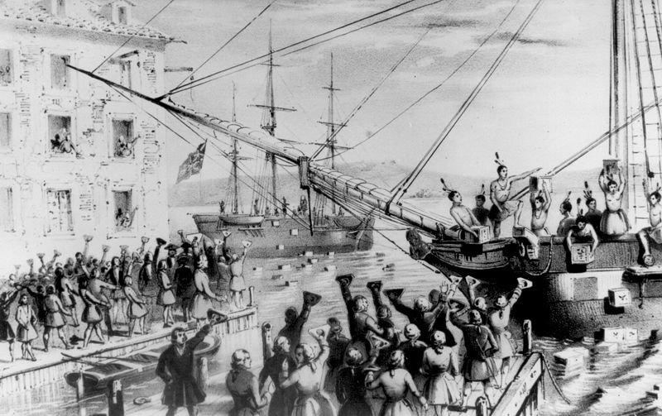
Taxation Without Representation
1761
“Taxation Without Representation” was first used by American colonists in response to being taxed by British Parliament
1773
American colonists protested British taxation during the Boston Tea Party
Notes:
Teaching notes
Suggested Pacing: 2 minutes
Directions:
Say, “ 'Taxation Without Representation' is a phrase that was first used by the American colonists in 1761.
The colonists were frustrated because they were being taxed by the British Parliament to which they had not elected any representatives.
In 1773, frustration over being taxed without a voice in British Parliament drove the colonists to protest.
American colonists dumped 342 chests of tea into Griffin’s Wharf in Boston, Massachusetts. This event became known as the Boston Tea Party.
The tea had been imported by the British East India Company. The colonists were protesting taxation without representation.”
Attribution:
Copy of lithograph by Sarony & Major, 1846 / Public domain

Slide 4
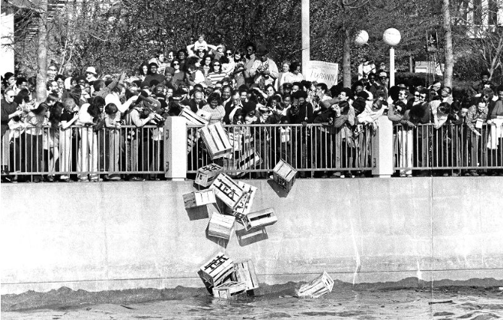
Let's Review
Residents of Washington, D.C.
Pay full federal taxes
Pay higher per capita taxes than all 50 of the United States
Have no representation in Congress
Have no say in how their federal tax dollars are spent
Notes:
Teaching notes
Suggested Pacing: 2 minutes
Directions:
Say, “Washington, D.C. residents use the motto ‘Taxation Without Representation’ because they do not have a say in how their tax dollars are being spent.
Residents of Washington, D.C. pay full federal taxes. In fact, they pay higher per capita taxes than all 50 of the United States.
Despite paying more money in federal taxes than any state in the country, the people who reside in Washington, D.C. have no representation in Congress, and therefore, have no say in how their federal tax dollars are spent.
In addition to using the motto 'Taxation Without Representation,' Washintonians have also referred to the Boston Tea Party in time of protest.”
Attribution:
Members of Self Determination for D.C. dump tea crates into the Potomac River. Evening Star (Washington, D.C.), Washington Star Photograph Collection. DC Public Library.

Slide 5
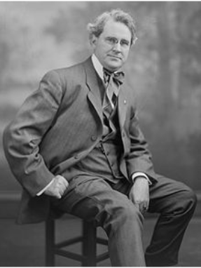
The Political Cartoons of Clifford Berryman
Political cartoon
Cartoon that makes a point about a political issue or event
Usually near editorials and opinion essays in a newspaper
Clifford Berryman
Award winning cartoonist in Washington, D.C.
Drew thousands of political cartoons
Notes:
Teaching notes
Suggested Pacing: 2 minutes
Directions:
Say, “In this lesson, we will spend time analyzing political cartoons. Like a motto, a political cartoon makes a point.
Specifically, political cartoons make a point about a political issue or event. They usually appear near editorials and opinion essays in a newspaper.
Clifford Berryman was a prominent figure in Washington, D.C. He was an award winning cartoonist with The Washington Post from 1891 to 1907 and The Washington Star newspaper from 1907 to 1949.
Berryman drew thousands of political cartoons commenting on American presidents and politics during his career.
One topic Berryman covered heavily was the representation of the District of Columbia in Congress.
The cartoons you will be analyzing in this lesson were drawn between 1930 and 1933.”
Attribution:
Harris & Ewing / Public domain

Slide 6
Political Cartoon Analysis Protocol
Observe: What do you see?
Reflect: What does it make you think?
Question: What do you still wonder?
Notes:
Teaching notes
Suggested Pacing: 2 minutes
Directions:
Say, “Political cartoons can be funny, but their main purpose is to persuade the reader. Good political cartoons make the reader think about current events.
They also try to sway the reader’s opinion toward the cartoonist's point of view.
We read political cartoons, but we need to make sure that we read them through a critical lens in order to understand the cartoonist’s message. Here are three steps to use in analyzing a political cartoon."
Review the Political Cartoon Analysis Protocol with students.
Attribution:
​​​​​​​Teacher's Guide: Analyzing Political Cartoons. Library of Congress.

Slide 7
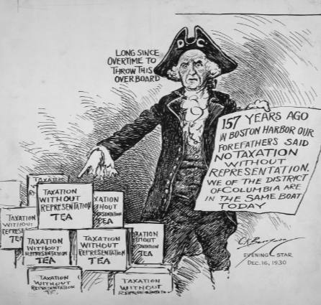
Analyzing a Political Cartoon
Observe
What do you notice first?
What people and objects are shown?
What, if any, words do you see?
What might be a symbol?
What other details can you see?
Notes:
Teaching notes
Suggested Pacing: 4 minutes
Directions:
Say, “Let’s analyze a political cartoon drawn in 1930 by Clifford Berryman. This cartoon is called, ‘District citizens still taxed without representation.’
Berryman's comics frequently used a character he called DC. DC represents the District of Columbia in these cartoons.”
Handout the Political Cartoon Analysis Practice handout.
Review the Political Cartoon Analysis Protocol by completing a think aloud with students.
Students should record notes on their Political Cartoon Analysis Practice handout.
Refer to the Political Cartoon Analysis Practice handout (completed) as needed.
Say:
“The first step in the Political Cartoon Analysis Protocol is to observe the cartoon.
As I look at the cartoon, I see 'DC' on the character’s hat representing Washington, D.C.
I notice DC and boxes that all have the same label on them.
The labels on the boxes read 'Taxation Without Representation Tea.' This might be a symbol, especially because there are many boxes with the same label on them.
The sign DC is holding has a number on it, and that number refers to how many years it has been since the Boston Tea Party.
DC still lacks representation after all of this time.
DC’s sign also says that Washington, D.C. is in the same boat today. Nothing has changed for DC.”
Attribution:
District citizens still taxed without representation. Berryman, Clifford Kennedy, 1869-1949, Clifford Berryman Cartoon Collection. DC Public Library.

Slide 8
Analyzing a Political Cartoon
Reflect
What’s happening in this cartoon?
Who do you think was the audience for this cartoon?
What issue do you think this cartoon is about?
What do you think the cartoonist’s opinion on this issue is?
Notes:
Teaching notes
Suggested Pacing: 2 minutes
Directions:
Say, “The second step in the Political Cartoon Analysis Protocol is to observe the cartoon.
This is where I can really think about what is happening in the cartoon.
I am also going to consider what the cartoonist is trying to say.
In the cartoon, DC appears upset because the District of Columbia has been in 'the same boat' for 157 years.
I think the audience for this cartoon could be the residents of Washington, D.C. and the citizens of the United States.
The issue of this cartoon is D.C.’s lack of representation in Congress.
Berryman’s opinion is clear: Washington, D.C. has been denied representation in Congress for too long."
Students should record notes on their Political Cartoon Analysis Practice handout.
Refer to the Political Cartoon Analysis Practice handout (completed) as needed.
Attribution:
District citizens still taxed without representation. Berryman, Clifford Kennedy, 1869-1949, Clifford Berryman Cartoon Collection. DC Public Library.

Slide 9
Analyzing a Political Cartoon
Question
What do you wonder about:
Who?
What?
When?
Where?
Why?
How?
Notes:
Teaching notes
Suggested Pacing: 2 minutes
Directions:
Say, “The final step in the Political Cartoon Analysis Protocol is to question. This is my chance to generate some ideas based on my analysis of the cartoon and really stretch my thinking. The questions I generate will lead to more observation and reflection.
To generate some new ideas, I’m going to use some basic 'wonder' prompts: Who? What? When? Where? Why? How?
After observing and reflecting on the cartoon, I’ve generated three important questions:
Why do the residents of Washington, D.C. lack voting rights?
When will Washington, D.C. earn representation?
How can changes be made to allow residents of Washington, D.C. voting rights?”
Students should record notes on their Political Cartoon Analysis Practice handout.
Refer to the Political Cartoon Analysis Practice handout (completed) as needed.
Attribution:
District citizens still taxed without representation. Berryman, Clifford Kennedy, 1869-1949, Clifford Berryman Cartoon Collection. DC Public Library.

Slide 10
Turn and Talk
Political Cartoon Analysis
Why did Berryman choose to use the Boston Tea Party as a symbol for Washington, D.C. struggles? Explain the connection.
Why is Berryman’s message relevant in modern day Washington, D.C.?
Notes:
Teaching notes
Suggested Pacing: 3 minutes
Directions:
Say, “Think back to what you know about the Boston Tea Party. Now that we’ve analyzed Berryman’s cartoon, let’s discuss.
Why did Berryman choose to use the Boston Tea Party as a symbol for Washington, D.C. struggles? Explain the connection.
Is Berryman’s message relevant in modern day Washington, D.C.? Explain.”
Prompt students to turn and talk to their partners about the question.
Conduct a whole class discussion calling on a few students to share their thinking.
Student look-fors:
Answers will vary.
The man in the cartoon, DC, points to boxes labeled 'taxation without representation' and says, 'Long since overtime to throw this overboard.’
DC holds a statement noting that 157 years after the Boston Tea Party, District citizens are still in the same boat as the colonists were back then.
Berryman’s message in this political cartoon is relevant in modern day Washington, D.C.
Washingtonians are still facing the same unfair taxation today.
Attribution:
District citizens still taxed without representation. Berryman, Clifford Kennedy, 1869-1949, Clifford Berryman Cartoon Collection. DC Public Library.

Slide 11
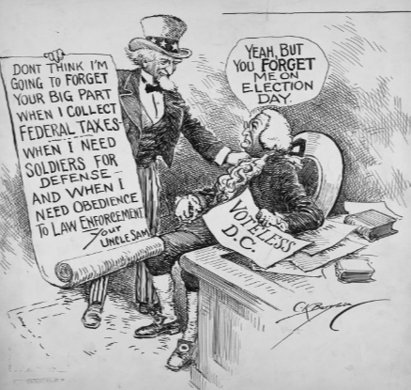
Political Cartoon Analysis: "The Forgotten Man"
"The Forgotten Man"
Notes:
Teaching notes
Suggested Pacing: 5 minutes
Directions:
Say, “Let’s analyze another political cartoon drawn by Clifford Berryman. This image was drawn in 1932, two years after the first cartoon we analyzed, and is entitled 'The Forgotten Man.' "
Review the Political Cartoon Analysis Protocol with students. Give students time to independently record their thinking on their Political Cartoon Analysis Practice handout.
Refer to the Political Cartoon Analysis Practice handout (completed) as needed.
Use the following guiding questions as needed to help students understand the meaning of the cartoon.
Who is the man DC is talking to? Uncle Sam
What does Uncle Sam represent? The United States federal government
Why does DC say, "Yeah, but you forget me on election day?" Uncle Sam is taking tax money from DC but does not allow DC voting privileges on election day.
Prompt students to turn and talk to their partners about the question.
Conduct a whole class discussion calling on students to share their thinking.
Student look-fors:
Observe
What do you notice first? Uncle Sam and DC are having a discussion.
What people and objects are shown? Uncle Sam and DC are shown. Uncle Sam has a scrolling document. DC has a sign that says Voteless D.C.
What, if any, words do you see? Uncle Sam has a scrolling document. DC has a sign that says Voteless D.C.
What might be a symbol? Uncle Sam and the “Voteless D.C.” sign are symbols. Uncle Sam is standing and DC is sitting. This might symbolize power.
What other details can you see? Uncle Sam appears to be controlling DC with his hand on his arm.
Reflect
What’s happening in this cartoon? Uncle Sam and DC are having a discussion. Uncle Sam appears to be in control.
Who do you think was the audience for this cartoon? Residents of Washington, D.C. and the citizens of the United States.
What issue do you think this cartoon is about? D.C. paying taxes without representation.
What do you think the cartoonist’s opinion on this issue is? Washington, D.C. has been denied representation in Congress and is not being treated fairly.
Question
Student answers will vary.
Why do the residents of Washington, D.C lack voting rights?
Why is Washington, D.C. treated unfairly?
Why does Washington, D.C. pay taxes to the federal government but lack voting rights?
When will Washington, D.C. earn representation?
How can changes be made to allow residents of Washington, D.C. voting rights?
Attribution:
The Forgotten Man. Berryman, Clifford Kennedy, 1869-1949, Clifford Berryman Cartoon Collection. DC Public Library.

Slide 12
Turn and Talk
"The Forgotten Man"
What is Berryman suggesting about D.C.’s federal tax dollars?
Why is Berryman’s message relevant in modern day Washington, D.C.?
Notes:
Teaching notes
Suggested Pacing: 4 minutes
Directions:
Say, “Turn to a partner and explain what Berryman is suggesting about D.C.’s federal tax dollars.
Think about the money Washington, D.C. contributes in federal taxes as well as the lack of representation D.C. has in the federal government.”
Prompt students to turn and talk with their partners about the political cartoon. Conduct a whole class discussion, calling on a few students to share their thinking.
Student look-fors:
Berryman’s cartoon is suggesting Washington, D.C. is not being treated fairly.
“Uncle Sam” is taking D.C.’s tax money when he needs it but forgetting about D.C. when it’s time to vote.
Berryman’s message in this political cartoon is relevant in modern day Washington, D.C.
Washingtonians are still facing the same unfair taxation today.
Attribution:
The Forgotten Man. Berryman, Clifford Kennedy, 1869-1949, Clifford Berryman Cartoon Collection. DC Public Library.

Slide 13
Express Your Understanding
"Still not represented?"
Use the Political Cartoon Analysis Protocol to analyze Clifford Berryman’s “Still not represented?”
What message is Berryman sending through this cartoon?
Why is Berryman’s message relevant in modern day Washington, D.C.?
Notes:
Teaching notes
Suggested Pacing: 10 minutes
Directions:
Hand out a copy of the exit ticket.
As a formative assessment, collect exit tickets.
Say, “Now it’s your turn to analyze a Clifford Berryman political cartoon. This cartoon is from 1933 and is called 'Still not represented?'
After completing the Political Cartoon Analysis Protocol chart on your exit ticket, respond to the following question: What message is Berryman sending through the cartoon, 'Still not represented?' "
Student Look-fors:
Refer to Exit Ticket (completed).
Attribution:
Still not represented? Berryman, Clifford Kennedy, 1869-1949, Clifford Berryman Cartoon Collection. DC Public Library.

