Slide 1
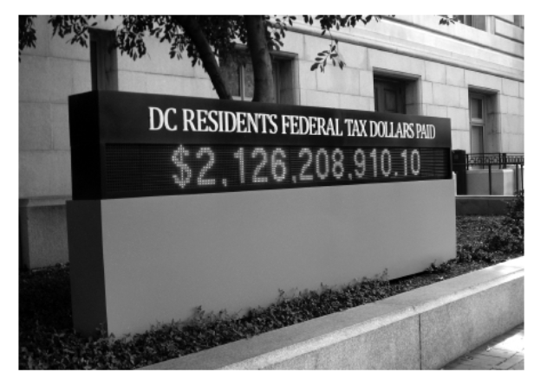
Taxation Without Representation
Home Rule: Grade 12, Lesson 2
Notes:
About this lesson
This lesson focuses on how the US system of federal taxes works and poses the question “What does DC get for paying federal taxes?”
Students . . .
understand that despite paying the highest per capita federal taxes in the country, Washingtonians do not have a say in how their tax dollars are spent.
track terms on a vocabulary log.
express their understanding by completing an exit ticket.
Materials:
Vocabulary Log (blank)
Vocabulary Log (completed)
Exit Ticket (blank)
Exit Ticket (completed)
ELA Standards:
SL.11-12.1: Initiate and participate effectively in a range of collaborative discussions (one-on-one, in groups, and teacher-led) with diverse partners on grades 11-12 topics, texts, and issues, building on others' ideas and expressing their own clearly and persuasively.
W.11-12.4: Produce clear and coherent writing in which the development, organization, and style are appropriate to task, purpose, and audience. (Grade-specific expectations for writing types are defined in standards 1-3 above.)
W.11-12.2: Write informative/explanatory texts to examine and convey complex ideas, concepts, and information clearly and accurately through the effective selection, organization, and analysis of content.
RI.11-12.7: Integrate and evaluate multiple sources of information presented in different media or formats (e.g., visually, quantitatively) as well as in words in order to address a question or solve a problem.
DC Content Power Standards:
12.DC.22.6: Review the reasons why Washington, D.C. residents do not have voting representation in Congress, and assess the prospects for current efforts to get congressional representation for the District.
C3 Framework Indicators and Common Core Standards for Literacy in History/Social Studies:
D2.Civ.3.9-12. Analyze the impact of constitutions, laws, treaties, and international agreements on the maintenance of national and international order.
D2.Civ.4.9-12. Explain how the U.S. Constitution establishes a system of government that has powers, responsibilities, and limits that have changed over time and that are still contested.
D2.Civ.12.9-12. Analyze how people use and challenge local, state, national, and international laws to address a variety of public issues.
D2.Civ.14.9-12. Analyze historical, contemporary, and emerging means of changing societies, promoting the common good, and protecting rights.

Slide 2
Let's Discuss
Why do we pay them?
What are taxes?
Notes:
Teaching notes
Suggested Pacing: 3 minutes
Directions:
Use an established classroom routine to pair students or use elbow partners.
Say, “What are taxes? Why do we pay them?”
Prompt students to turn and talk to their partners about the question.
Conduct a whole class discussion calling on a few students to share their thinking.
Student Look-Fors:
Student answers will vary.
Students may suggest taxes they are familiar with, such as income tax from an after school job or sales tax from making a purchase.
Attribution:
​​​​​​​Conversation Clipart

Slide 3
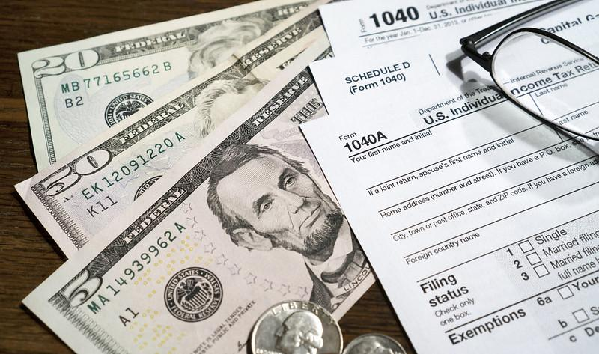
What is a tax?
Tax:
an amount of money that a government requires people to pay
used to pay for the services done by the government
Notes:
Teaching notes
Suggested Pacing: 3 minutes
Directions:
Hand out Vocabulary Log.
Say, “In order for our government to run successfully, it needs money. The government needs money to fund schools, to protect citizens, and to provide many other public services.
A tax is an amount of money that a government requires people to pay and that is used to pay for the services done by the government.
Society uses taxes to raise money that will cover these public costs.
Americans pay taxes on things such as property, goods purchased, and income. Taxes fund local, state and federal services.”
Ask students to record the following definition on the Vocabulary Log next to the term.
tax
an amount of money that a government requires people to pay
used to pay for the things done by the government
Refer to Vocabulary Log (completed) as needed.
Attribution:
Taxes - Illustration

Slide 4
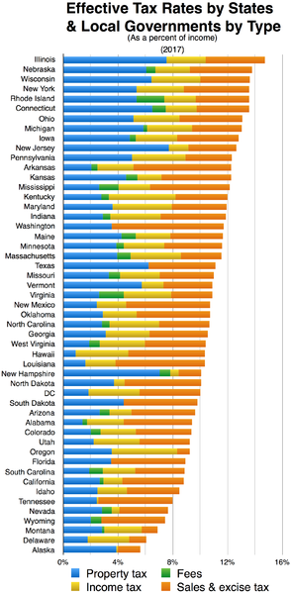
Local and State Taxes
Based on earned income
May differ by state
Local taxes apply to people who live and work in a locality
State taxes are collected from entire state
Notes:
Teaching notes
Suggested Pacing: 2 minutes
Directions:
Say, “Local and state taxes are collected based on a person’s earned income. These types of taxes depend on where a person lives.
Not every state has the same local and state tax laws. Governments in many states impose a local income tax.
Local income tax may be assessed by cities, counties, school districts or other municipalities. These taxes generally apply to people who live or work in the locality.
State taxes are collected from residents of an entire state.”
Ask students to record the following definition on the Vocabulary Log next to the term.
Local and State Taxes
Based on earned income
May differ by state
Local taxes apply to people who live and work in a locality
State taxes are collected from entire state
Refer to Vocabulary Log (completed) as needed.
Attribution:
Wikideas1 / CC0

Slide 5
Where do local and state taxes go?
Public schools
Libraries
Welfare
Government projects
Law enforcement and fire service
Health care services
Road construction
Services which benefit communities
Notes:
Teaching notes
Suggested Pacing: 3 minutes
Directions:
Say, “Local and state taxes are typically used for the same types of funding, including public schools, libraries, hospitals, welfare, government projects, law enforcement and fire service, health care services, road construction, and other services which benefit communities.”
Ask students to record the following examples on the Vocabulary Log next to the term.
Local and state tax spending
public schools
libraries
welfare
government projects
law enforcement and fire service
health care services
road construction
services which benefit communities
Refer to Vocabulary Log (completed) as needed.
Attribution:
Chevy Chase Branch Library, school children move book collection. DC Public Library Archives. DC Public Library.

Slide 6
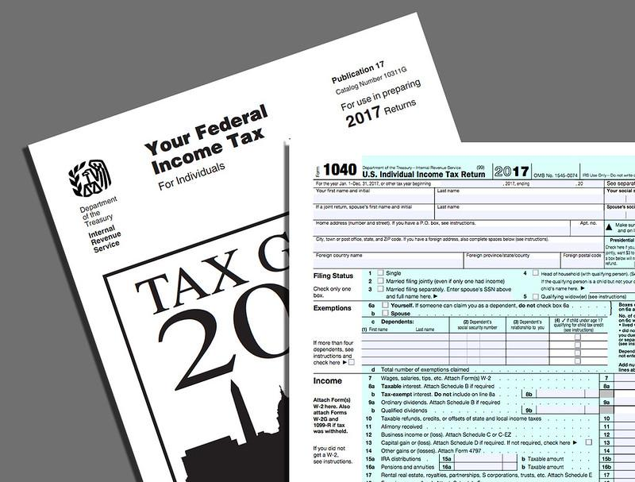
Federal Tax
Separate from state and local taxes
About same amount as state and local governments combined
Used to provide services and protection for U.S. residents
Notes:
Teaching notes
Suggested Pacing: 2 minutes
Directions:
Say, “Federal, state or local taxes are completely separate. Each entity has its own authority to charge taxes.
The federal government collects about the same amount as the state and local governments combined. Federal tax money is used to provide services and protection for U.S. residents.”
Ask students to record the following definition on the Vocabulary Log next to the term.
Federal tax
Separate from state and local taxes
About same amount as state and local governments combined
Used to provide services and protection for U.S. residents
Refer to Vocabulary Log (completed) as needed.
Attribution:
IRS FORMS illustration.

Slide 7
Where do federal taxes go?
Social security
National defense
Health care
Social safety net programs
Education
Research
Notes:
Teaching notes
Suggested Pacing: 2 minutes
Directions:
Say, “Federal taxes are used to provide services and protection for United States residents.
These services include social security, national defense, health care, social safety net programs, education and research."
Ask students to record the following examples on the Vocabulary Log next to the term.
Federal tax spending
Social security
National defense
Health care
Social safety net programs
Education
Research
Refer to Vocabulary Log (completed) as needed.
Attribution:
Budget Prioritizes Improvements to Critical Park Infrastructure while Saving Tax Dollars. NPS Photo.

Slide 8
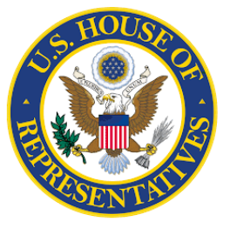
Who determines federal tax spending?
Federal spending includes the country as a whole
President presents budget to Congress
House and Senate each create resolutions
Final version voted on by Congress
Notes:
Teaching notes
Suggested Pacing: 2 minutes
Directions:
Say, “Federal spending includes the country as a whole. Determining how federal tax dollars will be spent is a very long and detailed process.
Each year, the President presents his budget to Congress, traditionally in February.
The President’s budget proposes spending levels for federal programs. The funding for these programs is determined annually. The President may recommend policy changes to ongoing programs.
Congress’s response to the President’s budget proposal begins in the Budget Committees of the House and the Senate.
The House and Senate each create resolutions to the budget. Congress comes together in agreement, and the final version is voted on by Congress.”
Attributions:
Ipankonin / Public domain
Ipankonin / CC BY-SA

Slide 9
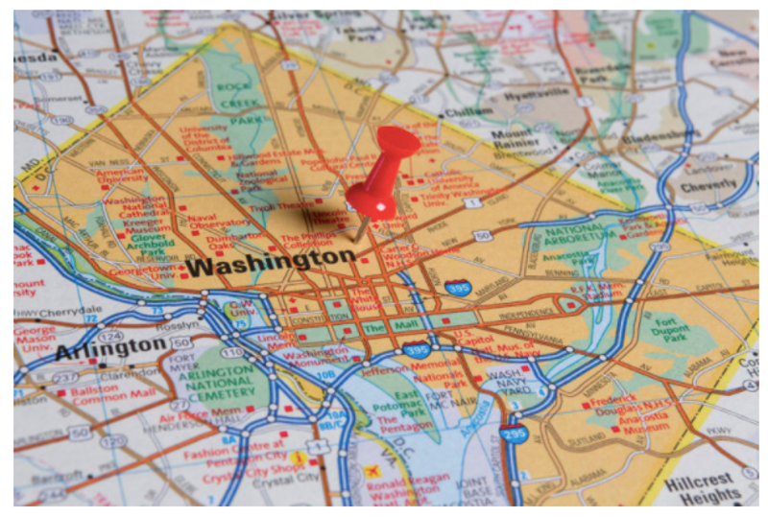
Washington, D.C. and District Taxes
D.C. residents pay district taxes that are similar to state taxes
Money goes to Congress
Congress allocates money to pay for D.C.’s municipal budget
Congress reviews and modifies D.C.’s local budget
Residents of Virginia and Maryland who work in D.C. are exempt
Notes:
Teaching notes
Suggested Pacing: 3 minutes
Directions:
Say, “So where does Washington, D.C. fit into the mix when it comes to federal taxes?
Since Washington, D.C. is not considered a state, there is a misconception that Washingtonians do not need to pay state taxes. This is far from reality.
D.C. residents pay district taxes that are similar to state taxes. The money goes to Congress and then is allotted to pay for D.C.’s municipal budget.
This causes some people to think that the money comes directly from Congress.
D.C. receives no income from a state, and D.C.’s ability to raise revenue is restricted by Congress. Congress not only reviews but can also modify D.C.'s local budget.”
People who work in D.C. but live in Virginia and Maryland are exempt from paying D.C. taxes. This results in high district taxes on business and individuals.”
Attribution:
A Resident’s Guide to the DC Budget. DC Fiscal Policy Institute.

Slide 10
Residents of Washington, D.C.
Pay full federal taxes
Pay higher per capita taxes than all 50 of the United States
Have no representation in Congress
Have no say in how their federal tax dollars are spent
Notes:
Teaching notes
Suggested Pacing: 1 minute
Directions:
Say, “Another misconception is that Washingtonians do not pay federal taxes because Washington, D.C. is not a state.
In reality, residents of Washington, D.C. pay full federal taxes. In fact, they pay higher per capita taxes than all 50 of the United States.
Despite paying more money in federal taxes than any state in the country, the people who reside in Washington, D.C. have no representation in Congress, and therefore, have no say in how their federal tax dollars are spent.”
Attribution:
Community Archives, DC Public Library

Slide 11
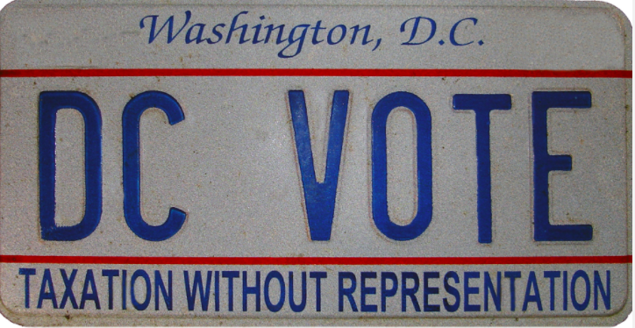
Express Your Understanding!
Why is “Taxation Without Representation” a relevant motto for present day citizens of Washington, D.C.?
Notes:
Teaching notes
Suggested Pacing: 5 minutes
Directions:
Hand out a copy of the exit ticket.
As a formative assessment, students are asked to complete a quick-write to the following question: “Why is Taxation Without Representation a relevant motto for present day citizens of Washington, D.C.? Use examples from this lesson and answer.”
Collect exit tickets as formative assessment.
Student Look-Fors:
Student responses will vary.
See completed example.
Attribution:
Attribution:
DC VOTE license plate. District of Columbia. Department of Motor Vehicles. Washingtoniana Ephemera Collection. DC Public Library.

