Slide 1
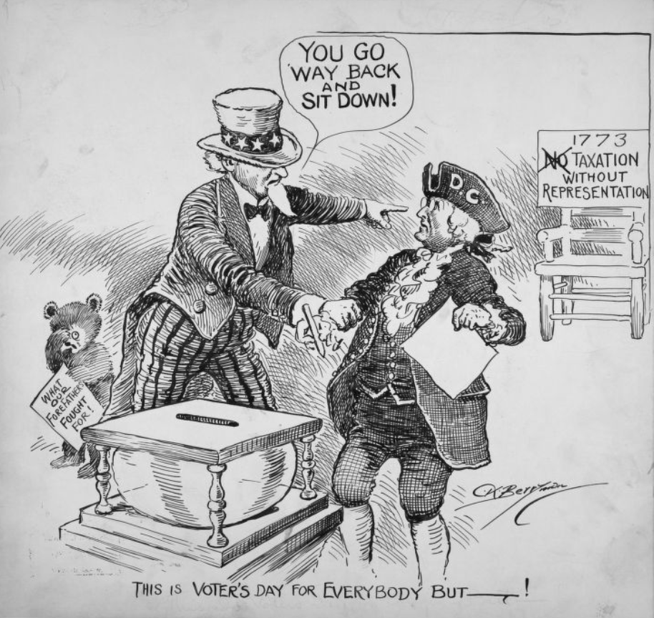
The Federal Government in Washington, D.C.
Home Rule: Grade 12, Lesson 1
Notes:
About this lesson
This lesson focuses on the meaning of federal representation and how the federal government lives in Washington, D.C. Students will be able to explain what makes D.C. unique as a district, specifically in how D.C. lacks representation in the national political system. Students consider how this lack of representation impacts Washington, D.C. residents and track their thinking during the lesson. Students express their understanding by completing a formative exit ticket.
Materials:
Thought Catcher (blank)
Thought Catcher (completed)
Exit Ticket (blank)
Exit Ticket (completed)
ELA Standards:
SL.11-12.1: Initiate and participate effectively in a range of collaborative discussions (one-on-one, in groups, and teacher-led) with diverse partners on grades 11-12 topics, texts, and issues, building on others' ideas and expressing their own clearly and persuasively.
W.11-12.4: Produce clear and coherent writing in which the development, organization, and style are appropriate to task, purpose, and audience. (Grade-specific expectations for writing types are defined in standards 1-3 above.)
W.11-12.2: Write informative/explanatory texts to examine and convey complex ideas, concepts, and information clearly and accurately through the effective selection, organization, and analysis of content.
RI.11-12.7: Integrate and evaluate multiple sources of information presented in different media or formats (e.g., visually, quantitatively) as well as in words in order to address a question or solve a problem.
DC Content Power Standards:
12.DC.22.6: Review the reasons why Washington, D.C. residents do not have voting representation in Congress, and assess the prospects for current efforts to get congressional representation for the District.
C3 Framework Indicators and Common Core Standards for Literacy in History/Social Studies:
D2.Civ.3.9-12. Analyze the impact of constitutions, laws, treaties, and international agreements on the maintenance of national and international order.
D2.Civ.4.9-12. Explain how the U.S. Constitution establishes a system of government that has powers, responsibilities, and limits that have changed over time and that are still contested.
D2.Civ.12.9-12. Analyze how people use and challenge local, state, national, and international laws to address a variety of public issues.
D2.Civ.14.9-12. Analyze historical, contemporary, and emerging means of changing societies, promoting the common good, and protecting rights.
Attribution:
This is Voter's Day for Everyone But--!. Berryman, Clifford Kennedy, 1869-1949, Clifford Berryman Cartoon Collection, DC Public Library.

Slide 2
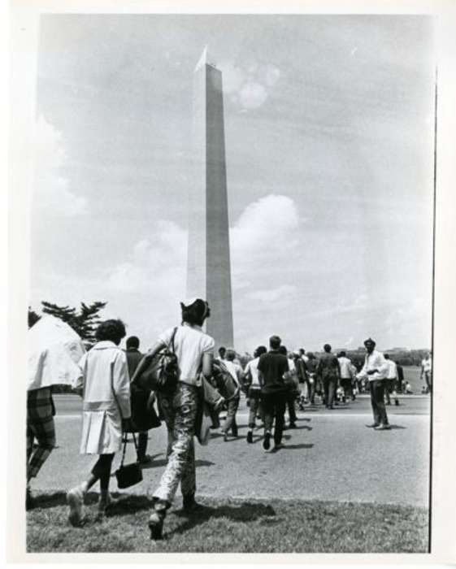
Let's Discuss
What is unique about Washington, D.C.?
I think Washington D.C. is unique because . . .
I agree that . . .
Notes:
Teaching notes
Suggested Pacing: 2 minutes
Directions:
Use an established classroom routine to pair students or use elbow partners.
Say, “What is unique about Washington, D.C.? Turn to your partner and discuss your thinking."
Students write thoughts on the Thought Catcher.
Prompt students to turn and talk to their partner about the question.
Conduct a whole class discussion calling on a few students to share their thinking.
Attribution:
Protestors walk toward the Washington Monument. Evening Star (Washington, D.C.), Washington Star Photograph Collection. DC Public Library.

Slide 3
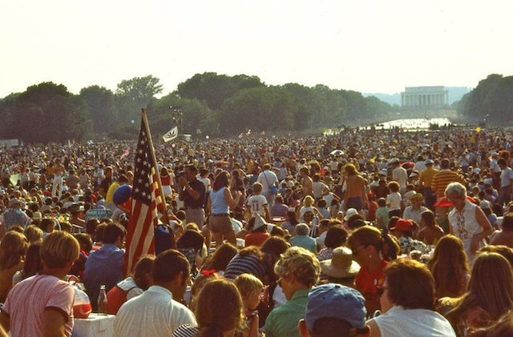
The Capital of America: Washington, D.C.
District of Columbia
Named after Christopher Columbus
Referred to as Washington after George Washington
Notes:
Teaching notes
Suggested Pacing: 1 minute
Directions:
Say, “Washington, D.C. was originally known as the District of Columbia. It was named after Christopher Columbus. Many people referred to it as Washington, after George Washington, and that is how D.C. earned it’s modern-day name. “
Attribution:
Bicentennial crowd in front of Lincoln Memorial. Crain, Darrell C., 1910-1995, Darrell C. Crain, Jr. Photograph Collection. DC Public Library.

Slide 4
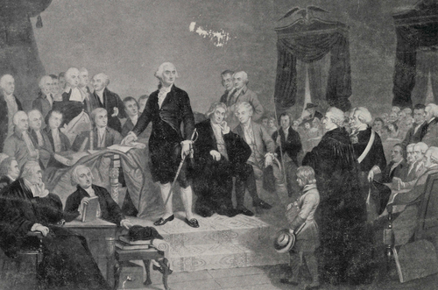
Established by the Constitution
The Constitution states that the country’s capital city must be in a district, not a state.
Founding fathers were concerned that if D.C. became a state, its proximity to the capital would be problematic.
Notes:
Teaching notes
Suggested Pacing: 2 minutes
Directions:
Say, "In 1789, the Constitution of the United States said that a capital city would be created in a district but did not say where it should be. James Madison and the founders of our country were concerned that if the capital were to be a state, the members of the government would feel obligated to it, and this would influence their decision-making. Madison worried that if the District of Columbia became a state, representatives would be able to stop or interrupt government proceedings to get what they wanted, simply because of their proximity. Our founding fathers decided that the District of Columbia could not be a state because it was so close to the heart of our nation’s government."
Attribution:
George Washington takes his oath of office during his inauguration. Historic Image Collection. DC Public Library.

Slide 5
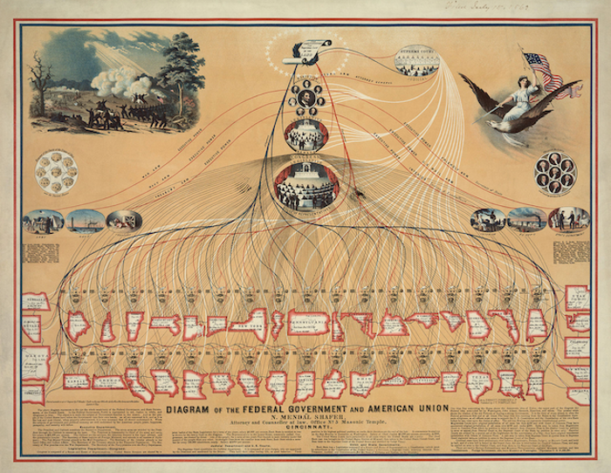
Congressional Foundations
Congress
House of Representatives:
Passes federal laws
Proportional representation of the 50 states
Senate:
Small group of elected people
Decides the laws of the country
Notes:
Teaching notes
Suggested Pacing: 2 minutes
Directions:
Say, “According to the United States Constitution, our country has two chambers that make up Congress. One of these chambers is the United States House of Representatives. The U.S. House of Representatives is part of the federal government’s legislative branch; it makes and passes federal laws. The U.S. House of Representatives is made up of 435 voting representatives. This number is a proportional representation of the 50 states. The second chamber of Congress is the United States Senate and is also part of the legislative branch.The United States Senate is a small group of elected people who decide the laws of the country.”
Attribution:
Diagram of the Federal Government and American Union. Wikipedia; public domain

Slide 6
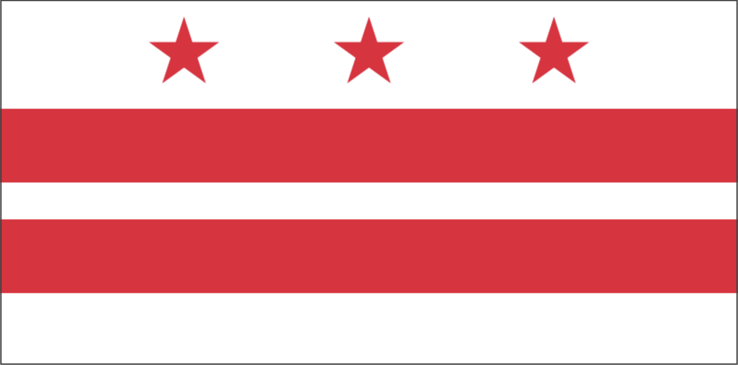
District of Columbia Government
Three branches: executive, legislative, judicial
Determined by D.C. Home Rule Act of 1973
Local officials have authority to pass laws and govern local affairs
Congress has power to overturn local laws
D.C. lacks a vote in Congress for federal representation
Notes:
Teaching notes
Suggested Pacing: 2 minutes
Directions:
Say, “Remember that Washington is not a state or even part of a state. It is in a separate district. The city and the district take up the same space.
The District of Columbia Government is made up of three branches of government: executive, legislative, and judicial. The current form of government was determined by the D.C. Home Rule Act of 1973.
Local officials have the authority to pass laws and govern over local affairs; however, the US Congress has the power to overturn local laws. Unlike any state in the country, the residents of D.C. lack a vote in congress for federal representation.
DC's delegate to the House of Representatives can introduce legislation and serve on committees, but is unable to vote on the final outcome. DC's shadow congresspersons include two shadow senators and one shadow representative, also unable to vote on legislation. Past shadow congresspersons including Jesse Jackson."

Slide 7
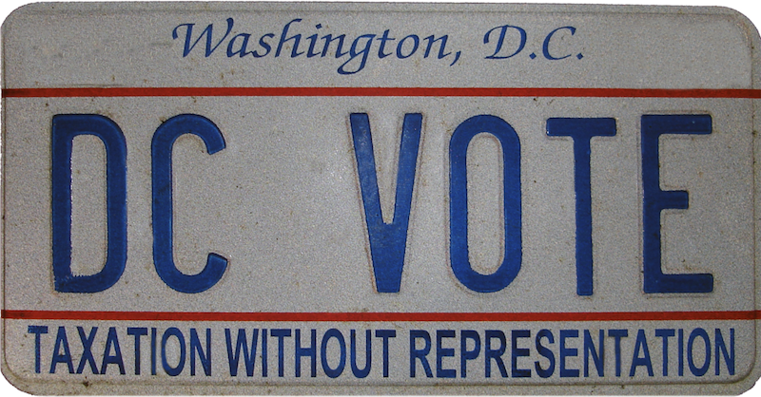
Lack of Federal Representation
What impact does this lack of representation in the national political system have on Washington D.C. residents?
Discuss with your partner:
Notes:
Teaching notes
Suggested Pacing: 2 minutes
Directions:
Use an established classroom routine to pair students or use elbow partners.
Say, “Consider what you know about the lack of federal representation in Washington, D.C. What impact does this lack of representation in the national political system have on Washington D.C. residents?"
Students write thoughts on the Thought Catcher independently.
Prompt students to turn and talk to their partner about the question.
Conduct a whole class discussion calling on a few students to share their thinking.
Attribution:
DC VOTE license plate. District of Columbia. Department of Motor Vehicles. Washingtoniana Ephemera Collection. DC Public Library.

Slide 8
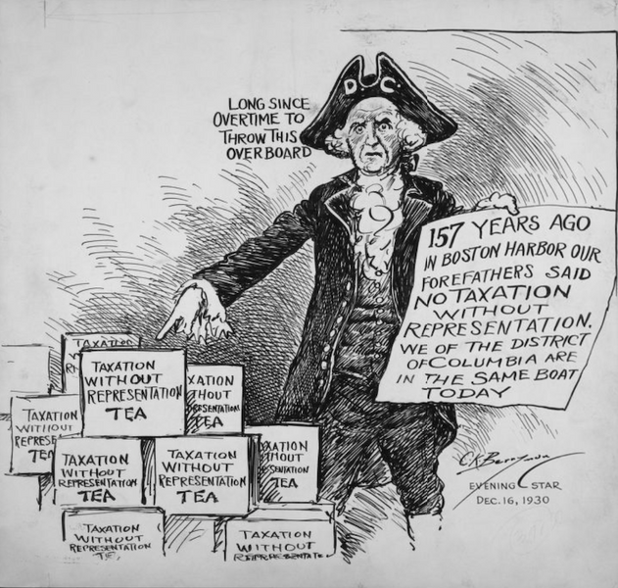
Impact on Citizens
Residents of Washington, D.C.
Do not have a vote in Congress
Elect only one non-voting representative to the House, along with a shadow representative and two shadow senators
Pay the highest average per capita federal income taxes in the United States
Notes:
Teaching notes
Suggested Pacing: 2 minutes
Directions:
Say, “D.C. residents do not have the same rights that American citizens in the 50 states do. Because representatives to Congress are elected only by Americans living in the 50 states, residents of Washington, D.C. do not have a vote in Congress, both in the House and on the Senate floor. D.C. elects one non-voting representative to the House of Representatives, along with a shadow representative and two shadow senators. The House Delegate can only draft legislation. Additionally, the citizens of Washington, D.C. pay the highest average per person federal income taxes in the United States. These citizens also pay more in total federal income tax than residents of 22 other states. Because citizens of D.C. do not have federal representation, they lack a voice in how those tax dollars are spent.
Attribution:
District citizens still taxed without representation. Berryman, Clifford Kennedy, 1869-1949, DC Public Library.

Slide 9
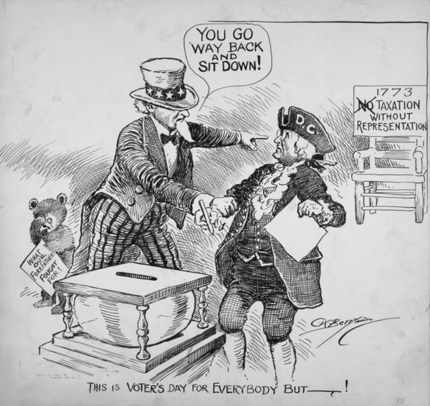
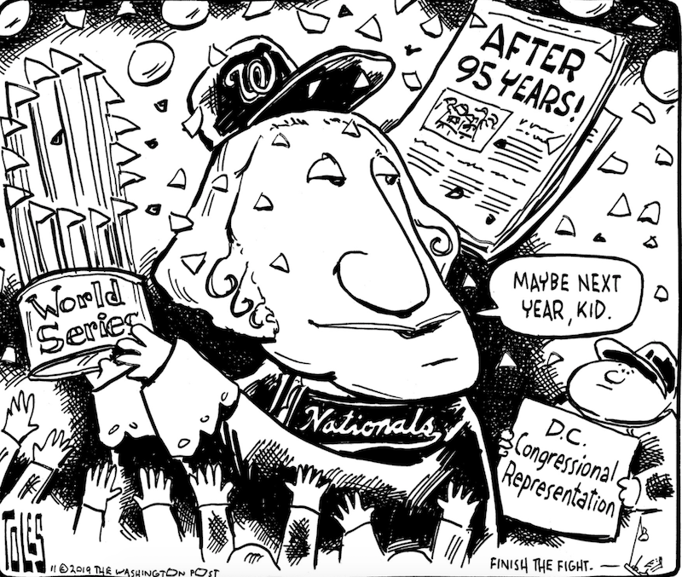
Let's Compare
What do the pictures have in common?
What is different about them?
Notes:
Teaching notes
Suggested Pacing: 2 minutes
Directions:
Say, “Political cartoons make a point about a political issue or event. Unlike ordinary cartoons, they are not located in the comics sections. They are most likely found close to the editorial. Let’s compare these two political cartoons. The image on the left is from 1934. The cartoon on the right is from 2019. What do the cartoons have in common? What is different about them?"
Share out student suggestions, acknowledging appropriate responses.
Student Look-Fors:
Students will notice that despite the almost 80 year gap between the publications of the two cartoons, the issue remains the same. Washington D.C. has been denied the right to statehood.
Attributions:
This is Voter's Day for Everyone But--!. Berryman, Clifford Kennedy, 1869-1949, Clifford Berryman Cartoon Collection, DC Public Library.
World Series Comic (2019). "D.C. Wins the Worlds Series - but not statehood", Tom Toles, Washington Post, November 1, 2019.

Slide 10
Express Your Understanding
What makes D.C. unique as a district?
Notes:
Teaching notes
Suggested Pacing: 4 minutes
Directions:
Hand out a copy of the exit ticket.
As a formative assessment, students are asked to complete a quick-write to the following question: “What makes D.C. unique as a district? Focus specifically on how D.C. lacks representation in the national political system.”
Collect exit tickets as formative assessment.
Attribution:
Protestors walk toward the Washington Monument. Evening Star (Washington, D.C.), Washington Star Photograph Collection. DC Public Library.

